Slide 1
The word of innovations
where to start the changes?
from the way we live or from protecting what we already have?

Slide 2
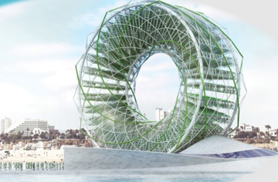
something useful and unusual? why not?
Though the Ring Garden is still only in its conceptual stage, its elegant combination of desalinization, solar energy, and food production is worth exploring, particularly for drought-stricken coastal communities like California. When fully operational, the rotating structure is projected to annually produce 16 million gallons of clean water, 40,000 pounds of crops grown without soil, and 11,000 pounds of biomass for livestock feed.

Slide 3
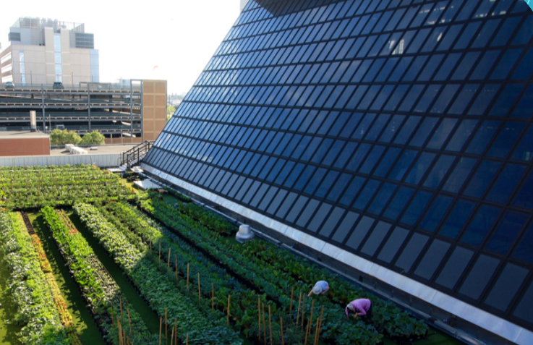
a so old method and yet so little used
Humans have grown plants atop structures since antiquity. The ziggurats of ancient Mesopotamia (4th millennium BC–600 BC) had plantings of trees and shrubs on aboveground terraces. An example in Roman times was the Villa of the Mysteries in Pompeii, which had an elevated terrace where plants were grown. A roof garden has also been discovered around an audience hall in Roman-Byzantine Caesarea. The medieval Egyptian city of Fustat had a number of high-rise buildings that Nasir Khusraw in the early 11th century described as rising up to 14 stories, with roof gardens on the top story complete with ox-drawn water wheels for irrigating them.
In Chicago, the world’s largest rooftop farm on the Methods Products manufacturing plant is powered by 100% renewable energy, provides jobs to local residents, and produces millions of pounds of pesticide-free, locally sourced vegetables each year. Also in Chicago, growers at Omni Ecosystems are pushing the boundaries of urban agriculture by growing rooftop wheat that is processed and utilized by local bakers.

Slide 4
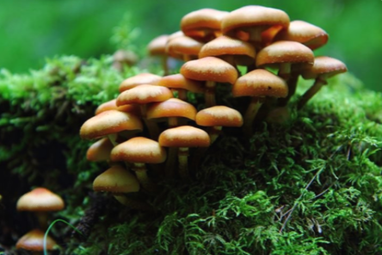
hat on one foot, guess what it is
Fungus sometimes feels like the forgotten kingdom of life, a misunderstood, often feared group of organisms without which our global ecosystem could not exist. The most iconic manifestations of fungi, mushrooms may be used to fight cancer, treat depression, or to cook a delicious meal. However, mushrooms are merely the fruiting body of a vast fungal organism, most of which exists below ground in the form of mycelium, the white stringy fungal network that plays a key role in ecological health. Scientists have infused these mycelial networks into the roots of plants, which allows them to endure extreme drought that otherwise would destroy them. Mycologist Paul Stamets has incorporated helpful fungus into a cow pasture, in which harmful bacteria from waste is absorbed and purified by the fungus before it reaches a water source. Stamets has also developed a patent for a fungal pesticide that destroys pests without the use of harmful chemicals.

Slide 5
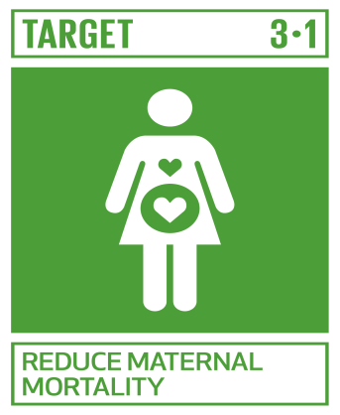
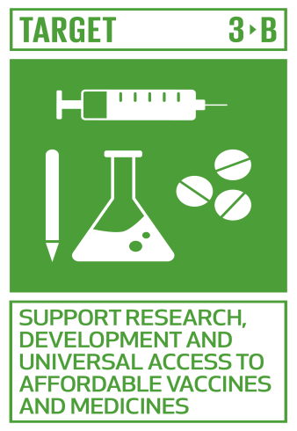
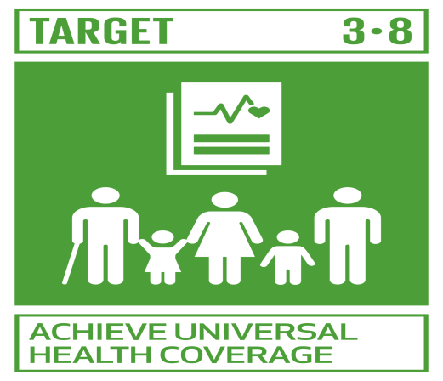
REDUCE MATERNAL MORTALITY(3.1) By 2030, reduce the global maternal mortality ratio to less than 70 per 100,000 live births. SUPPORT RESEARCH, DEVELOPMENT AND UNIVERSAL ACCESS TO AFFORDABLE VACCINES AND MEDICINES(3.B) Support the research and development of vaccines and medicines for the communicable and non-communicable diseases that primarily affect developing countries, provide access to affordable essential medicines and vaccines, in accordance with the Doha Declaration on the TRIPS Agreement and Public Health, which affirms the right of developing countries to use to the full the provisions in the Agreement on Trade-Related Aspects of Intellectual Property Rights regarding flexibilities to protect public health, and, in particular, provide access to medicines for all.
ACHIEVE UNIVERSAL HEALTH COVERAGE(3.8)
Achieve universal health coverage, including financial risk protection, access to quality essential health-care services and access to safe, effective, quality and affordable essential medicines and vaccines for all.

Slide 6
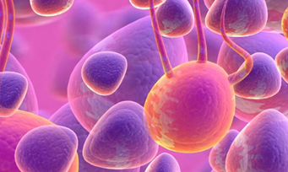
Huge Innovation in Medicine: A Blood Test Can Detect Eight Types Of Incipient Cancer
The test, called CancerSEEK, was developed in the US, and the researchers who created it said that "the" liquid biopsy "could be a motor in the fight against cancer.
The blood test was able to detect tumors in approximately 70% of cases on average in more than 1,000 early-stage cancer patients.
Cu ajutorul acestui test, care ar putea fi disponibil în următorii ani, cancerul a fost depistat înainte ca boala să se răspândească, oferind pacienţilor în cauză cea mai bună şansă pentru a o învinge.

Slide 7
From our point of view, we should protect what we have, because we will never know when we will need them most. For example, a plant that is extinct, and in the future in a few years, it would could be the antidote of a serious illness.
Where to start the changes? From the way we live or from protecting what we already have?

Slide 8
Thanks for watching
BY: VOICU CORNELIA MEI-ROSU ANDREEA

