Slide 1
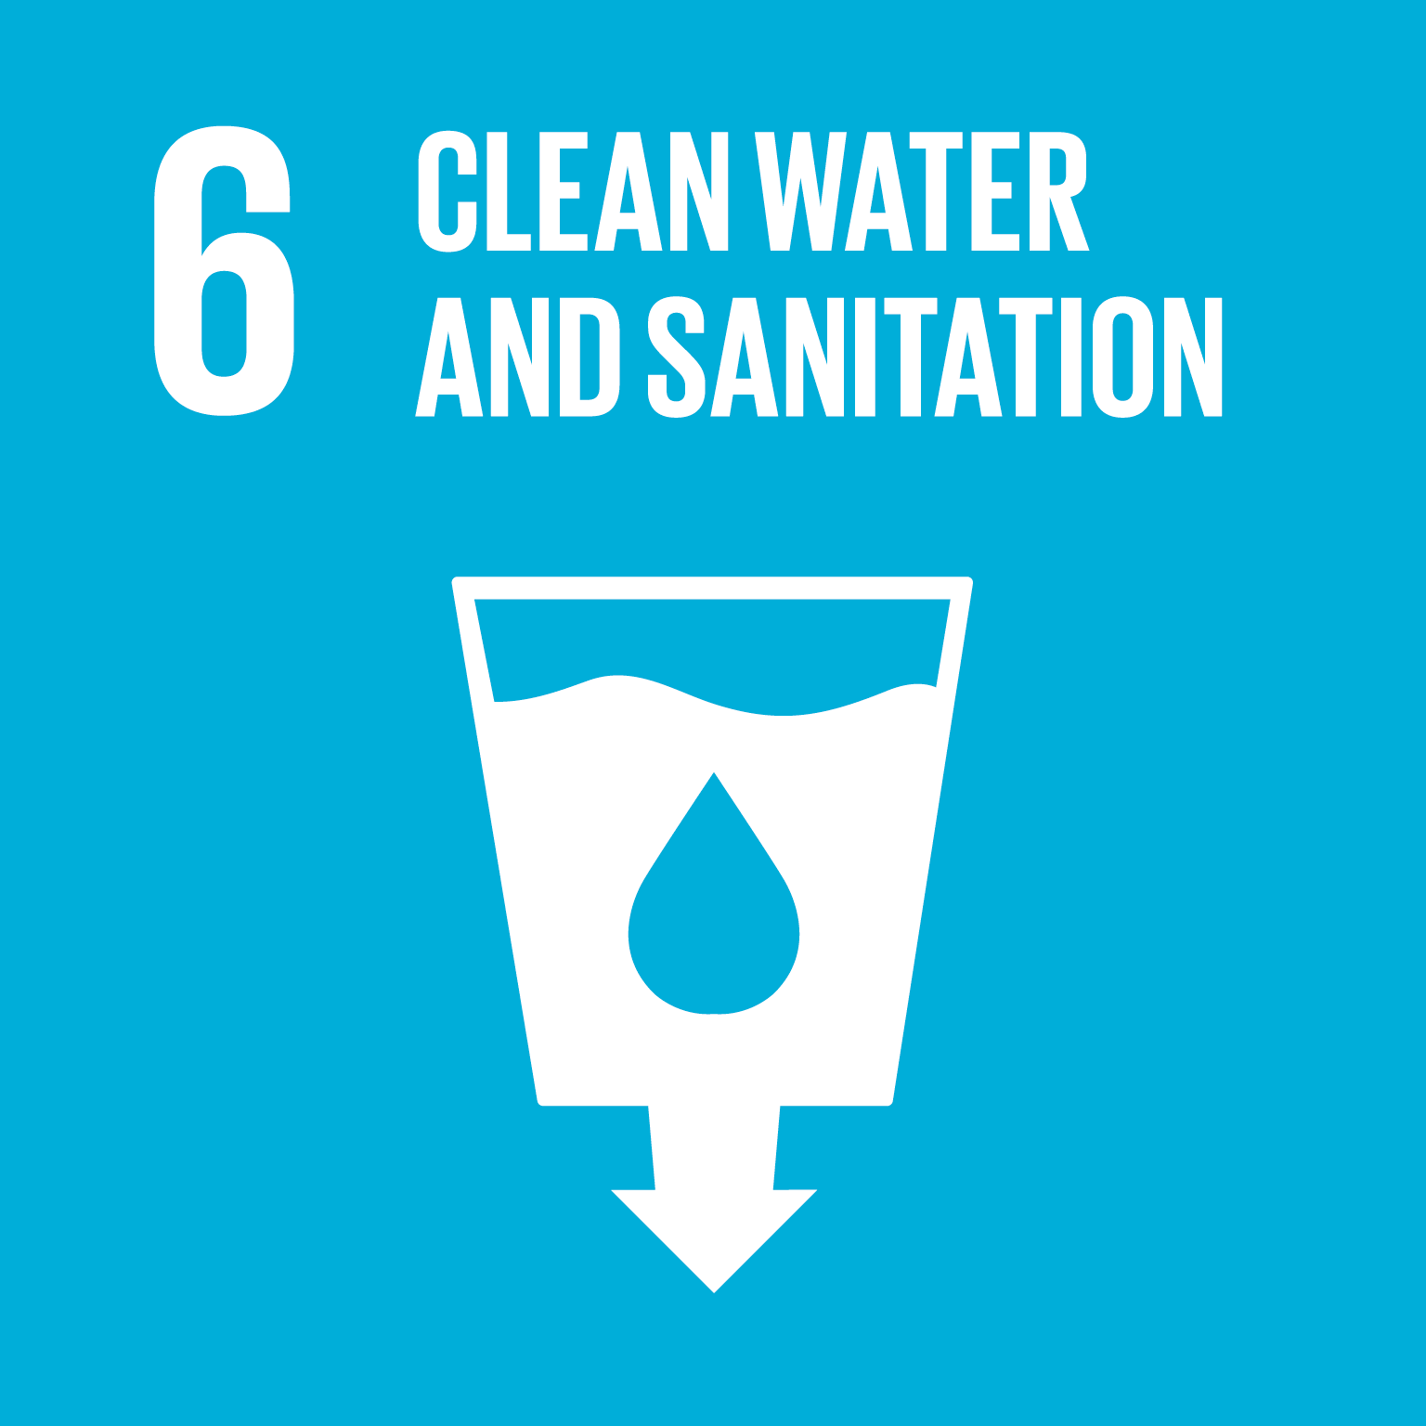
Innovation SDG
By: Sweccha Guntamukkala and Avery Sinnathamby
Teacher: Kimberly Church
Lebanon Trail High School
USA
This is where the picture of the SDG goes, then delete this box

Slide 2
Preview of Solution
The blueprint for our invention, Wonder Brush!

Slide 3
Essential Questions
How can water-use efficiency be substantially increased globally?
How can pressure on fresh water sources be decreased?

Slide 4
The Challenges
Finding a way to make more clean water available in a cost effective and sustainable manner
Distributing our innovation to everyone who needs it
Finding a manufacturer to help us create our innovation

Slide 5
In which places is clean water limited?
How can we maximize limited resources, like water, to create a solution that can improve lives?
How can we decrease the spread of disease through contaminated water?
The Challenge-
Guiding Questions
Finding studies showing the most cost effective and successful filters for water
Research showing the best ways to limit water waste
Testing ways to limit water waste while brushing teeth
Figuring out the pros and cons of current methods to filter water
The Challenge-
Guiding Activities
https://www.epa.gov/water-research/drinking-water-and-wastewater-research
https://www.glencanyon.org/glen_canyon/water-conservation
http://blogs.ei.columbia.edu/2011/04/04/from-wastewater-to-drinking-water/
https://globalhydration.com/waterborne-disease/common-methods-of-water-purification/
The Challenge-
Guiding Resources

Slide 6
Reflection Gallery
We learned that one can waste up to 5 gallons of water while brushing their teeth if the faucet is left open, so we decided to develop a way to decrease the amount of water that is used. In doing so, we are effectively reducing the risk of generating large amounts of water waste when water is, in fact, a precious resource in many places around the world. Our innovation also allows more people to be hygienic, whereas before, they might have suffered the effects of polluted water if they used it to brush their teeth, or they might have just neglected brushing their teeth altogether.

Slide 7
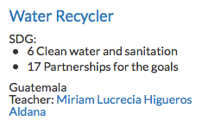
Partner School
We took inspiration from the Guatemalan Team headed by Miriam Lucrecia Higueros Aldana. Their team is also tackling ways to
reduce water waste and we
were impressed with their
innovations!

Slide 8
The Solution
After researching about water, we realized that some of our daily routines actually waste a lot of it, especially for hygienic purposes. We decided to modify the normal toothbrush by placing filters inside of it. Our invention allows us to limit not only the amount of water that is lost when the faucet is run but also, limit the amount of bacteria that is spread when people use contaminated water to brush their teeth, maximizing the amount of purified water available to impoverished regions.

Slide 9
The Solution/Implementation- Evidence Gallery
This is a video explaining our innovation and what motivated us to pursue this topic.

Slide 10
The Solution/Implementation- Evidence Gallery 2
The blueprint for our invention, Wonder Brush!

Slide 11
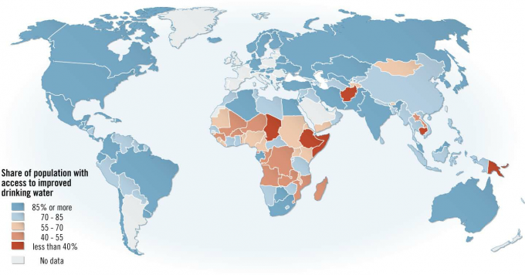
The Solution/Implementation- Evidence Gallery 3
The places in orange and red are our intended audiences.

Slide 12
Reflection Gallery 2
Brushing your teeth prevents gum disease and decreases one’s risk of developing heart disease. As a result, it is a important part of one’s daily lives. Unfortunately, many people around the world do not have access to clean drinking water for hygienic purposes, much less for them to drink. Therefore, people are left to use water that may be contaminated with feces or garbage, thus increasing their chance of getting viral or bacterial diseases. Our innovation enables people in impoverished areas to maintain their hygiene by brushing their teeth with contaminated water that is filtered before it reaches the head of the toothbrush, ensuring that people in less developed places can still brush their teeth with clean and filtered water without worrying about disease.

