Slide 1
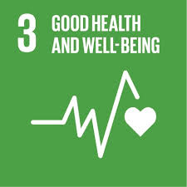
The Big Idea
Health and Wellness
Our SDG supports the research and development of vaccines and medicines for communicable and non-communicable diseases that primarily affect developing countries and facilitate access to affordable essential medicines and vaccines. This is with accordance with the Doha Declaration on the TRIPS Agreement and Public Health, which affirms the right of developing countries to make full use of the provisions of the Agreement on Trade-Related Aspects of Intellectual Property Rights with regard to flexibility to protect public health and, in particular, provide access to medicines for all.
Students: Monalaine Santos and Neha Bajaj
School: Lebanon Trail High School, USA
Teacher: Kimberly Church
This is where the picture of te SDG goes, then delete this box

Slide 2
Solution Preview
Virtual Reality Robotic Surgical Practice
It began as an idea to help others get access to good doctors, and doctors getting access to patients and patient care practice through VR. It has evolved into health care practice that can be operated with VR/robotics.
Imagine a doctor in the U.S., and a sick patient at a clinic in Guatemala. Using satellite technology, a doctor, using VR, can operate the robotic limbs of the machine in Guatemala and perform the surgery, just as the doctor in the U.S. performs robotic surgery on their patients here, but the only difference is that it is being operated from a distance.

Slide 3
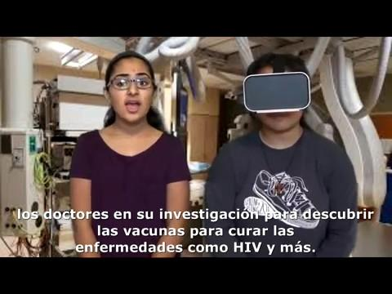
Click Image to Play Video In English (must be in slideshow mode)

Slide 4
The Essential Question
What kind of technology do doctors need?
What diseases affect the world?

Slide 5
The Challenge
The challenge is to arrive at an innovation to adapt to the lack of preventive vaccines available to poor countries around the world, which is cost-effective and transport-efficient.

Slide 6
The Challenge-
Questions Guide
What services are offered to poor countries?
How can we send materials?
Is there a way to build an effective infrastructure?
Is there a way to implement vaccines without harming the population?
Immunization without vaccines
The delivery of vaccines using modern technology such as airplanes
Virtual reality: Test vaccines in a virtual environment so that the population is not affected
Exposing the population to a virus to develop the immunity of the herd
The Challenge-
Activities Guide
https://www.path.org/power-of-vaccines/improving-delivery.php
https://www.gsk.com/en-gb/behind-the-science/access-to-healthcare/making-our-vaccines-more-accessible/
https://ac.els-cdn.com/S1877282X09000629/1-s2.0-S1877282X09000629-main.pdf?_tid=077154c3-f3c3-48fa-af4f-d773c3b9fedd&acdnat=1524967745_fafcf65e1ae850fd52ad7b46d33e8c65
The challenge-
Resources guide

Slide 7
The Partner/Associated School
The School: Springdales School
Country: India

Slide 8
The Reflection Gallery
Using the latest technological and scientific advances, underdeveloped countries can be easily vaccinated and, at the same time, improve the safety and efficiency of vaccines and vaccine distribution systems.

Slide 9
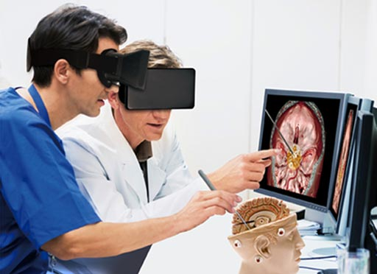
The Solution- step 1
Virtual Reality Surgical Practice
The solution to this problem is a virtual reality simulator that can allow doctors to examine vaccines, medicines, and operations on virtual patients instead of real people. The purpose of this is get access to the best medical doctors and health care providers.

Slide 10
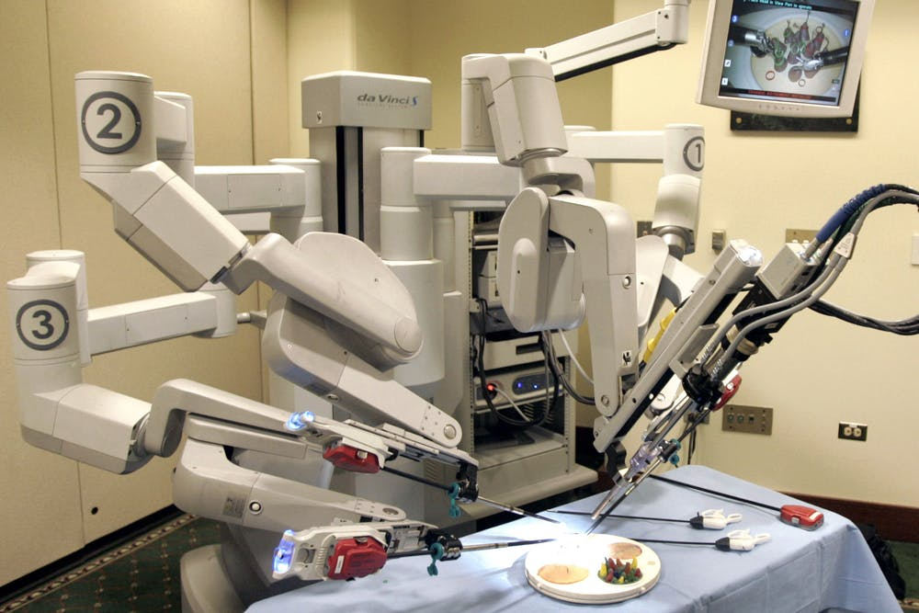
The Solution- Test Gallery- step 2
One solution to help doctors help more efficiently is a virtual reality operated robotic health care practice. This innovation can replicate a simulation of a patient for surgery, laproscopic surgery, or other needs.

Slide 11
The Solution- Test Gallery 2
In addition, some physicians must stay in an accessible position to provide guard service to the people of the world. Many doctors who are parked and can be sent immediately allow fast and quality care for people around the world.

Slide 12
The Solution- Test Gallery 3
Also, transport can be used to spread vaccines. We can use airplanes to launch vaccines and other medical supplies into war zones. This allows more soldiers to survive. It also reduces the spread of diseases and improves the quality of life in the least developed countries.

Slide 13
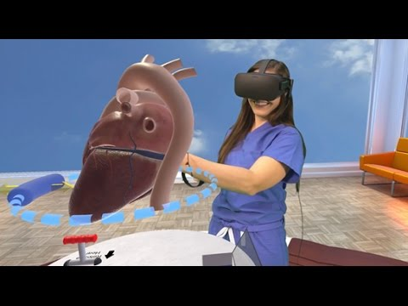
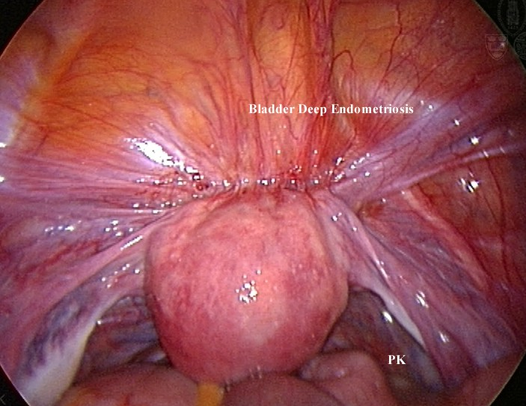
The Solution- Extension Project
Using VR to connect to a microchip that has been inserted in the patient to look for abnormalities, rather than use surgery.

Slide 14
The Reflection Gallery 2
This project allows many people to get a better lifestyle. When our innovations reach more people in a short period of time, we can expect an increase in the health and well-being of people all around the world.

