Slide 1
The Innovation Project
Week 2

Slide 2
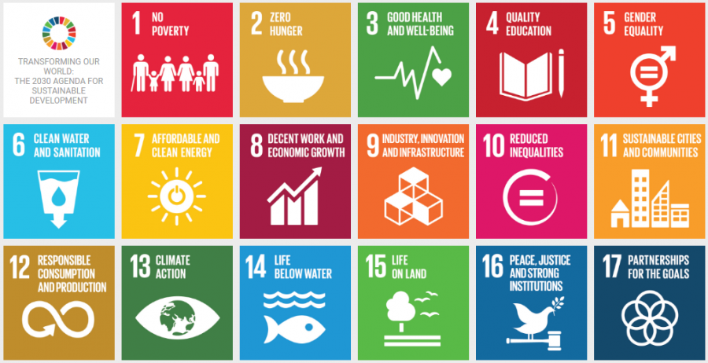
SUSTAINABLE DEVELOPMENT GOALS

Slide 3
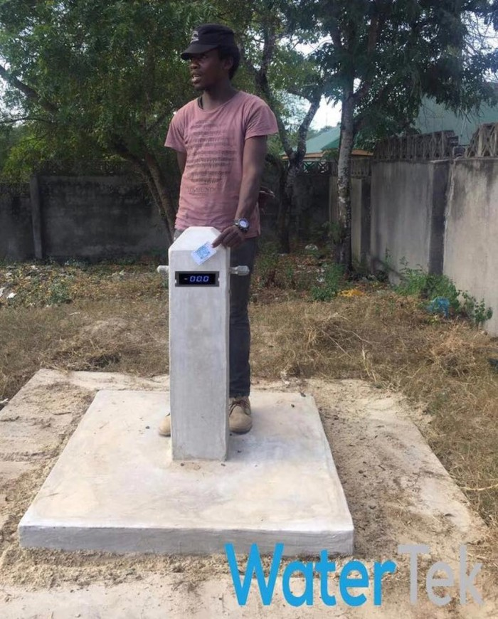
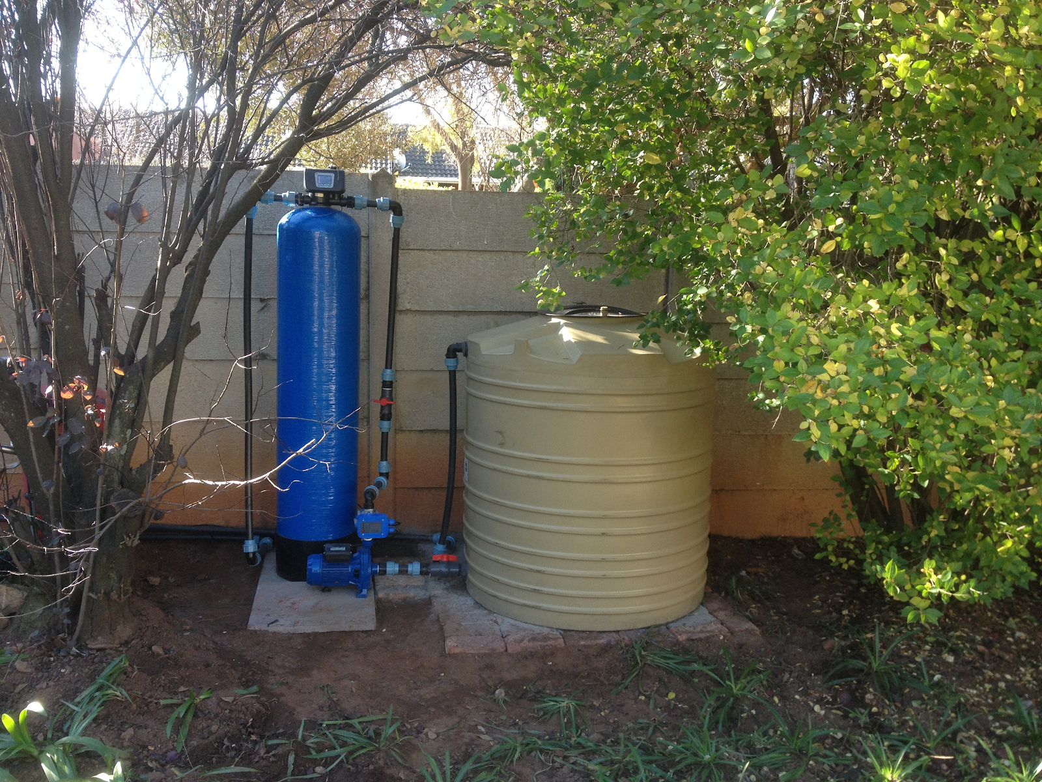
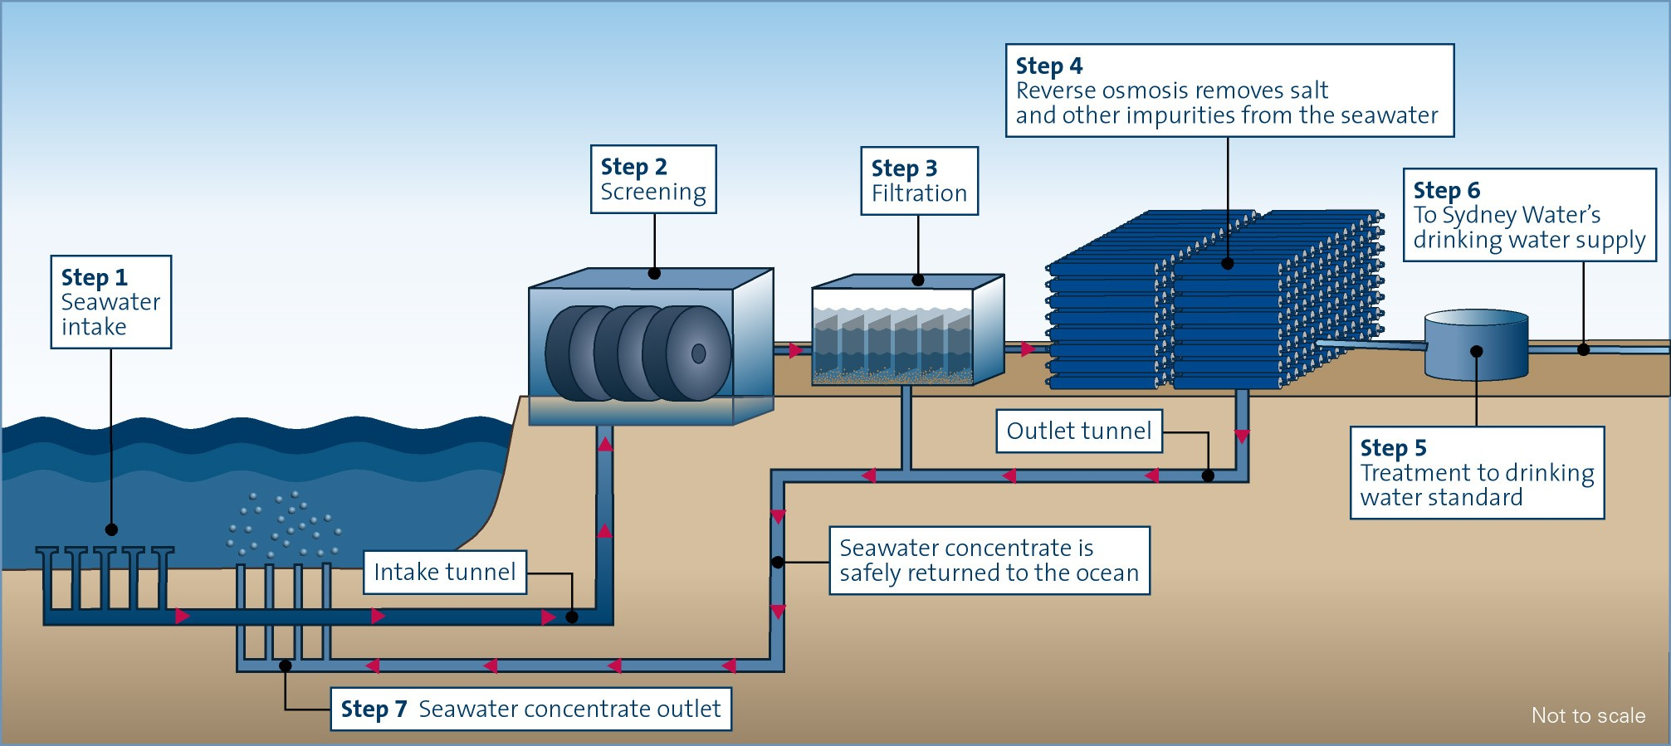

Slide 4
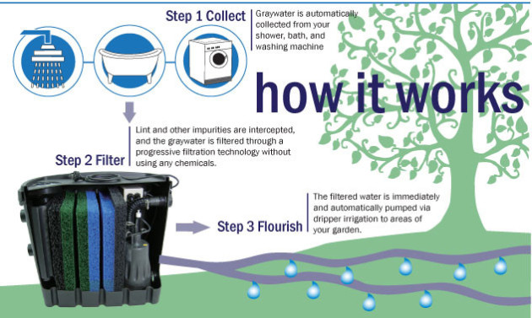
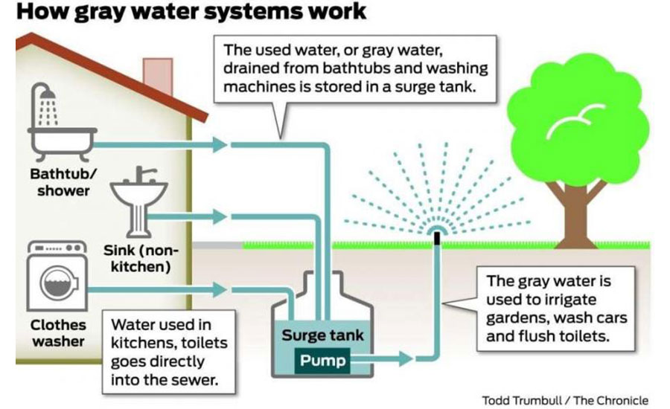
‘REUSE-REDUCE-RECYCLE’

Slide 5
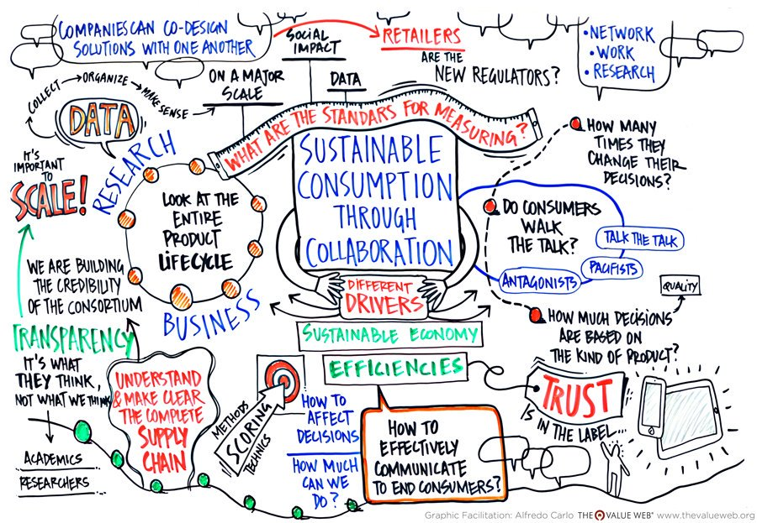
SUSTAINABLE CONSUMPTION AND PRODUCTION PATTERNS

Slide 6
ITS OUR CHOICE

