Slide 1
Presenting our goals
at
Mother of Mercy School

Slide 2
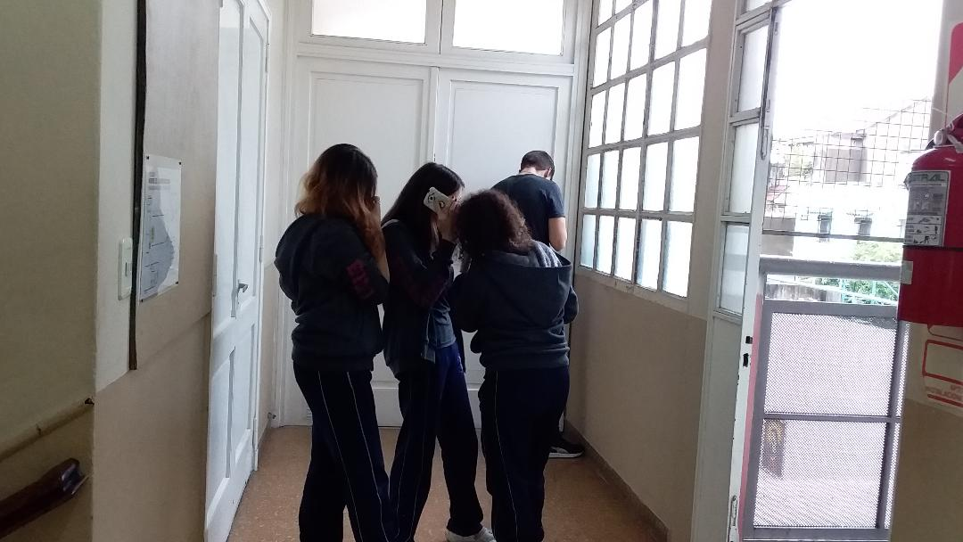
Students collaborating on…

Slide 3
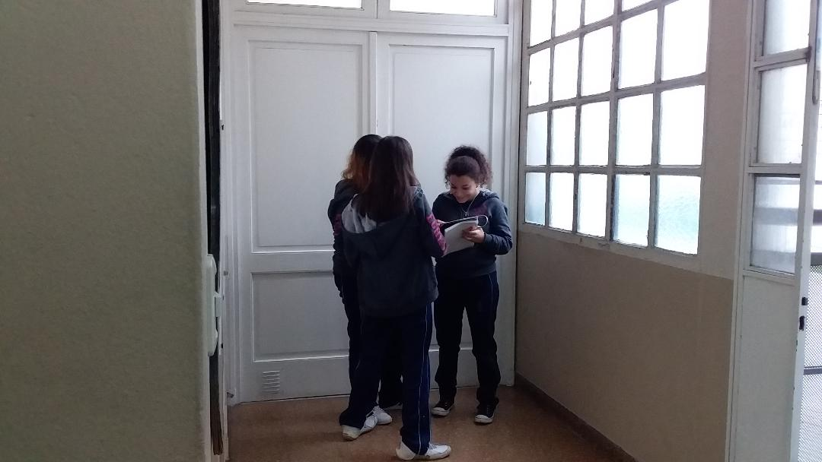
Students collaborating on

Slide 4
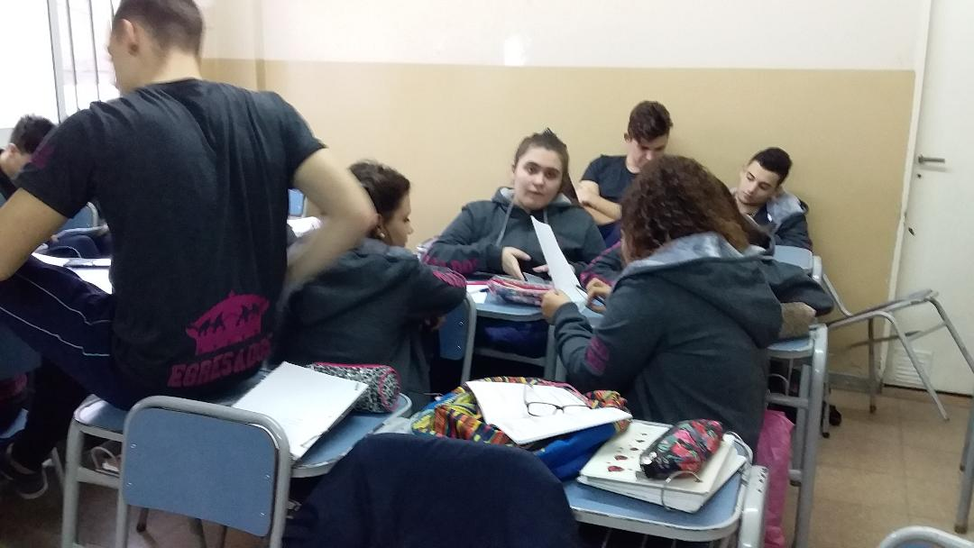
Students collaborating on…

Slide 5
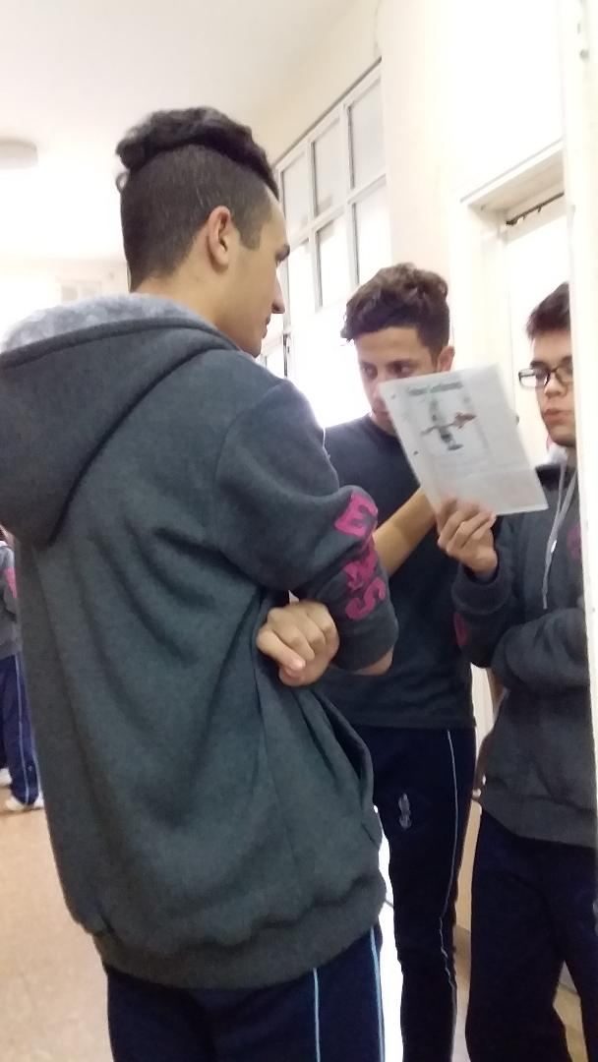
Students collaborating on…

