Slide 1
Sustainable Development Goals
15 & 11
“Biomedically Engineered Bioluminescent Plants As Sustainable Lighting Source To Create Community Security”
By: Gabriel Ibanez
Lebanon Trail High School, USA
Teacher: Kimberly Church

Slide 2
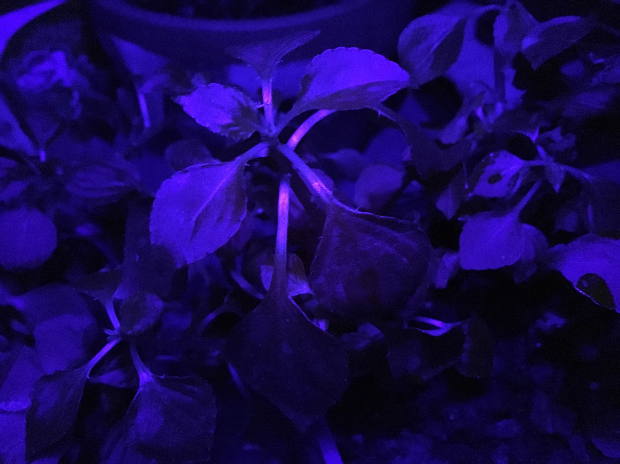
My own luminescent plants, Gabriel Ibanez, Sophomore at Lebanon Trail High School

Slide 3
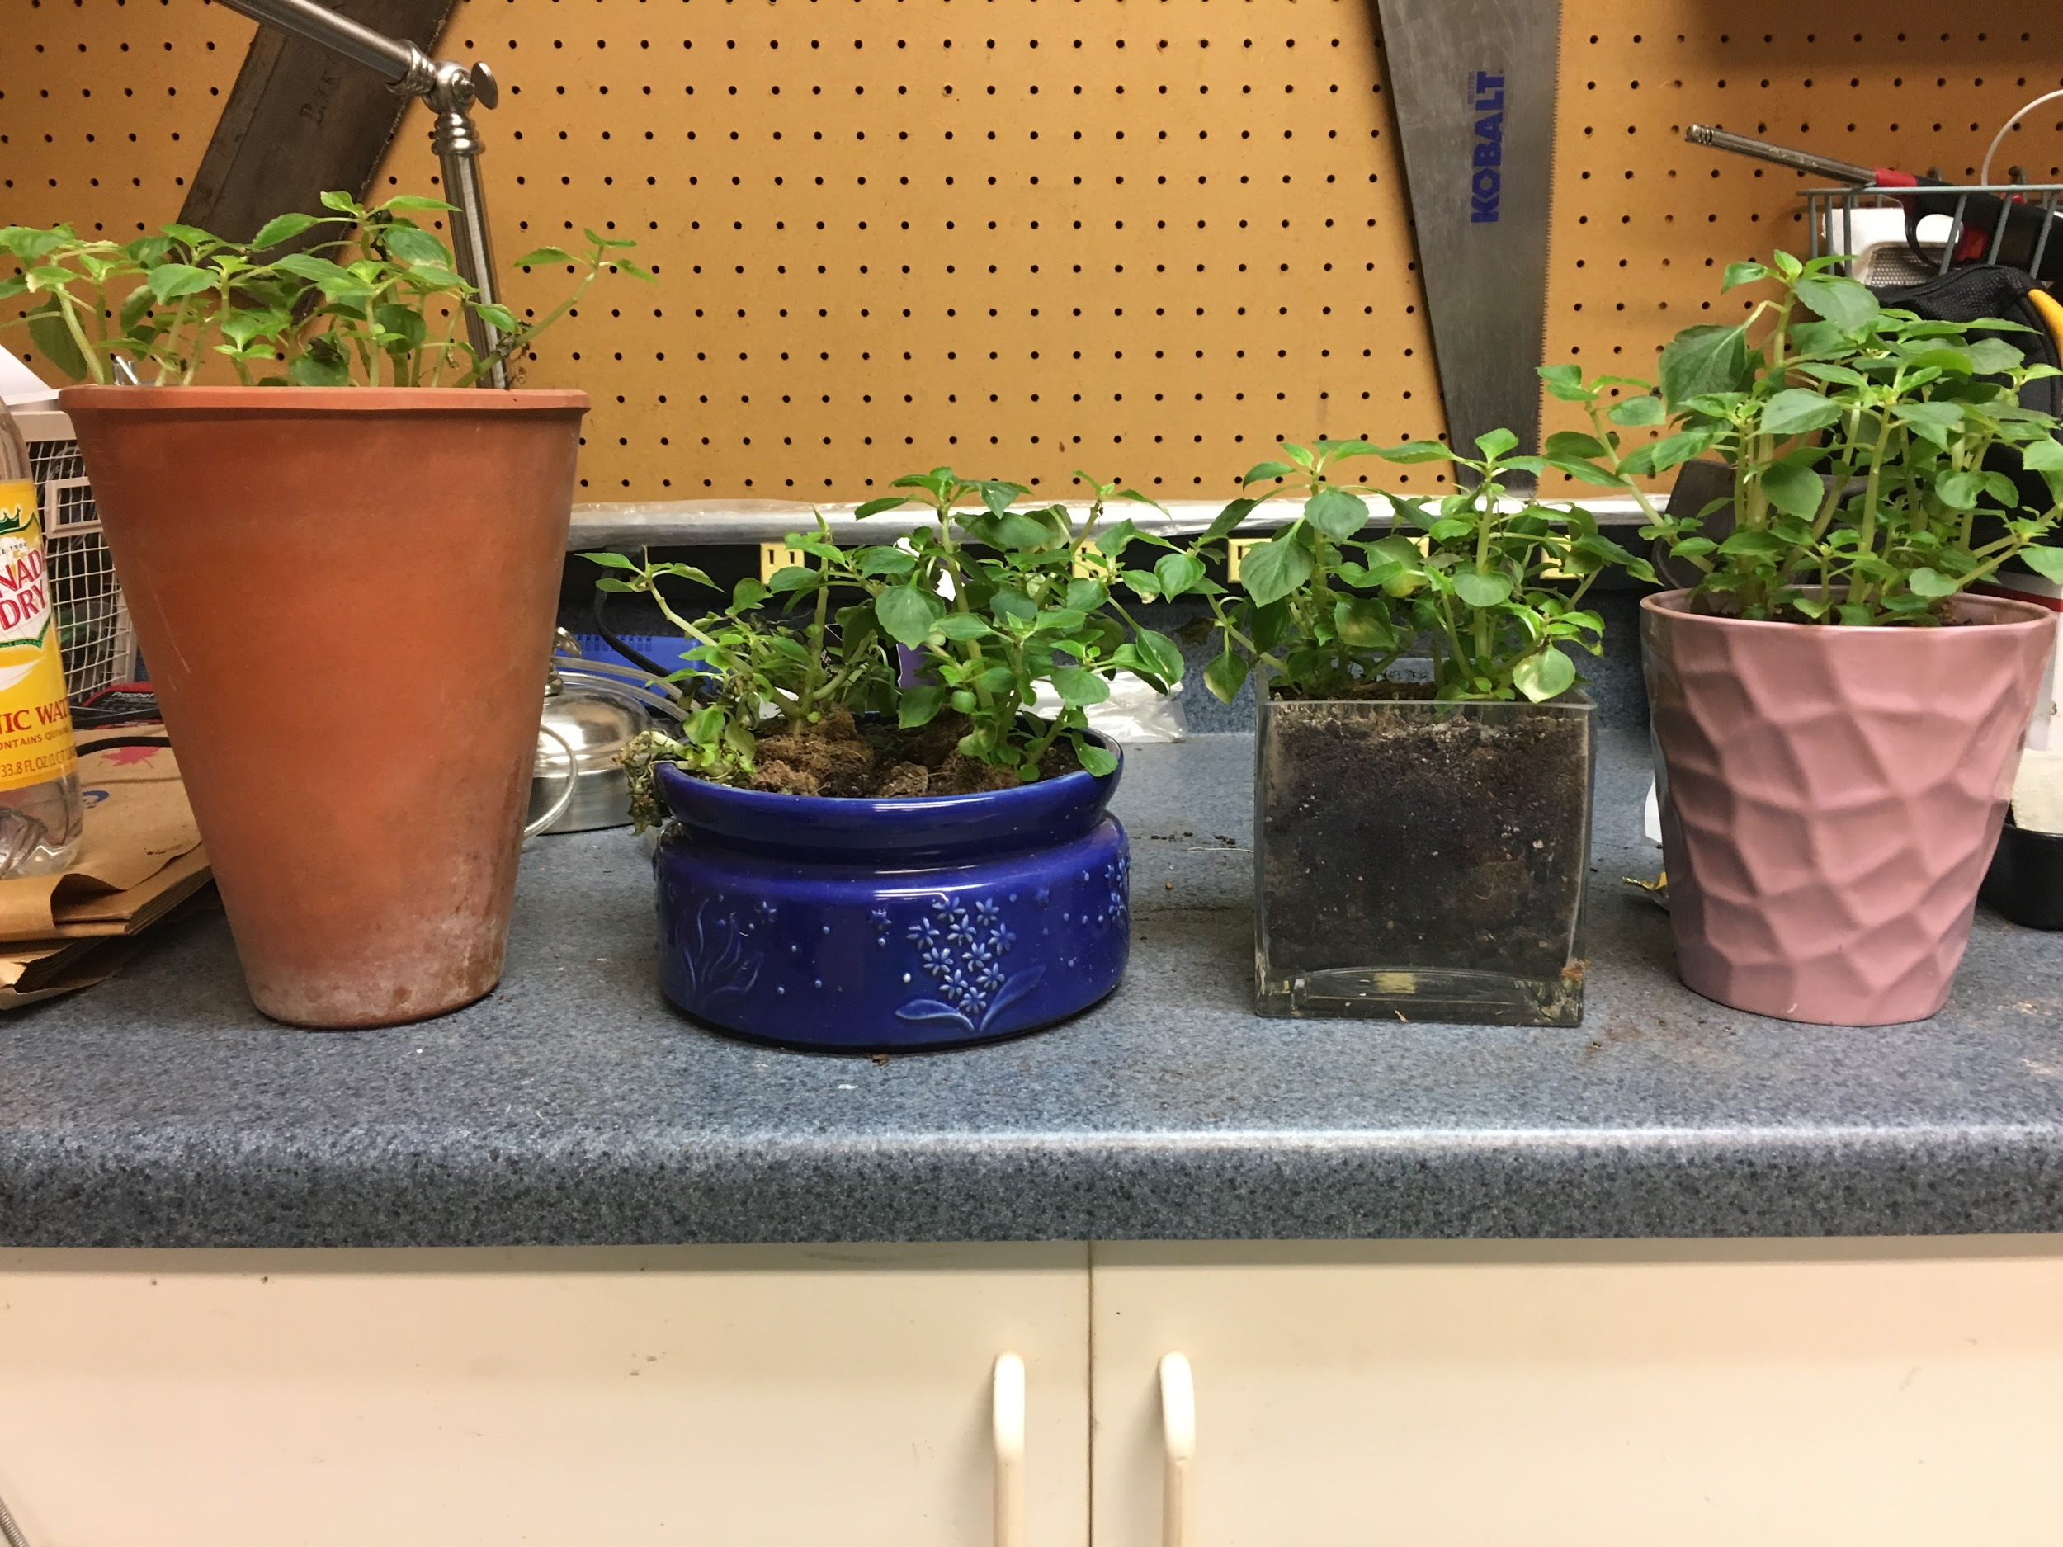
SDG 15 & 11
15: Protect, restore and promote sustainable use of terrestrial ecosystems, sustainably manage forests, combat desertification, and halt and reverse land degradation and halt biodiversity loss
11:Make cities and human settlements inclusive, safe, resilient and sustainable

Slide 4
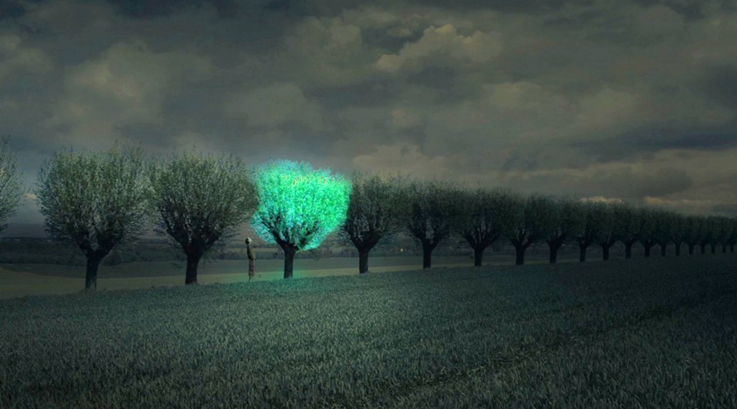
Guiding Resources/Inspiration
A laboratory at Stony Brook University, working with designer Dann Roosegaarde, has developed a glowing plant by merging luciferin–which is the chemical that enables fireflies to glow–with a simple plant. The result is a plant, in dirt, that glows. Naturally.
And it is awesome.
Roosegaarde, a self-described designer/artist/architect from the Netherlands, pronounced his vision for the future of technology incorporation at the 2014 SXSW in Austin, Texas.
His concept is based on “merging worlds of nature and technology” by taking what we can learn from nature and applying that to the world through the building of technology–namely, the urban landscape.
https://blog.suny.edu/2014/03/future-cities-lit-by-beautiful-bioluminescent-trees/

Slide 5
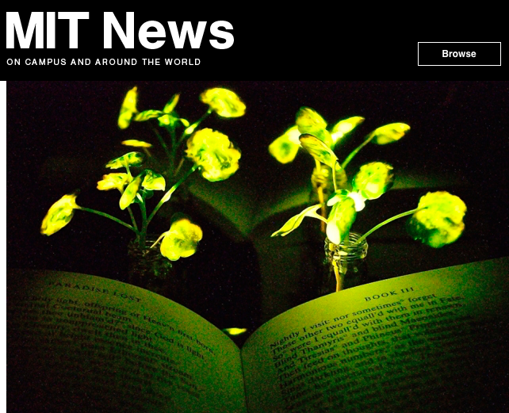
Guiding Resources/Inspiration
Lighting, which accounts for about 20 percent of worldwide energy consumption, seemed like a logical next target. “Plants can self-repair, they have their own energy, and they are already adapted to the outdoor environment,” Strano says. “We think this is an idea whose time has come. It’s a perfect problem for plant nanobionics.”
To create their glowing plants, the MIT team turned to luciferase, the enzyme that gives fireflies their glow.
http://news.mit.edu/2017/engineers-create-nanobionic-plants-that-glow-1213

Slide 6
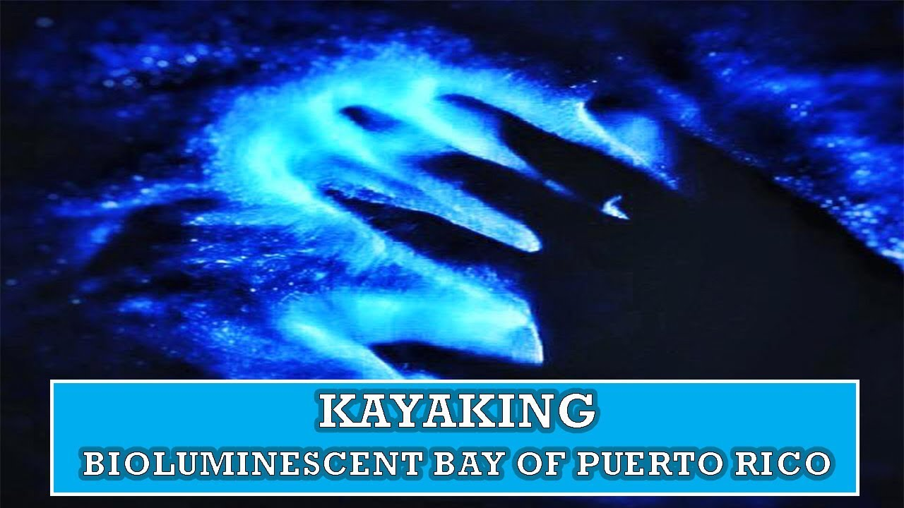
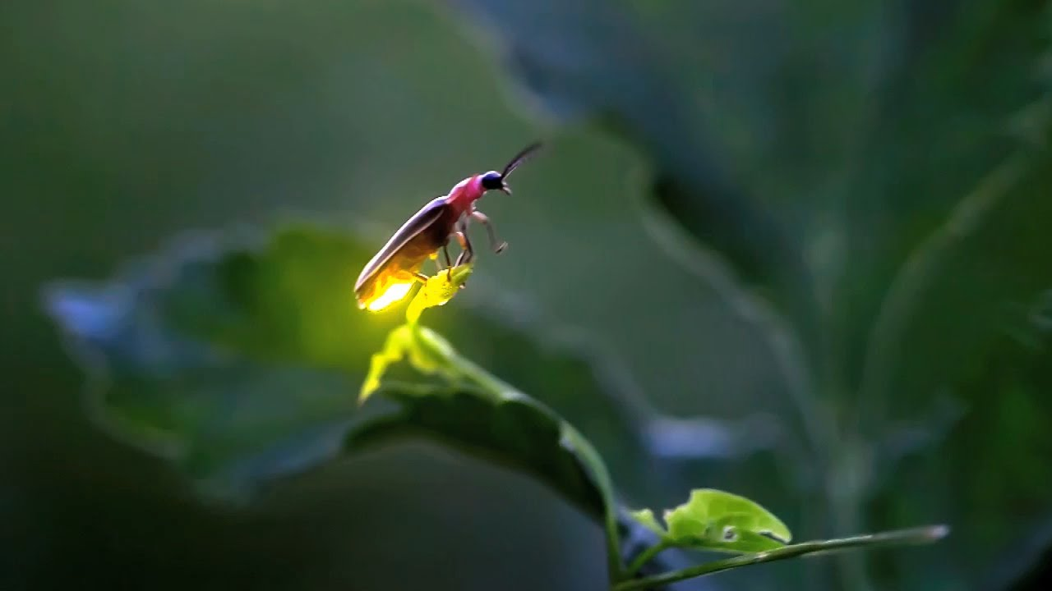
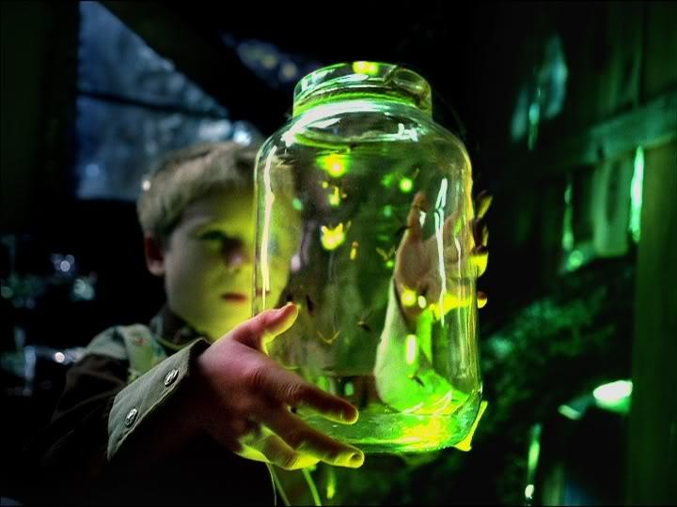
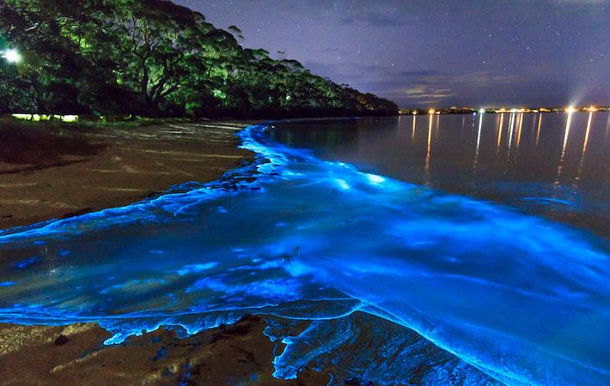
What is bioluminescence?

Slide 7
Skip To Demonstration Video presentation!
CLICK HERE TO VIEW VIDEO DEMO OF MY PROTOTYPE

Slide 8
Photoluminescence
(Fluorescence & Phosphorescence)
Fluorescence: Energy is absorbed & emission of light when energy falls.
Important factors:
Light is temporary: works only with energy source
GFP Protein used to create fluorescence in tracing specific items
Important people: Martin Chalfie, Osamu Shamrao, Roger Tsien won 2008 nobel prize.
Possibility Level: high is phosphorescence is used for controlling the activation of the fluorescent gene GFP
Phosphorescence: Organisms can store energy & electrons give off photons over a longer period of time.
Chemical equation for substance used is Phosphorus penta oxide
Possibility Level: high chance if the plant receiving the chemical does not cause the dissociation of the compound to the extent of no longer producing light

Slide 9
Chemiluminescence
(Manmade- Chemiluminescence & Bioluminescence)
MM-Chemiluminescence: Electrons get excited by chemical reactions, not light
Important Factors:
Oxidation-reduction
Possibility Level: high possibility if chemical compound is formed to be received by photosynthetic organisms
Bioluminescence: A type of Chemiluminescence
Important Factors:
Light produced by chemical reaction in organisms
Luciferin is a light emitting compound in organisms
Possibility Level: High possibility if luciferin can be activated by solar activity to emit light at night rather than during the day.

Slide 10
Incandescence
Definition: Light emitted due to exposure to heat.
Possibility level: Possible to use temperature stimulated genes/ proteins ( GFP & Luciferin), but because there are irregular temperature patterns the regulation of light is inconsistent.
Similar to how certain metals emit aglow when extremely hot or lava.

Slide 11
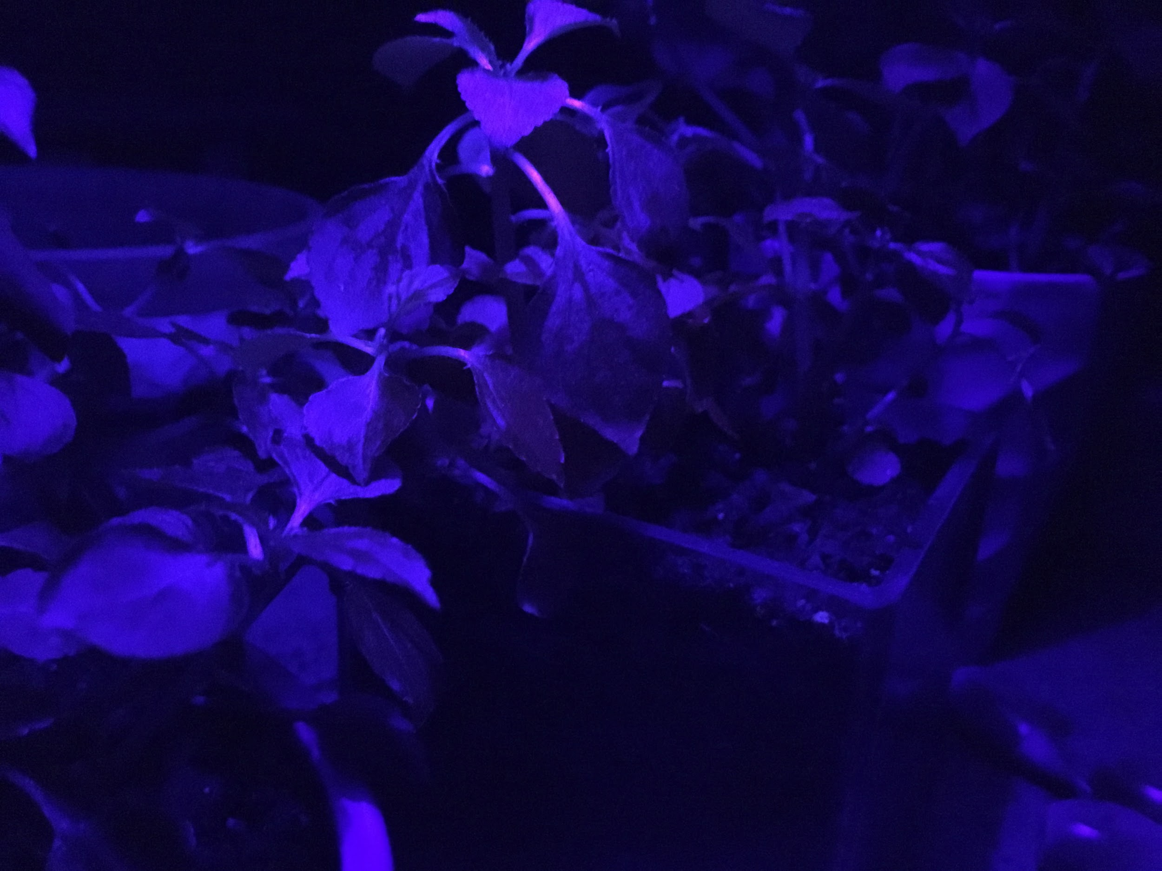
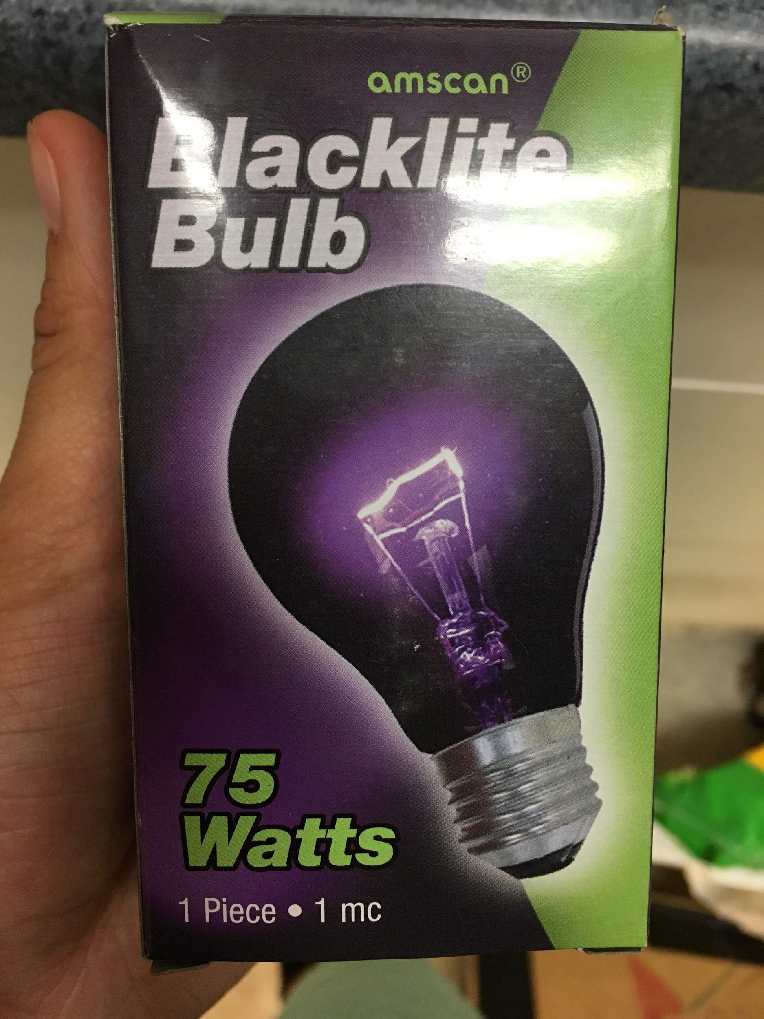
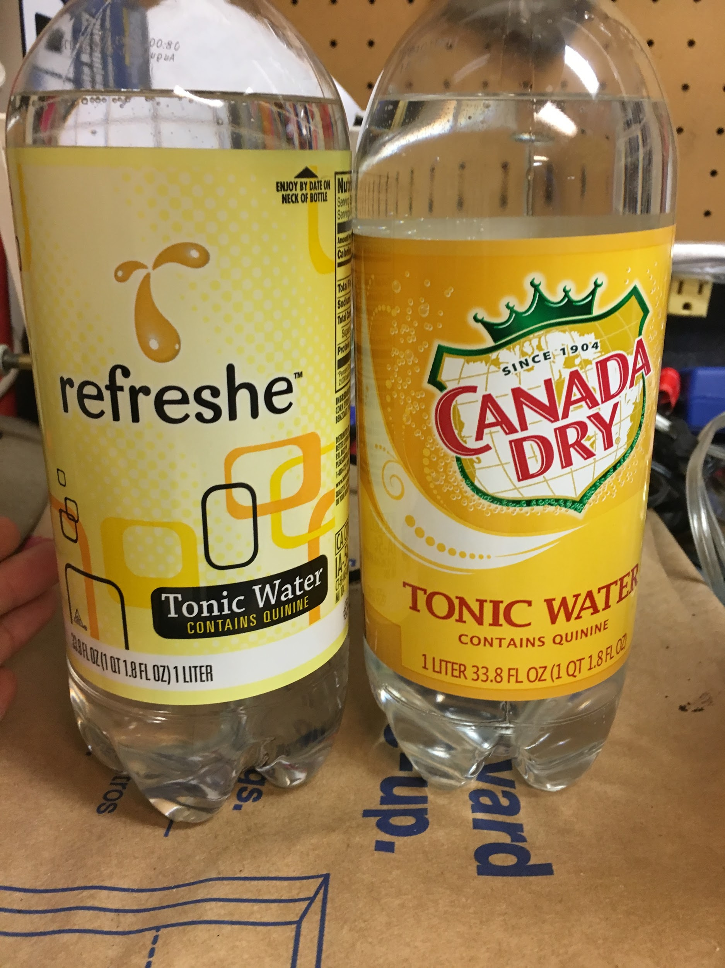
Black light Method
Definition: have a fluorescent material but don't shine unless black light is used.
Important Factor:
Some items that fluoresce include:
Tonic water
Chlorophyll (red)
Niacin & Riboflavin (found in vitamins)
Possibility Level: Slim unless human can alter the color frequencies emitted by a black light that cause other colors to be more dominant in chlorophyll rather than green. Also there needs to be a natural source of ultraviolet light that can stimulate the same effects as a black light.
The tonic was absorbed by the water, and fluoresces within the stem of the plant, however the plants are seen as red in person, but the camera picks up the fluorescence and it can’t be easily be seen in person

Slide 12
Prototype 1 Important Terms
GFP Gene: stands for Green Fluorescent Protein. It has been regulated to show other colors like red, blue and much more.
Luciferin: is a chemical compound found in Bioluminescent organisms, and when oxidized with the help of a enzyme called luciferase the energy release is light.

Slide 13
Prototype 1 Purpose and Possible Effect on Society!
Purpose: to create a plant that can emit enough light to replace that of lamp posts in cities. Also bring light to areas around the globe that do not have electricity to help them see in the dark.
Hypothetical effects on the society: Reduction of use of electricity in environments to create light to see on the streets or in a backyard. Most lights are manufactured by power plants to create the metal molds, glass, wires, etc… which all release harmful pollutants. With this new concept people can enjoy a natural development of light within their community. Also stress is created by high frequencies of light ( bright, blinding, temporary blindness), the colors used would be blue, green, red, and other colors that are less blinding, but emit enough light to see the surroundings well enough.
Targeted goals: create natural form of light, reduce pollution emitted to make artificial forms of light.

Slide 14
Prototype 1 How it functions?
Phosphorescence:
Phosphorescent chemicals added to a plants diet and monitor how it reacts with the plant cells.
One can inject the chemicals directly into the cells and try to have cells replicate with the phosphorescent chemical that emits light in the dark.
Bioluminescence:
The Luciferin protein can be activated by the oxidation of the luciferase gene.
If the Luciferin compound can be implanted into photosynthetic organisms, the have the possibility to have fluorescent regulate plants.
Fluorescence:
The GFP gene can be regulated to function with inhibitors that cause the activation of the gene during certain hours similar to that of a solar panel.

Slide 15
What the prototype lab is?
Materials:
Inpatients & silver Daisy’s
Tonic water
Canada Dry
Refreshe
Black 75wat black light
Procedure: 16 tablespoons of tonic water were given to each of the impatient and 8 tablespoons were given to the silver daisies. Next there was in group with plain tonic water the rest contained dyes like blue, red, and yellow.
Results: plants fluoresce but the fluorescence of the tonic water can’t be seen without a camera lens.

Slide 16
Prototype 1 (Plants with Light)
Oxford dictionaries define Luminescence as the emission of light by a substance that has not been heated, as in fluorescence or phosphorescence.
Some of these include: Photoluminescence & Chemiluminescence & Incandescence & Black Light
Nutrients Needed by Plants:
H20, Moisture
Nitrogen (N) for making green leaves
Potassium (K) for helping plants fighting off disease
Phosphorus (P) for making big flowers & strong roots
Proper temperature & Air Quality

Slide 17
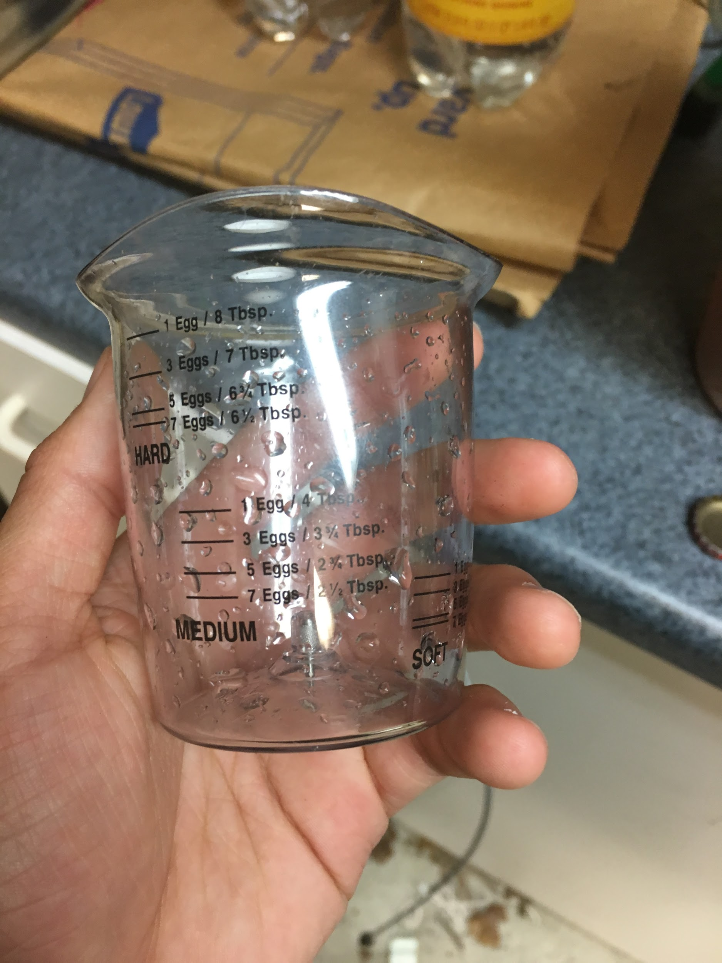
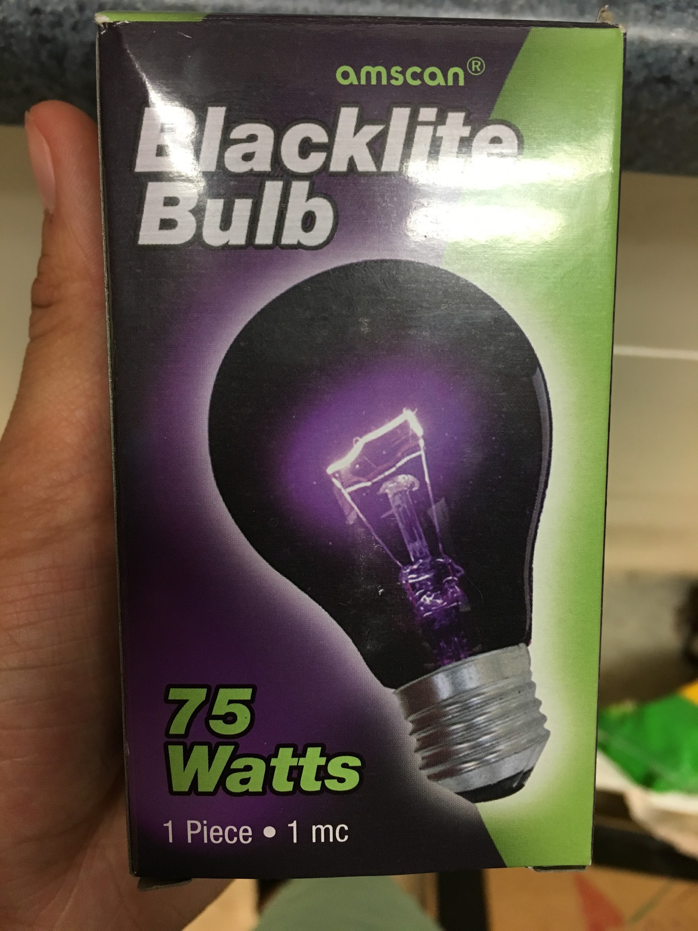
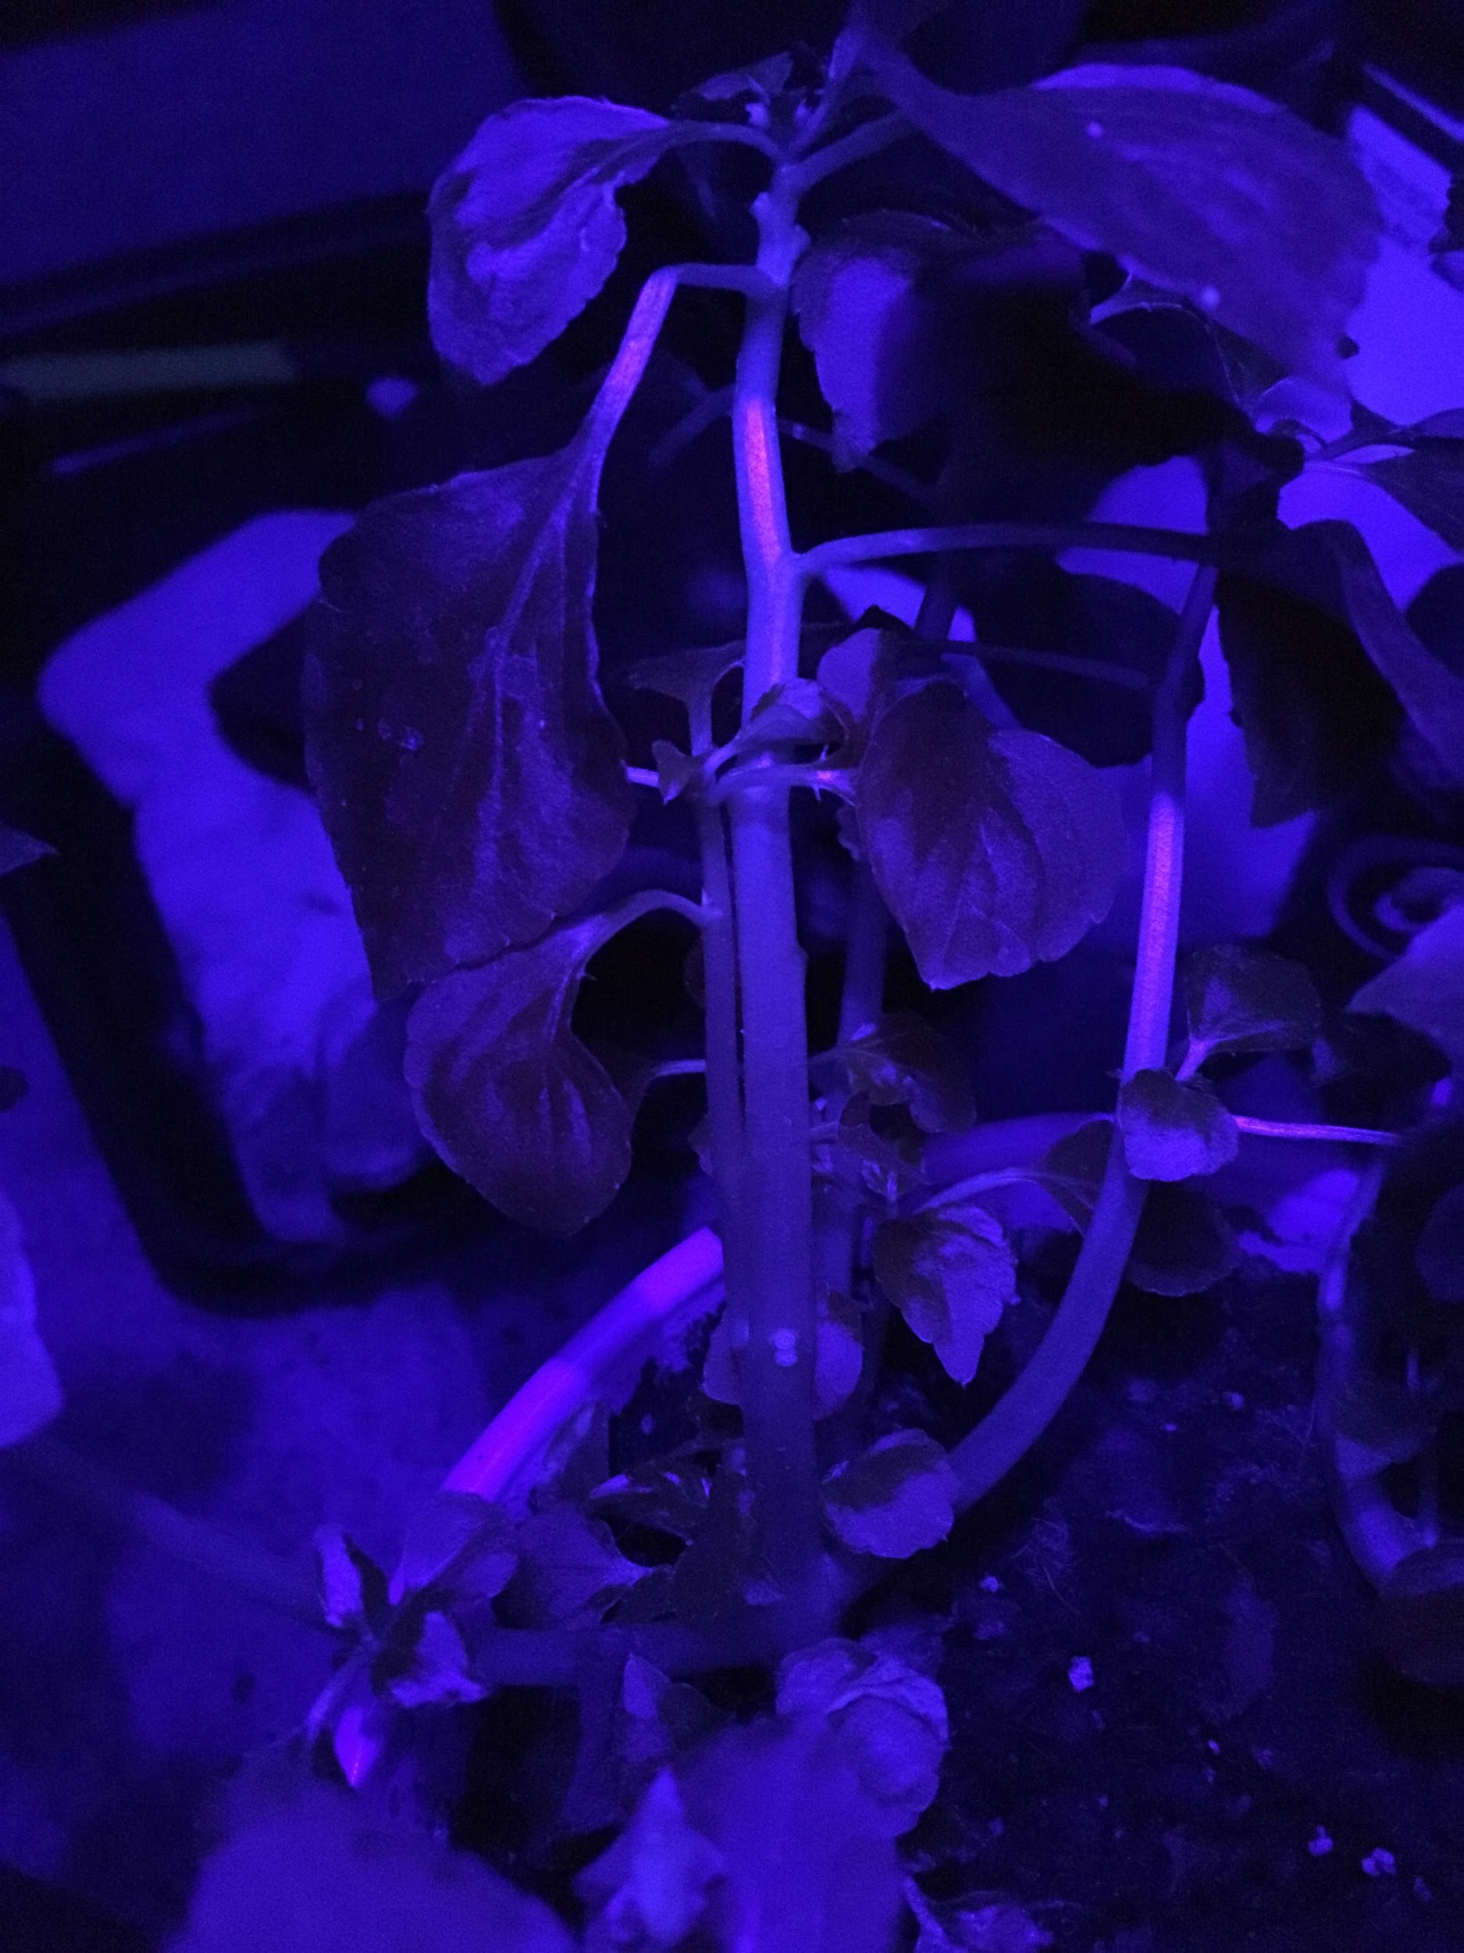
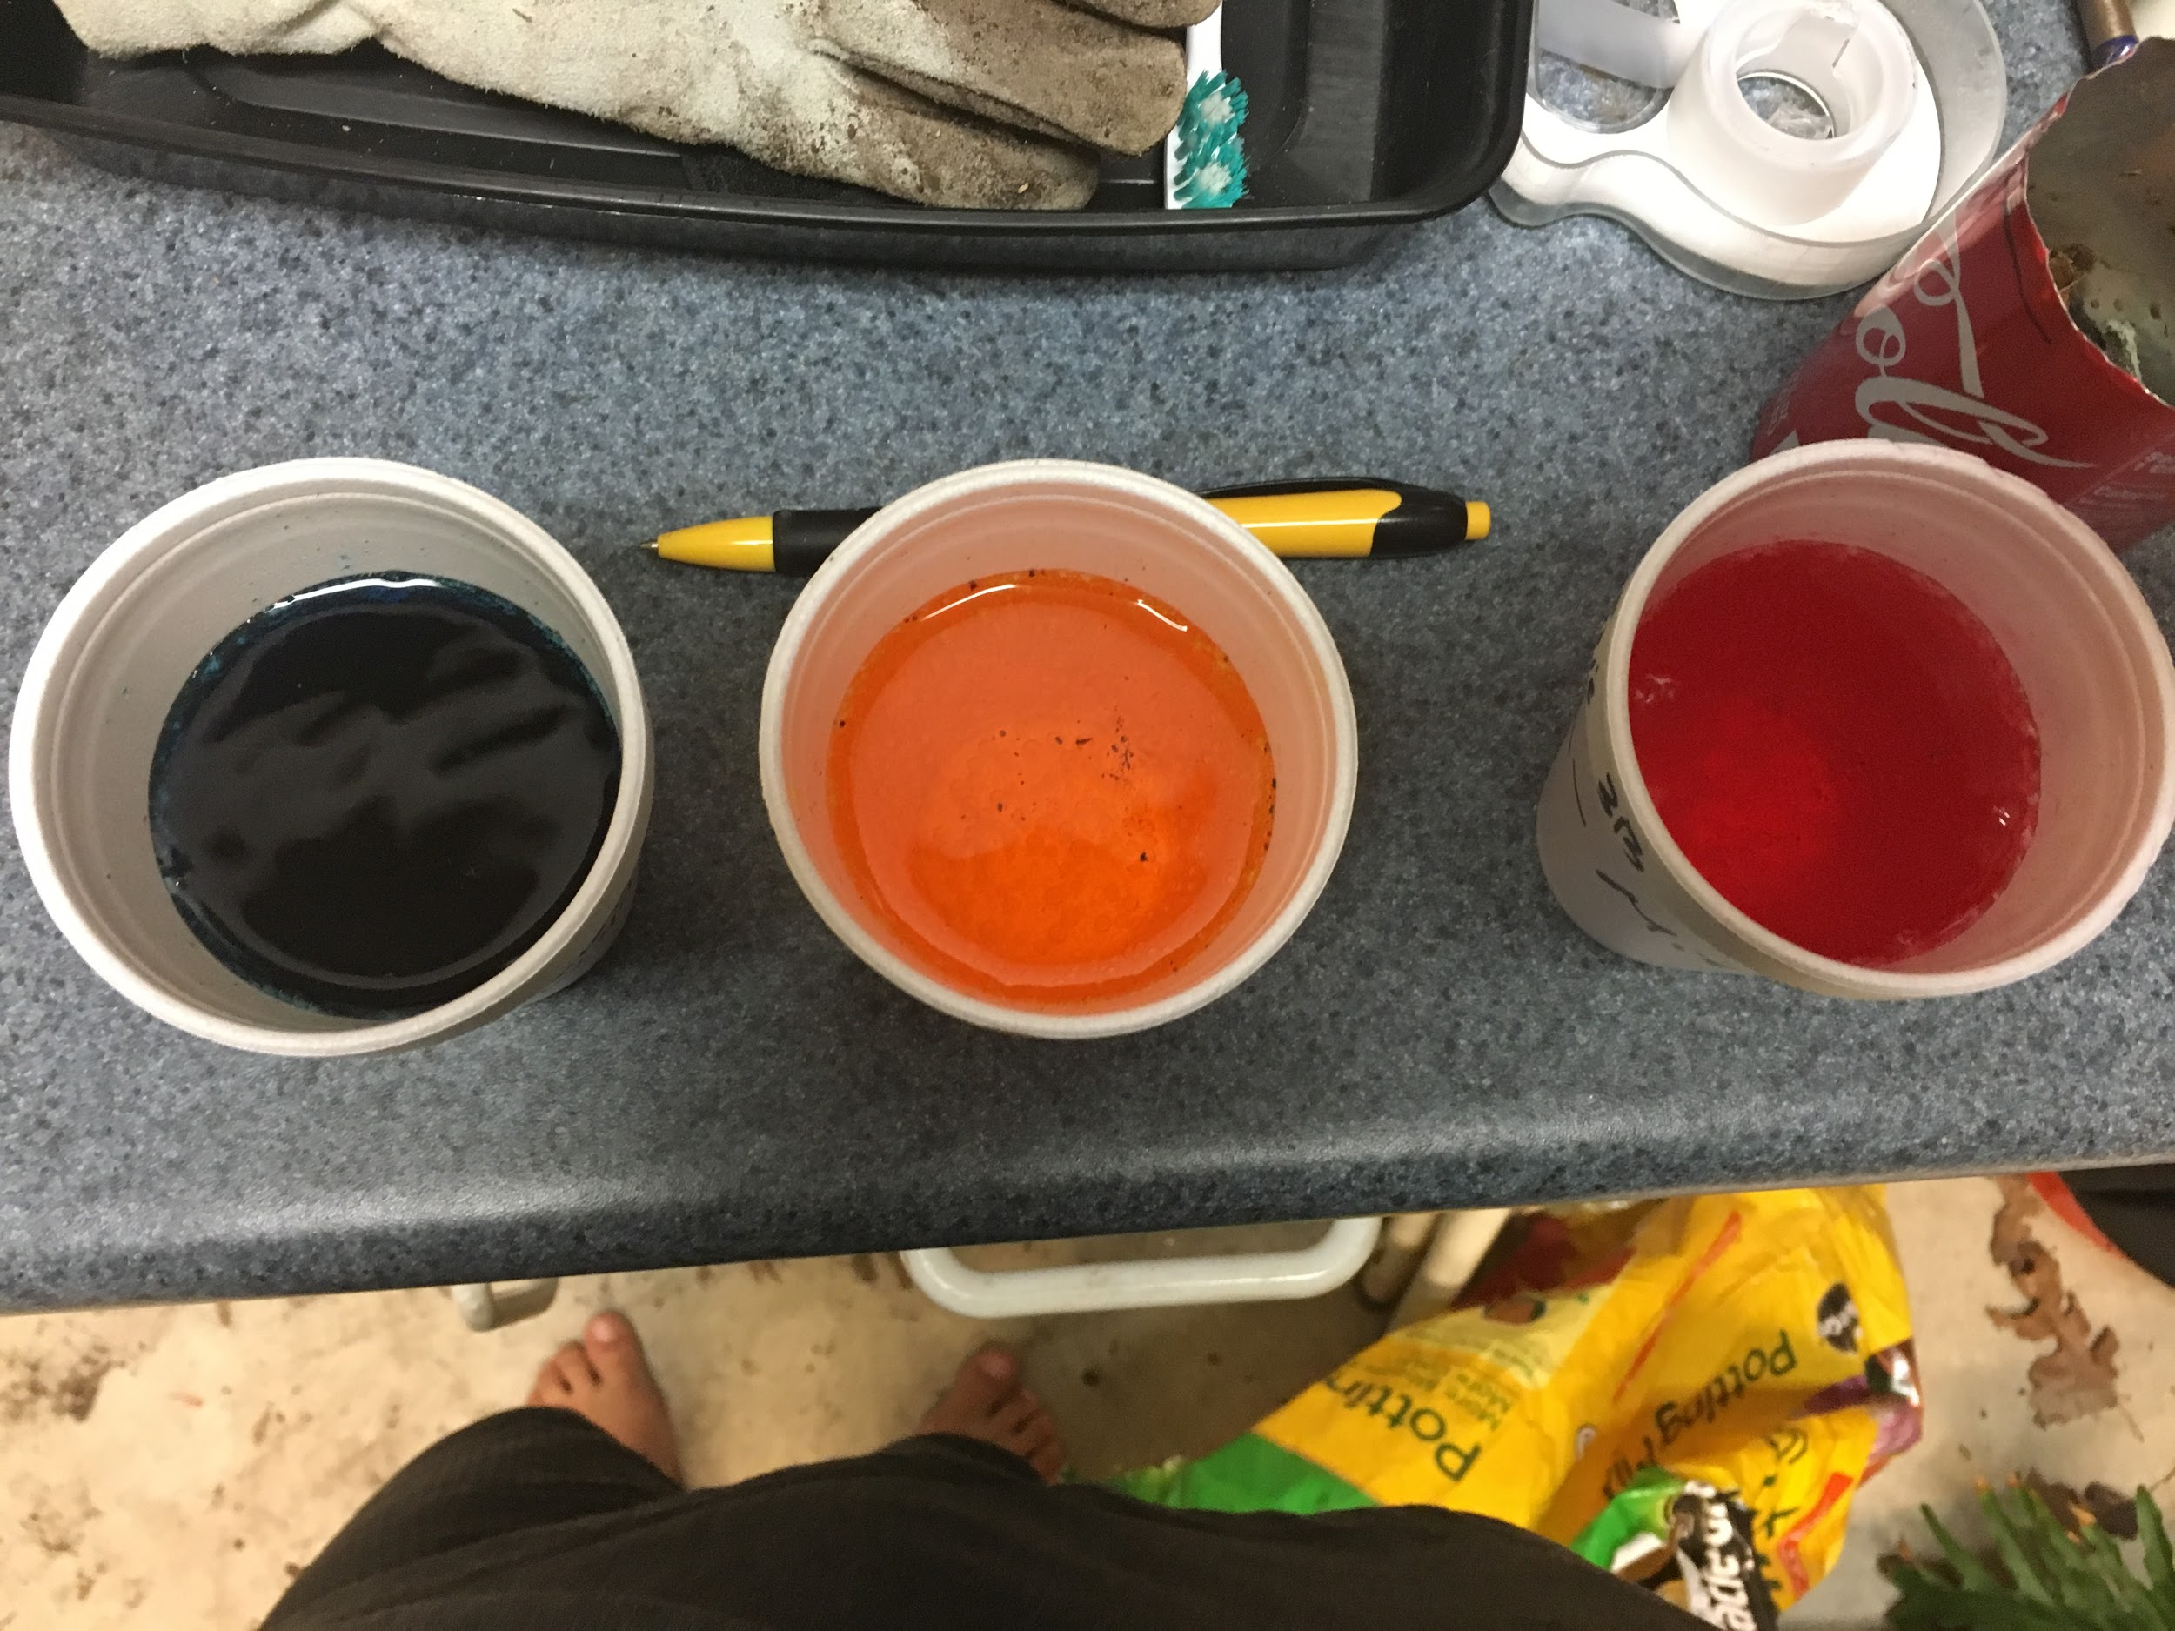
Photos of Prototype...actual bio-medically engineered plants for bioluminecense not yet created

Slide 18
Demonstration Video presentation!
CLICK HERE TO VIEW VIDEO DEMO OF MY PROTOTYPE

