Slide 1
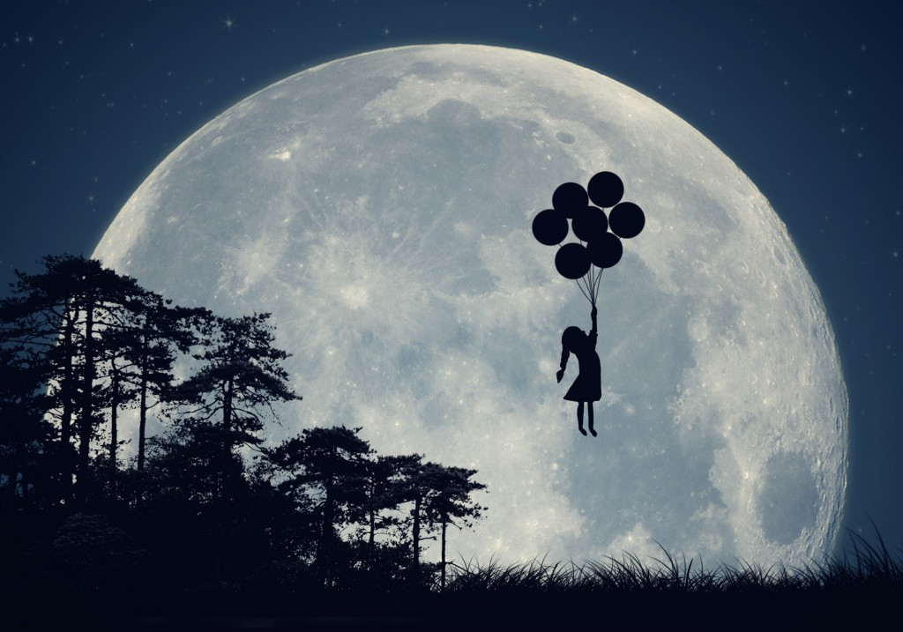
REM - SWAPAN
By – Team Sat Paul Mittal

Slide 2
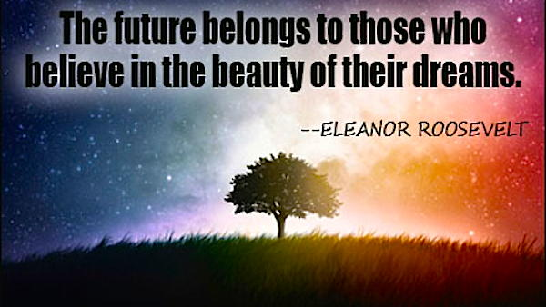

Slide 3
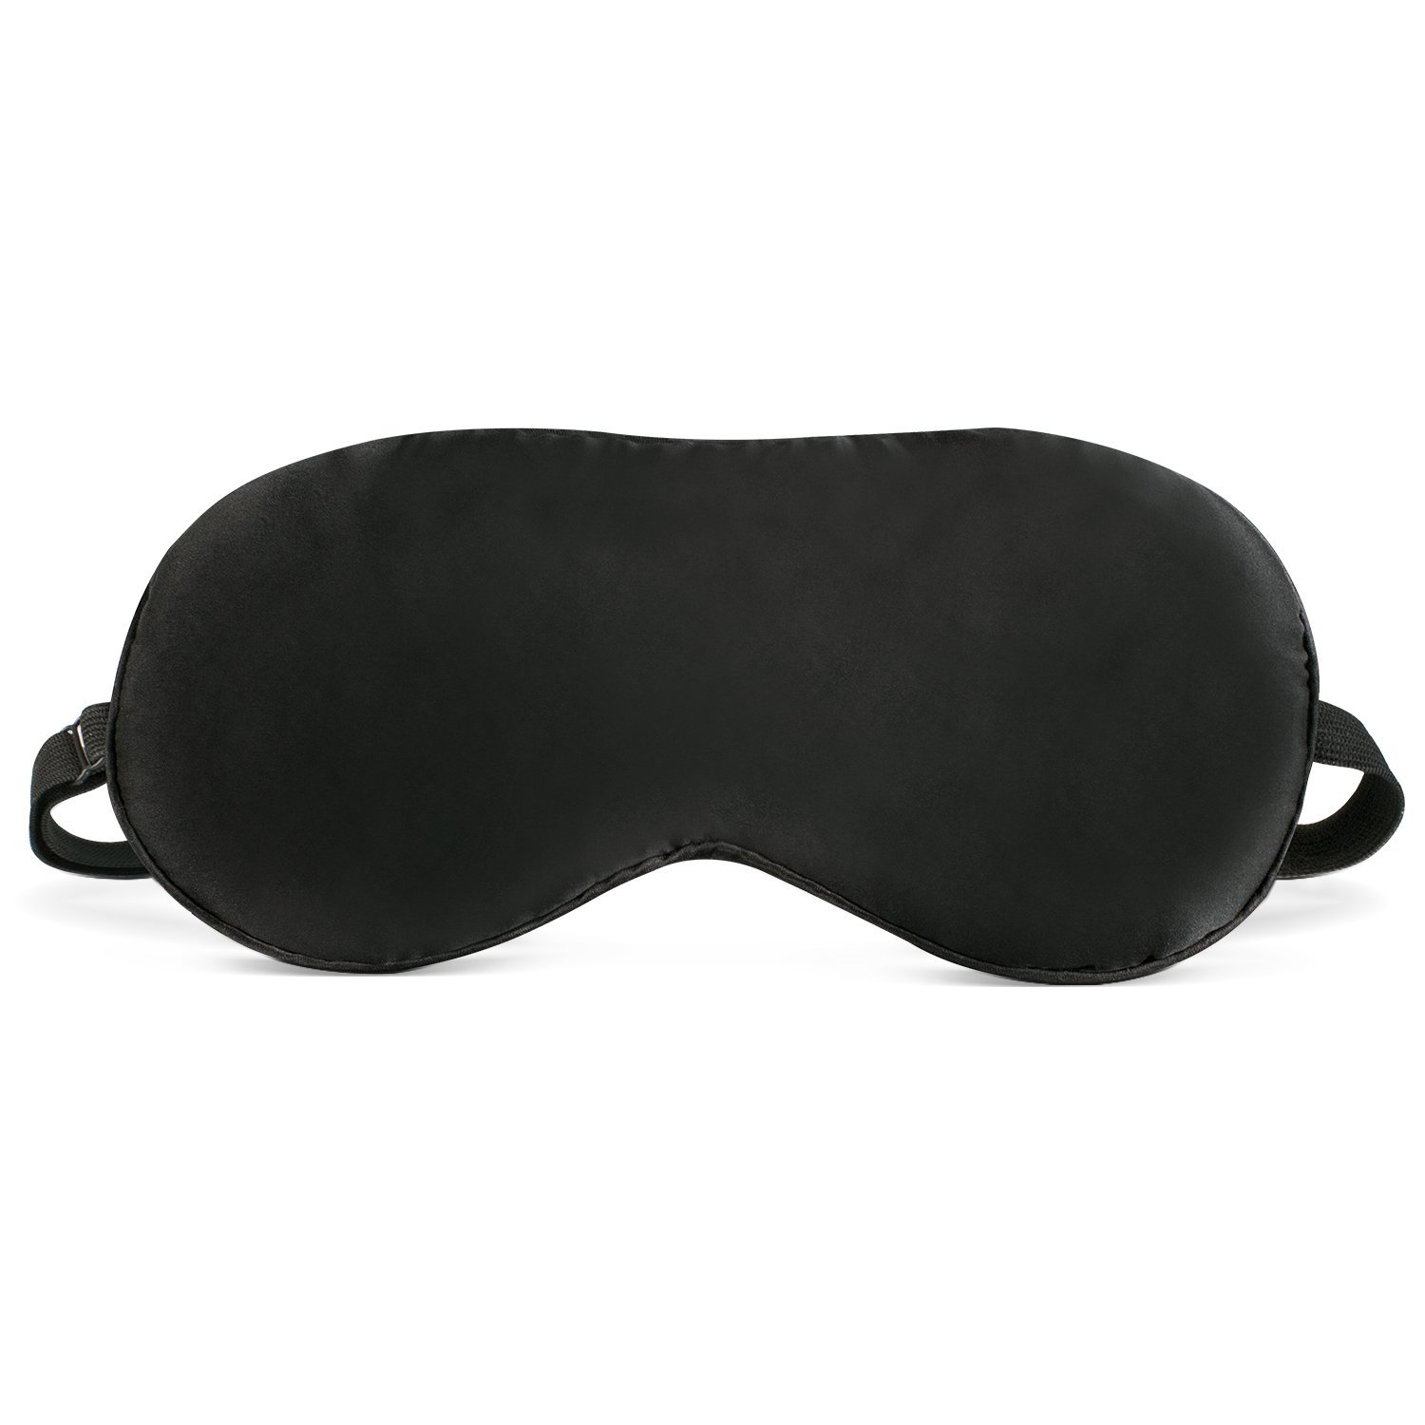
REM - SWAPAN

Slide 4
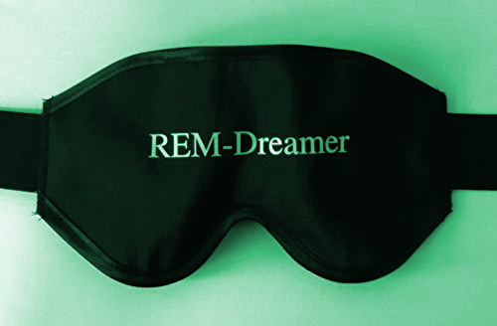
EXECUTIVE SUMMARY
REM Dreamer is an Eye Mask, which is a sleep inducing mask. The product is called REM - SWAPAN, which makes one feel drowsy and therefore induces, sleep.
Dreams are very important. To dream, sound sleep is essential. To fulfill our dreams visualisation is must and for that the sleeping pattern has to be normal.

Slide 5
10 Dreams That Changed Human History
Here are 10 scientists, writers, musicians, mathematicians and inventors who subsequently changed the course of human history~ BECAUSE THEY HAD A DREAM
APJ Kalam : Former Indian President
Mary Shelley: The World's First Sci-Fi Novel
Paul McCartney: Music That Inspires Music
Niels Bohr: The Structure of The Atom
Elias Howe: The Eye of The Needle
Albert Einstein: The Speed of Light
Srinivasa Ramanujan: The Man Who Knew Infinity
Robert Louis Stevenson: A Fine Bogey Tale
Otto Loewi: Nerve Impulse Breakthrough
August Kekulé: The Ouroboros Benzene Dream

Slide 6
The challenge
According to a recent survey:-
52.9% people suffer from insufficient sleep
10% take sleeping pills.
Survey method) conducted via Google forms was 140 people.
Insufficient sleep leads to severe consequences to one’s physical health and results in mental disorders.
Survey Conducted by :
Parn Narang
Rajveer Oswal

Slide 7
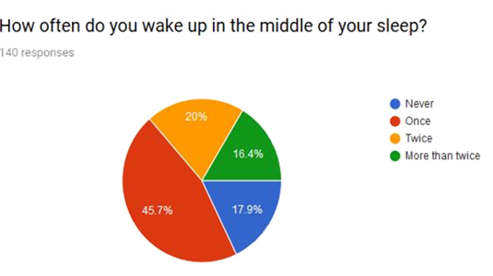

Slide 8
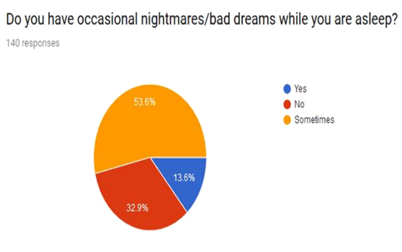

Slide 9
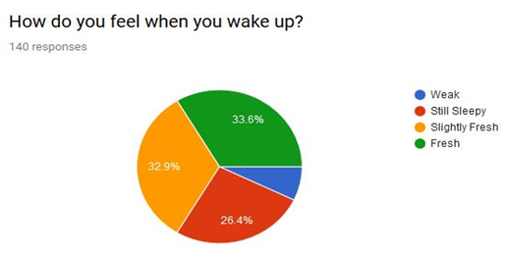

Slide 10
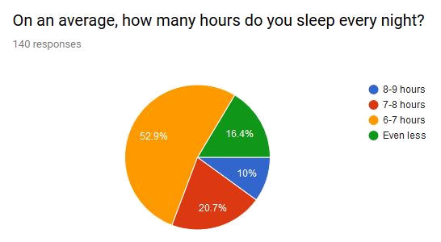

Slide 11
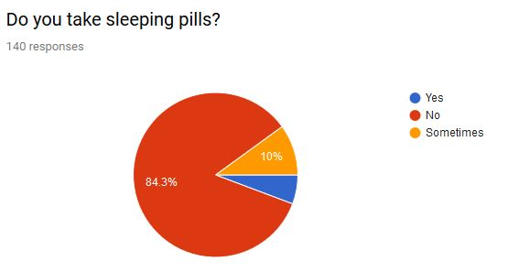

Slide 12
The hypothesis

Slide 13
VISION
To caters to the health and the wellbeing, using natural remedies with Ayurveda.
MISSION
•To provide a health product that induces sleep, and helps reduce stress and improve the immune system
•To ensure the wellbeing and comfort of everyone.

Slide 14
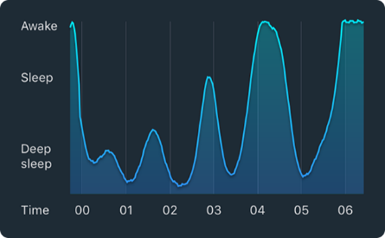
Regular Sleep Graph
This graph shows more irregular sleep where the user probably didn’t sleep as well as in our first example. Here the user remained in lighter sleep phase 4 am – 6 am and woke up for a short period of time at 3:15 am.

Slide 15
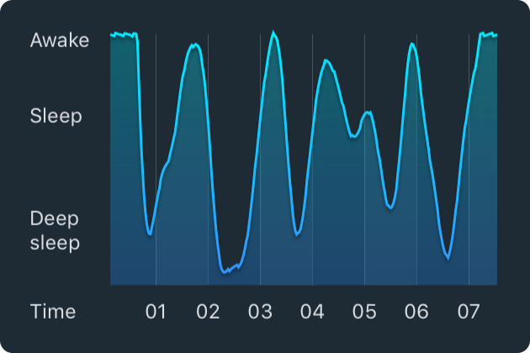
Irregular Sleep Graph
This graph shows peaks about 90 minutes apart. The peaks represent sleep cycles, including all sleep phases described above. This is a great example of a sleep graph showing regular sleep patterns

Slide 16
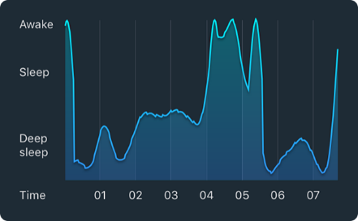
Disturbed Sleep Graph
The graph shows how alcohol influence can disrupt your sleep cycles. Although alcohol can make you fall asleep faster, it will make it harder for you to sustain a good nights sleep. The user in our example occasionally enters deep sleep during the first half of the night, but remains in lights sleep altered with period of being awake for the second half.

Slide 17
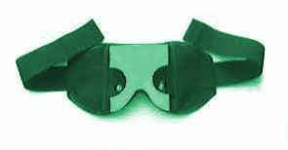
Do You Know?
My mask has stuffing of very small amount of dried, fragrant herbs which promote sound sleep and relieve stress. It will help to bring healing, restorative sleep(for insomnia) .
35
2
22

Slide 18
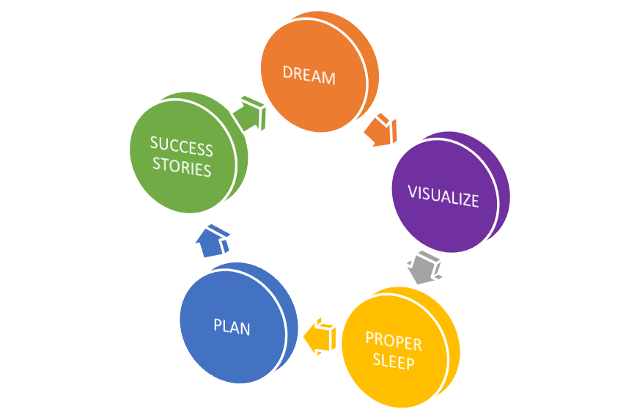
My Discoveries

Slide 19
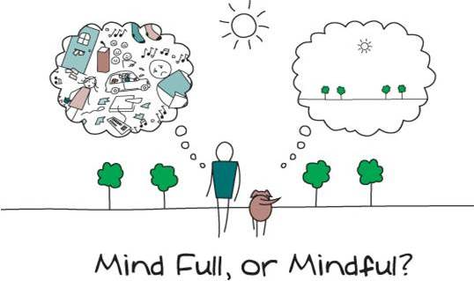
Takeaway

Slide 20
