Slide 1
Innovation project
Process and Proceeds

Slide 2
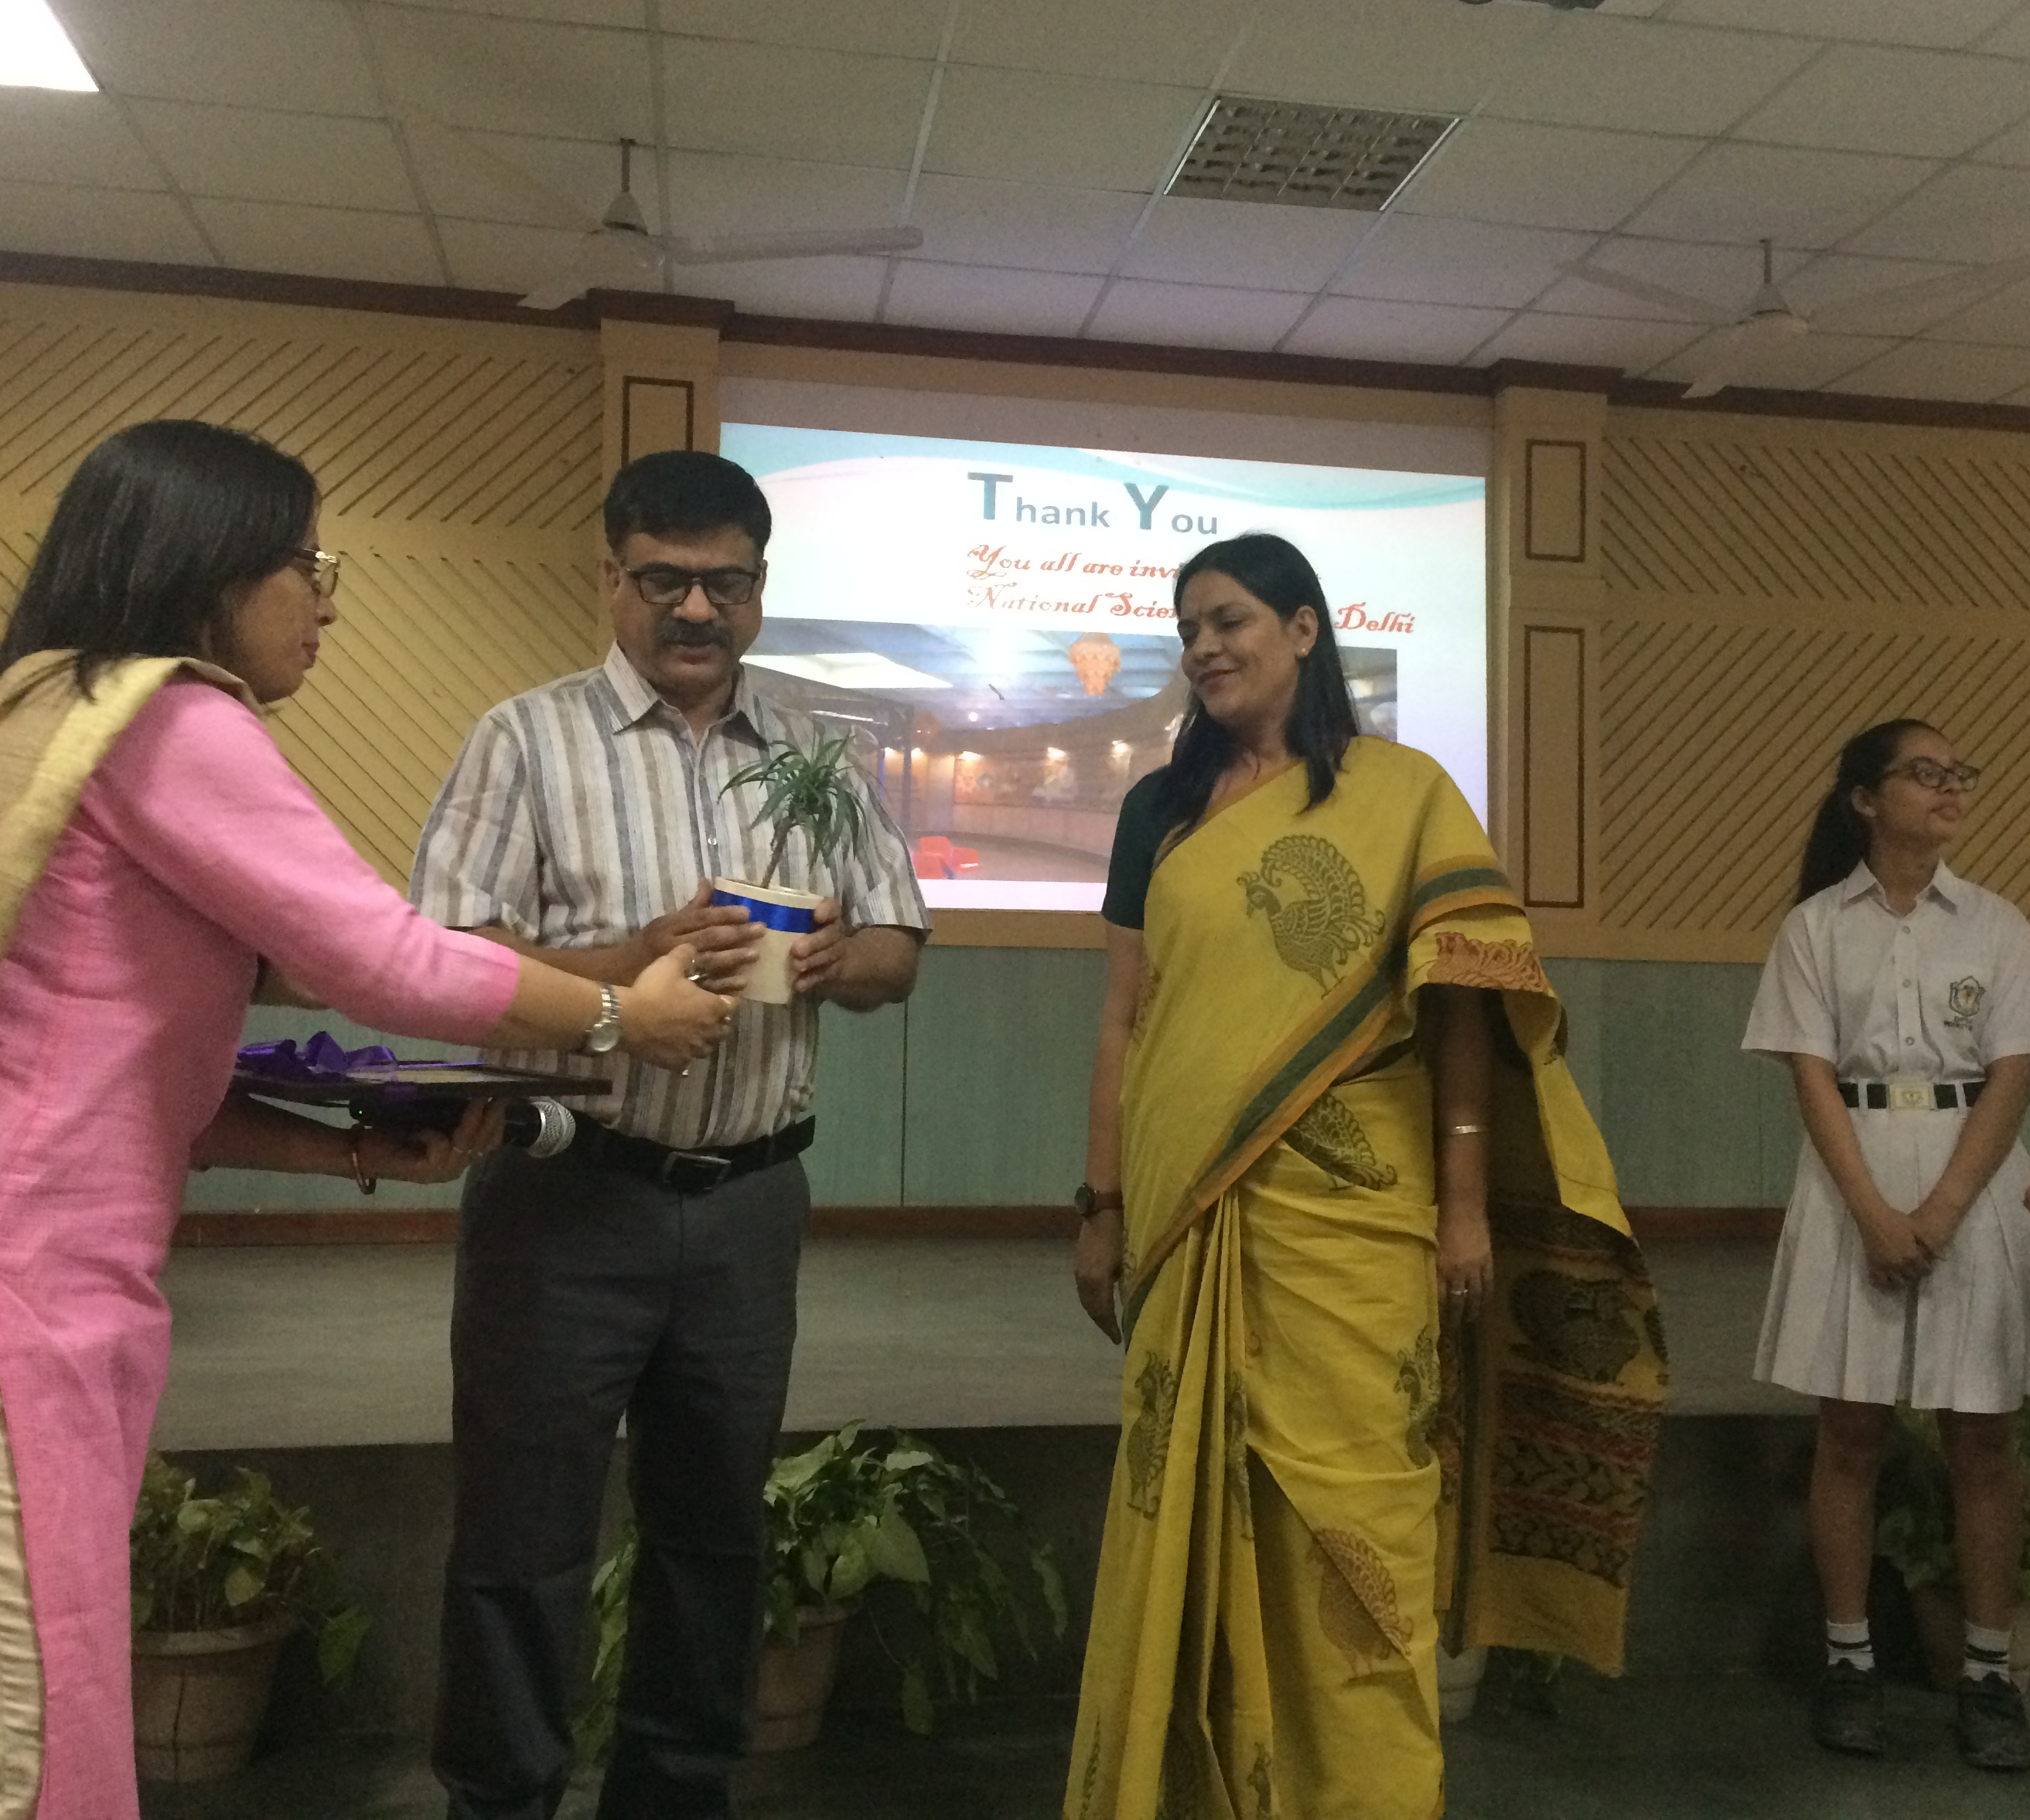
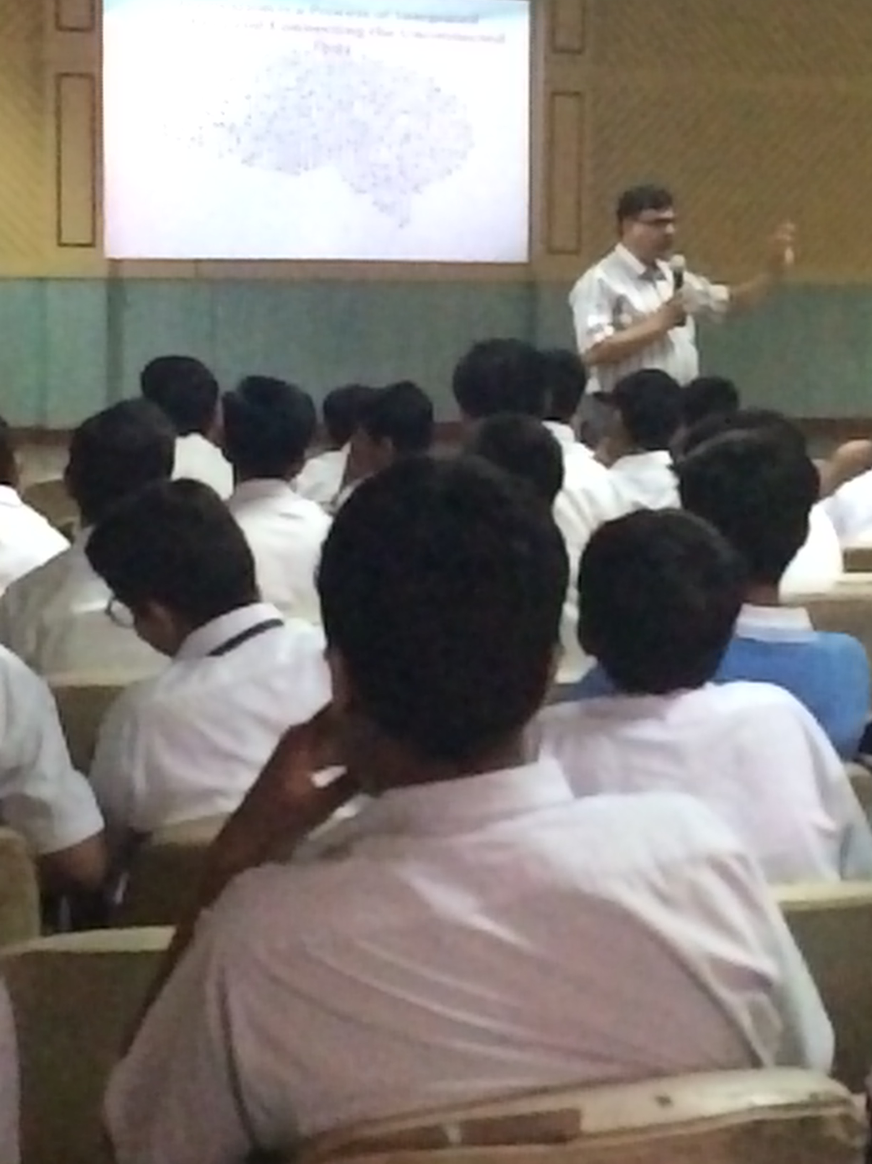
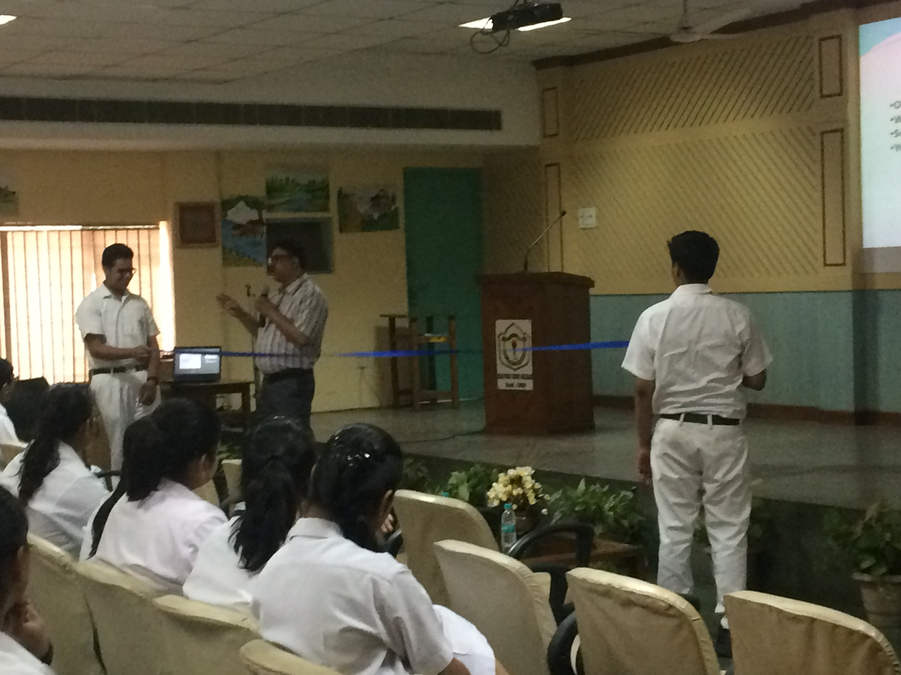
Guest speakING session of Innovation
Mr Kailash Chandra, Senior Education Officer
NATIONAL SCIENCE CENTRE DELHI

Slide 3
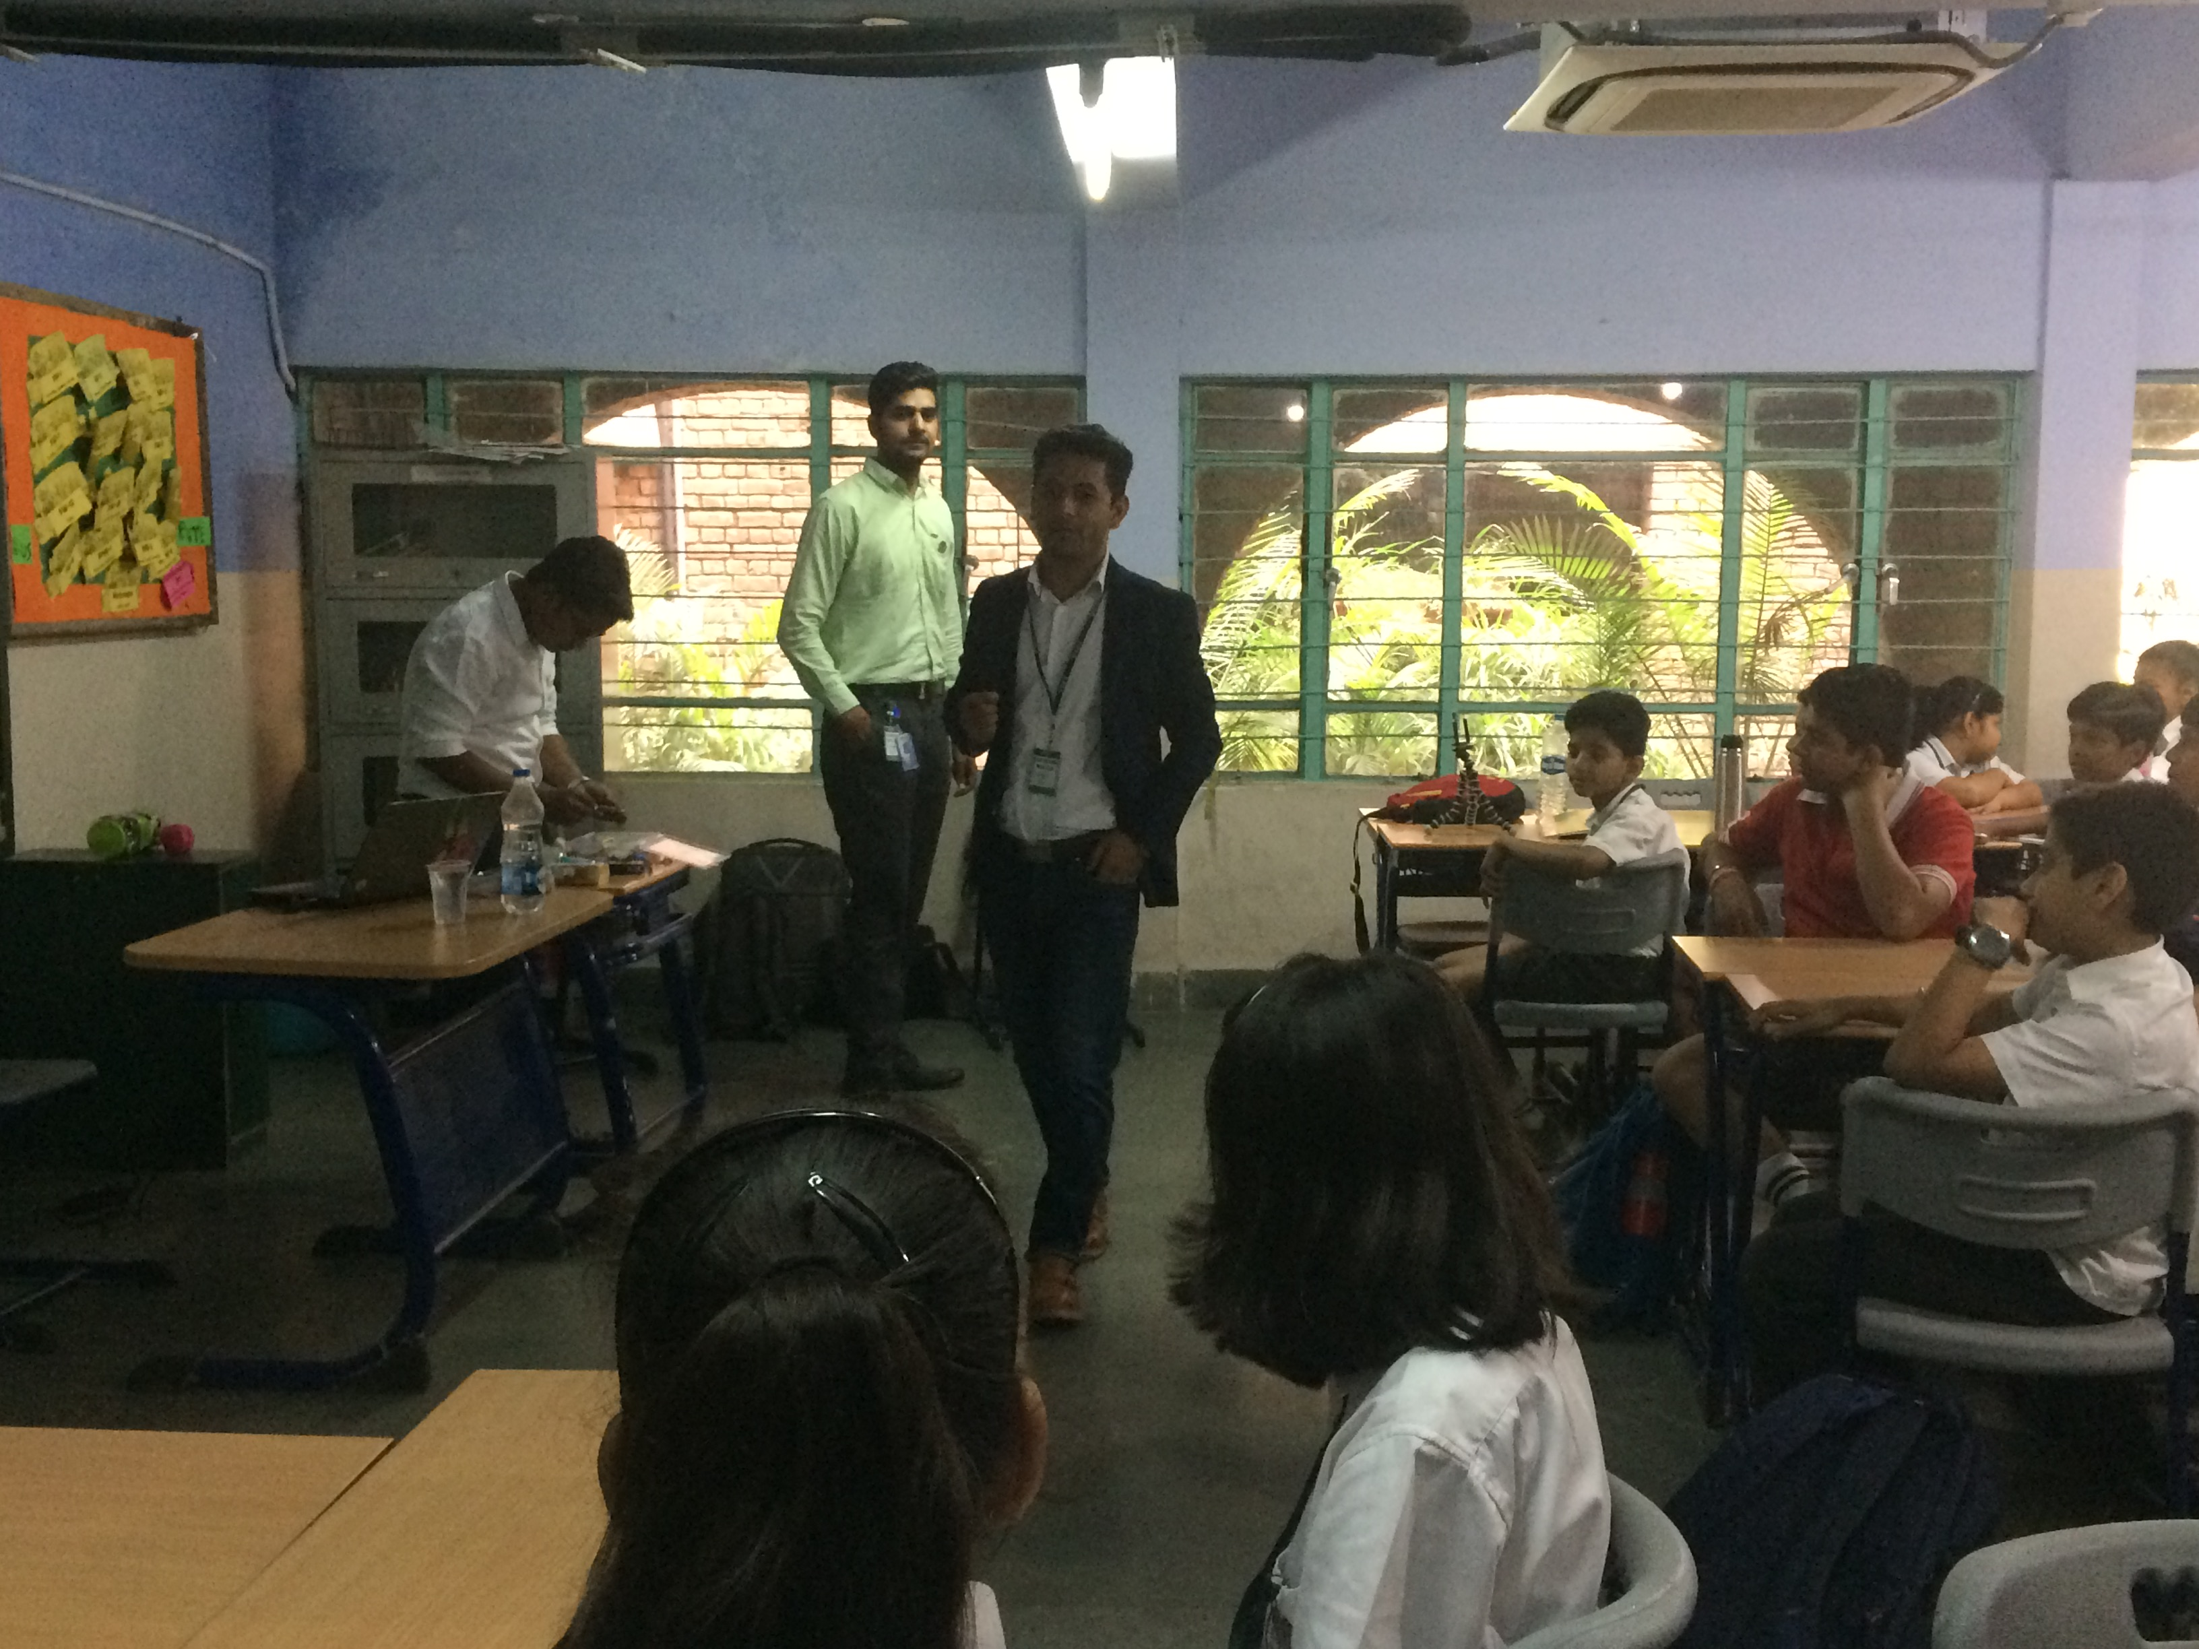
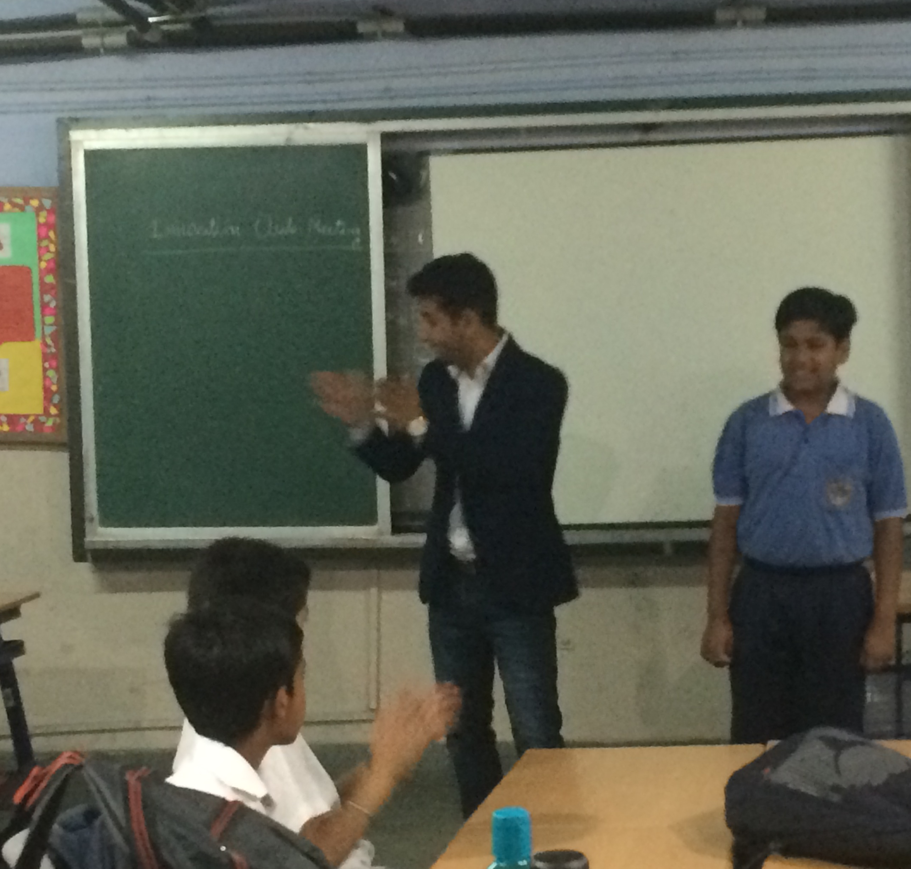
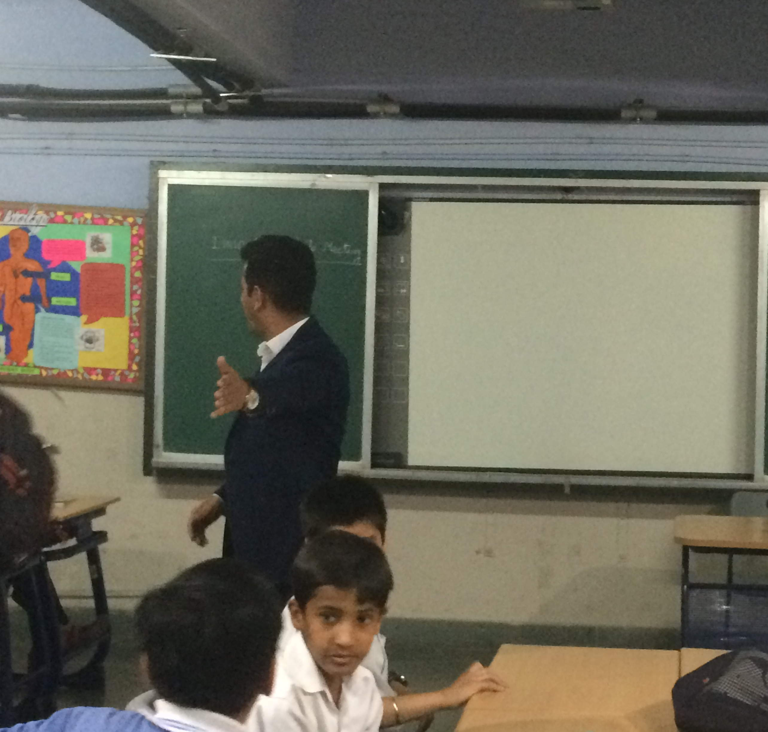
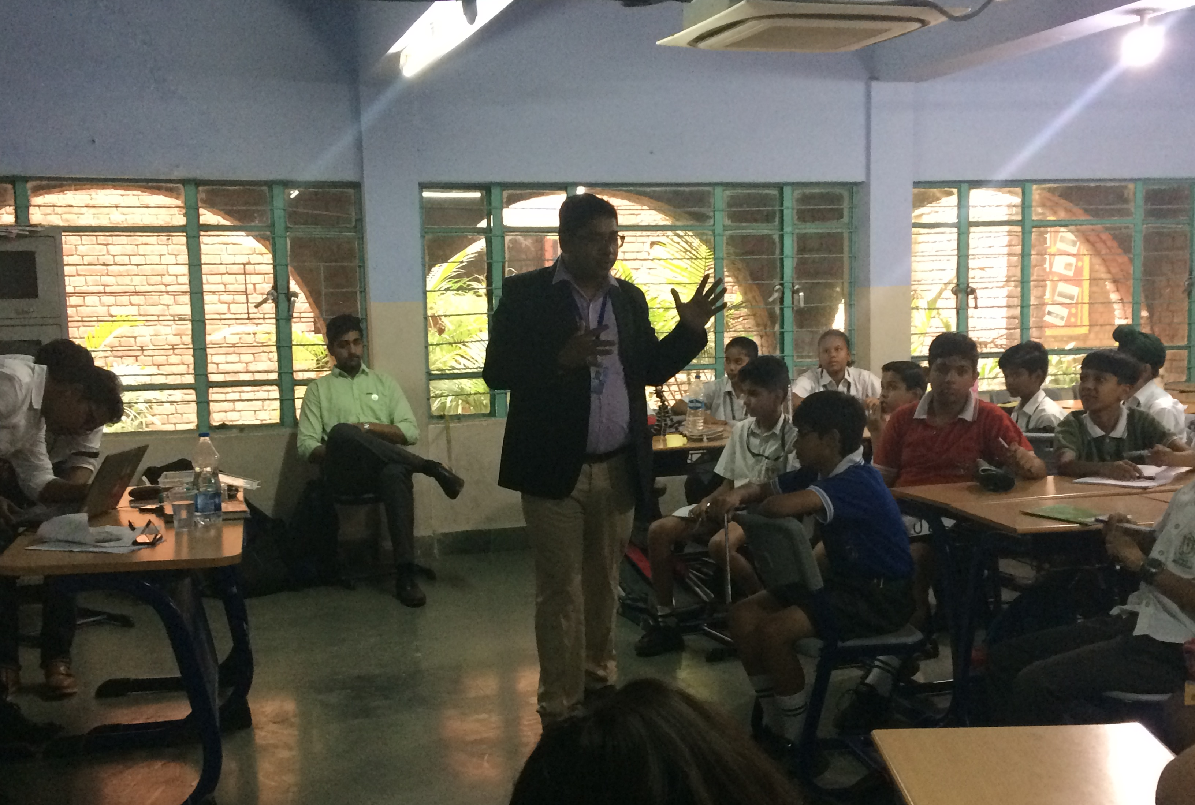
INNOVATION CLUB MEETS

Slide 4
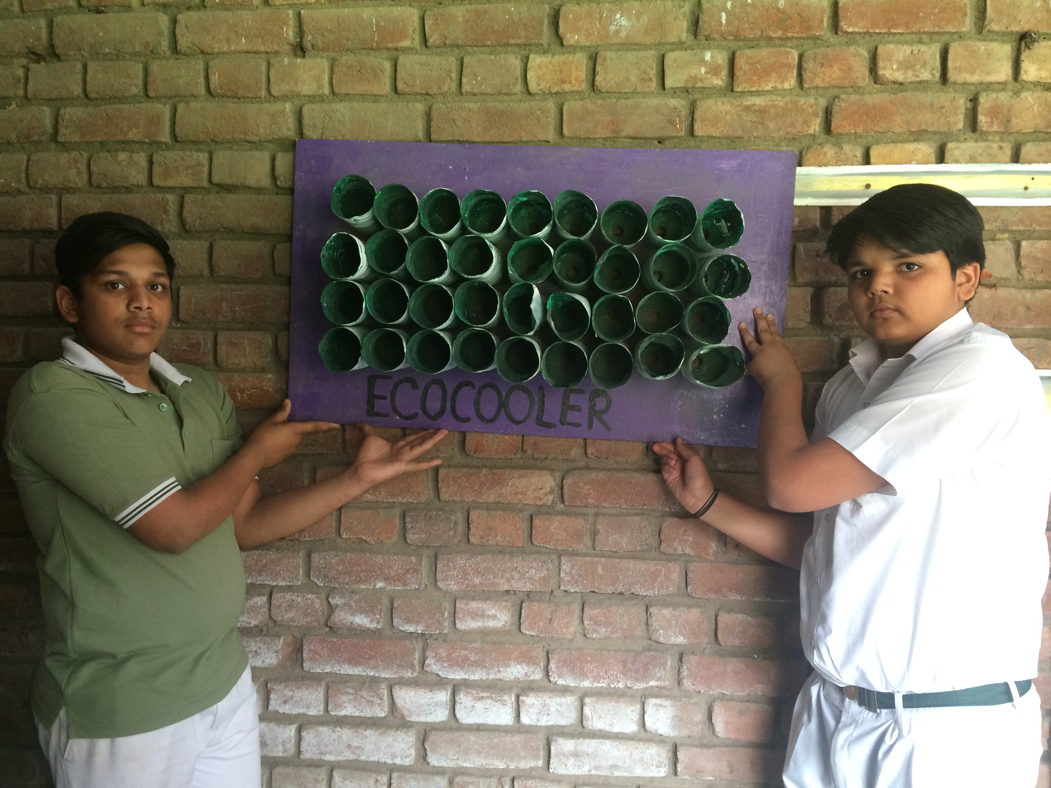
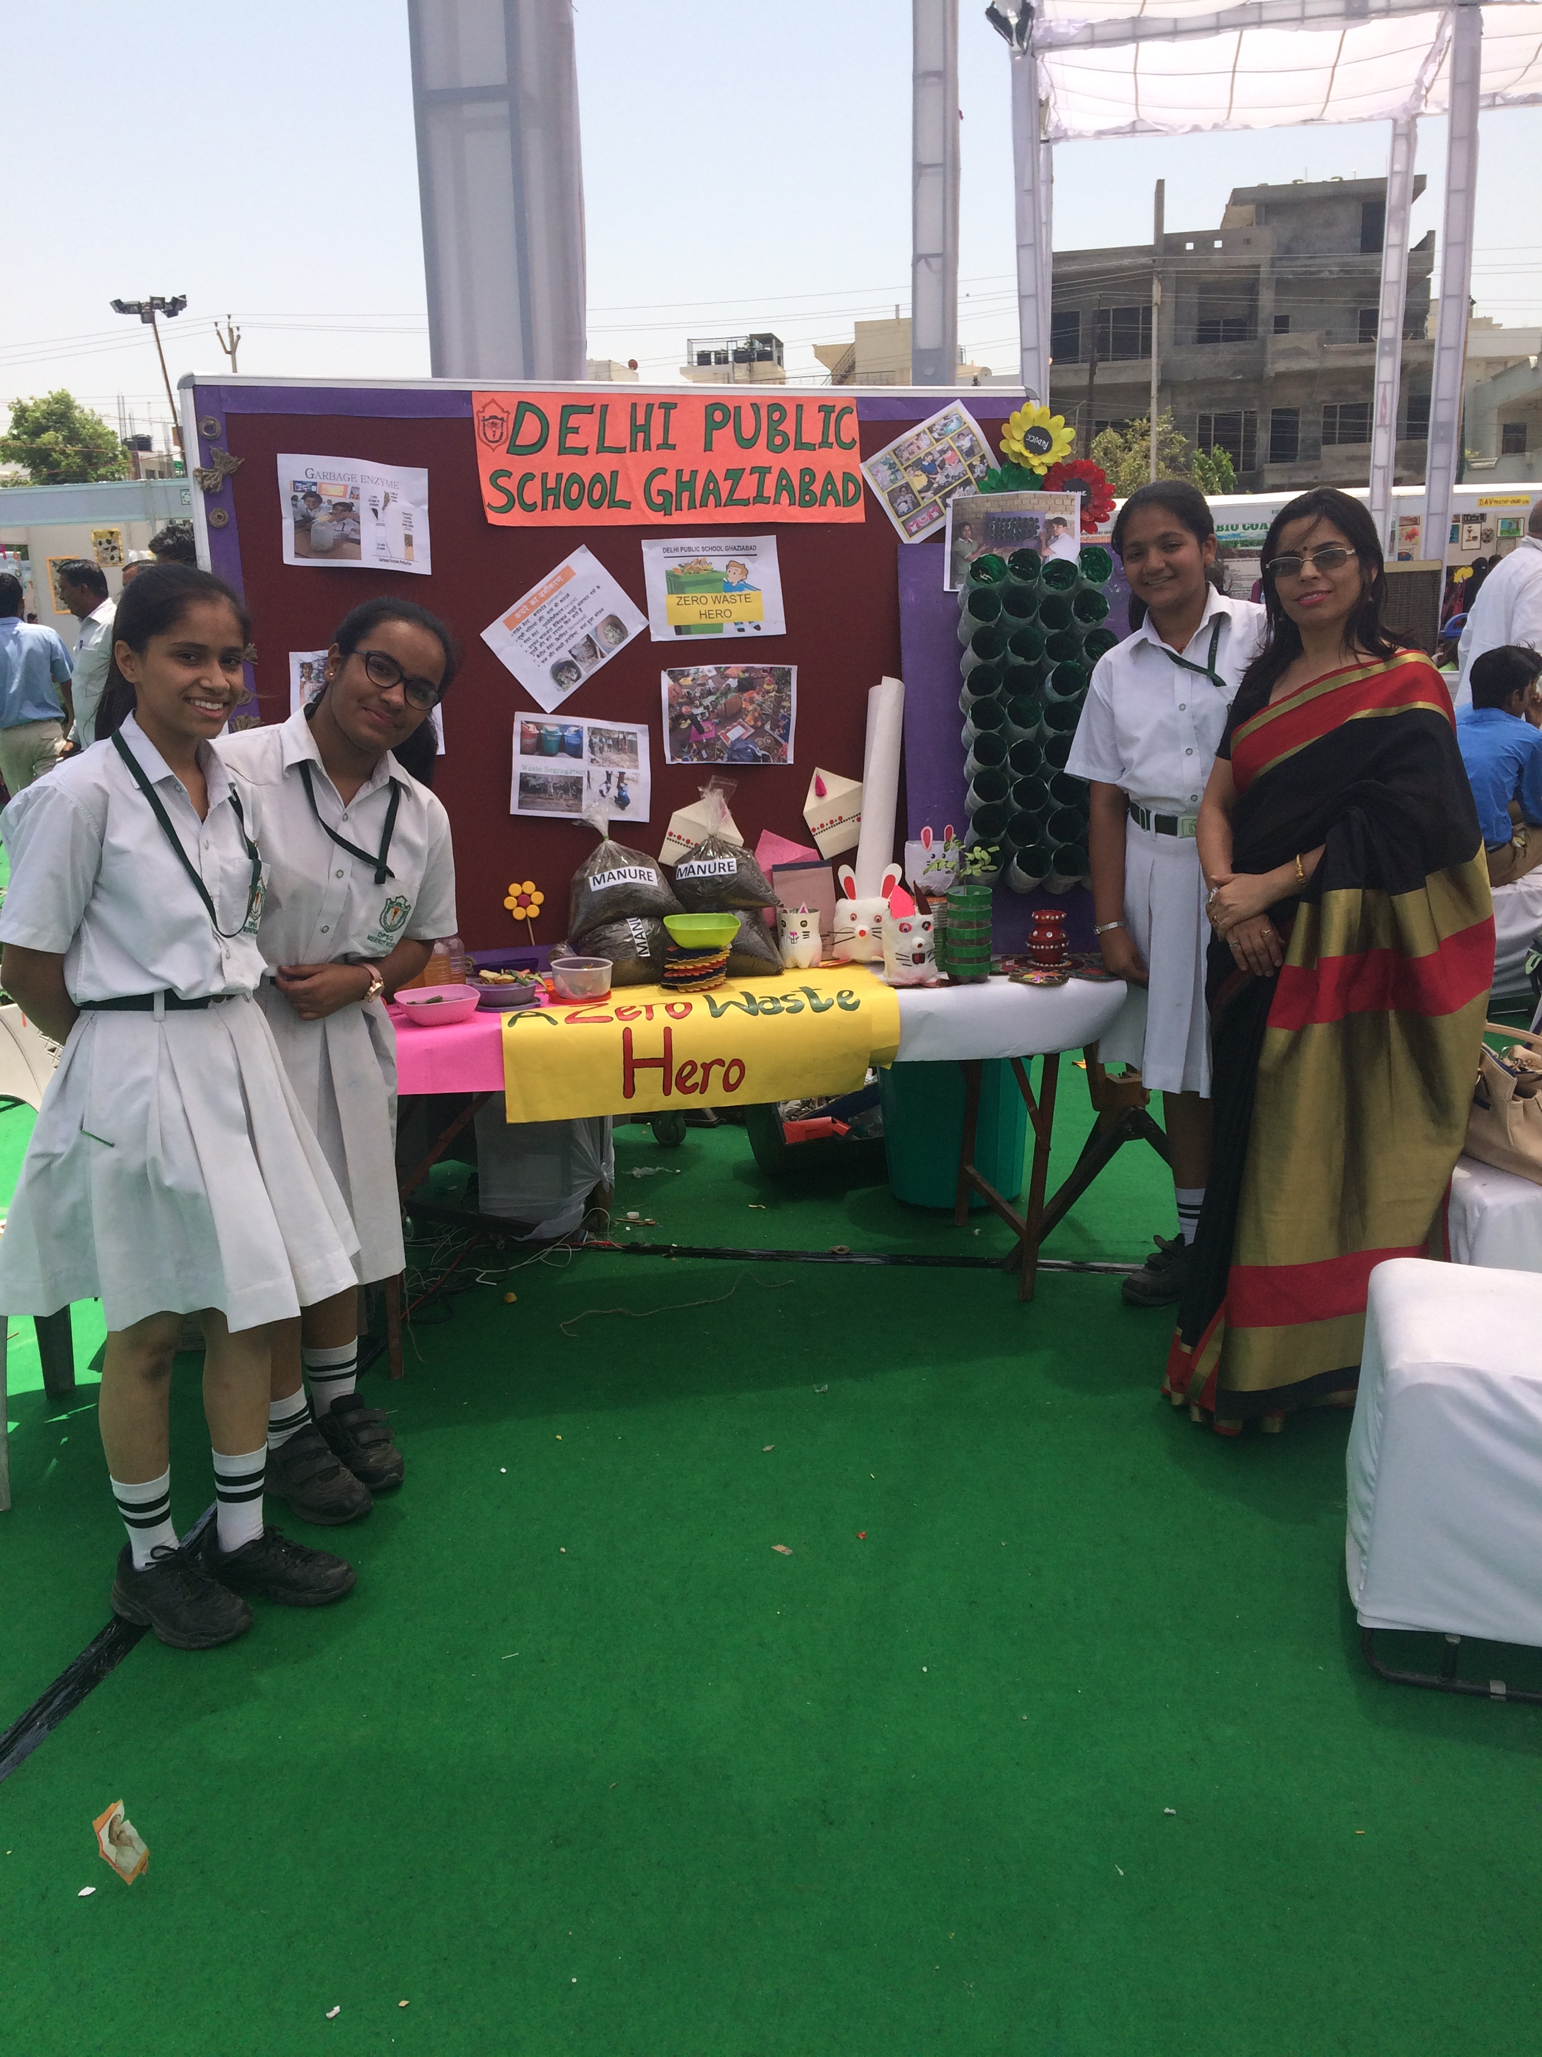
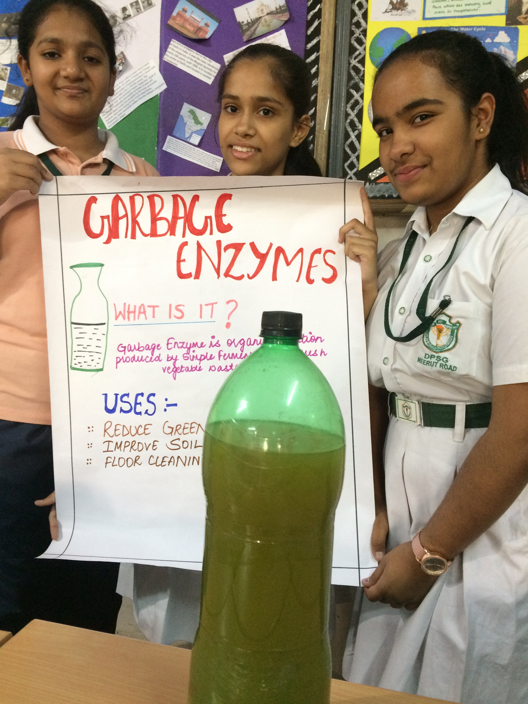
Innovation- Best out of waste
Garbage enzyme from fruit and
Vegetable Waste
Eco-cooler from waste bottles
Best Out of Waste

