Slide 1
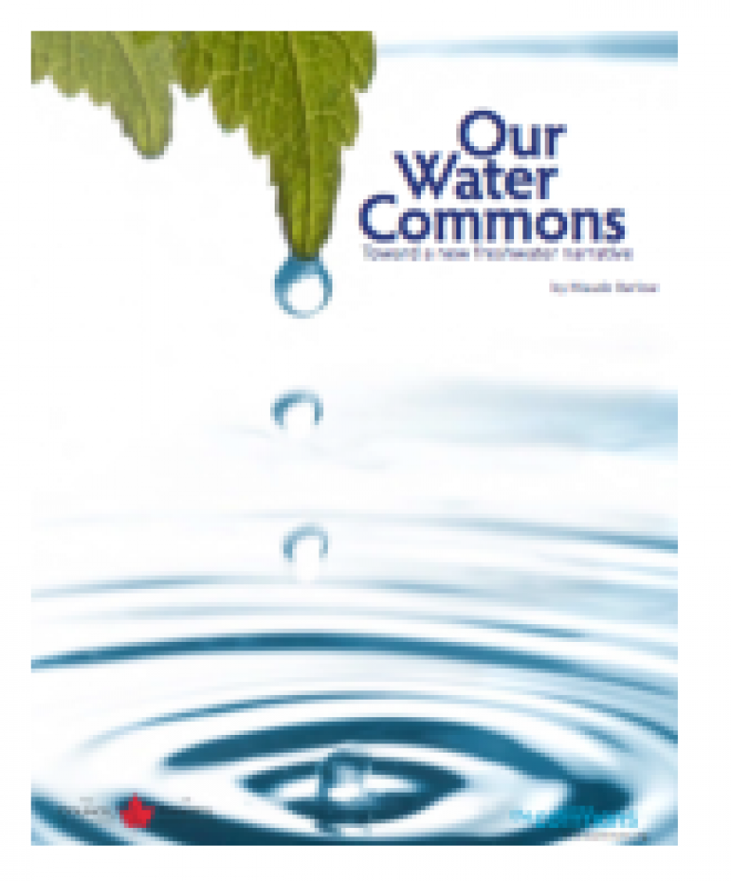
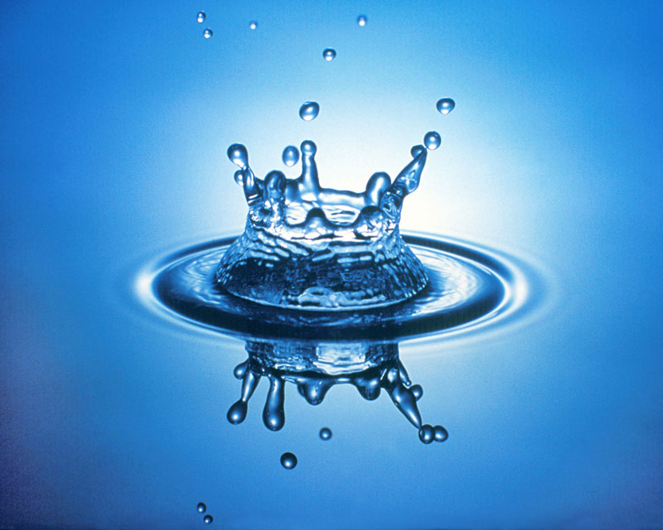
Clean water and sanitation
BY HASANPREET KAUR
This Photo by Unknown Author is licensed under CC BY-SA
This Photo by Unknown Author is licensed under CC BY-NC-SA

Slide 2
CLEAN WATER
CLEAN WATER
CLEAN WATER IS CRITICAL TO SURVIVE , ITS ABSENCE CAN IMPACT THE HEALTH , FOOD SECURITY AND LIVELIHOOD OF FAMILIES ACROSS THE WORLD
This Photo by Unknown Author is licensed under CC BY-NC-ND
This Photo by Unknown Author is licensed under CC BY-SA

Slide 3
SANITATION
THE PROCRSS OF KEEPING PLACES FREE FROM DIRT , INFECTION ETC. BY REMOVING WASTE AND GARBAGE BY CLEANING STREETS , SAFE DRINKING WATER ETC.
This Photo by Unknown Author is licensed under CC BY

Slide 4
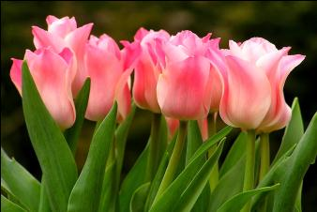
WHY IS SANITATION IMPORTANT ?
IMPROVING HEALTH
GOOD ECONOMIC INVESTMENT
GOOD SANITATION CAN PREVENT YOU FROM GETTING DIARRHOEA AND CAN ALSO HELP PREVENT OTHER SERIOUS DISEASES .
WHEN YOU PRATICE GOOD SANITATION , YOUR FROM FAMILY SAVES AND MONEY ON HEALTH CARE AND TREATMENT.
This Photo by Unknown Author is licensed under CC BY

Slide 5
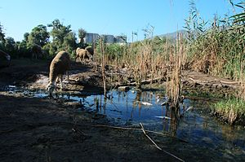
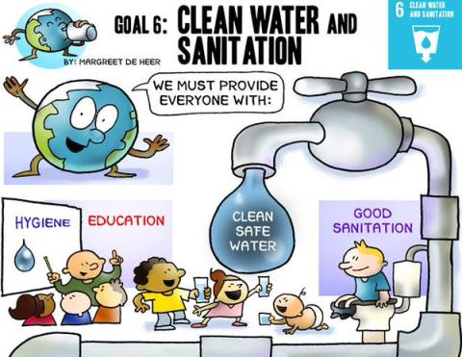
WATER AND SANITATION IN OUR WORLD
1.8 BILLION PEOPLE POLLUTED WATER AND POOR SANITATION PRATICES SPREAD DISEASES SUCH AS DIARRHOEA , CHLOERA ETC.

Slide 6
SAFE SANITATION IMPACTS ALL AREA OF LIFE
IMPROVING HEALTH
BETTER EDUCATION
SUMMARY
EVERY DAY 1000 CHILDREN DIE DUE TO DIARRHEAL DISEASES WHICH COULD BE PREVENTED BY IMPROVED WATER,SANITATION AND HEALTH
443 MILLION SICK DAYS ARE TAKEN BY CHILDREN EVERY YEAR DUE TO WASH RELATED DISEASES
SAFE SANITATION AND WATER IS VERY IMPORTANT IN WHOLE WORLD ,FOR US AND OUR FUTURE.

Slide 7
Thanks you

