Slide 1
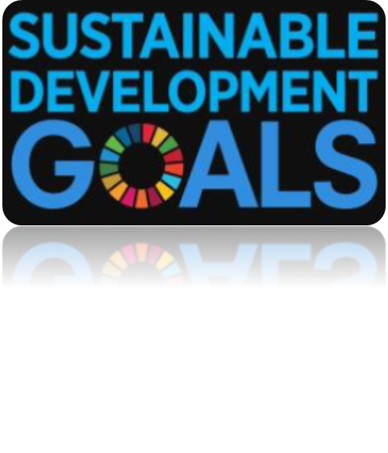
Welcome To Our Project!
The Global Goals For Sustainable Development.

Slide 2
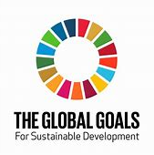
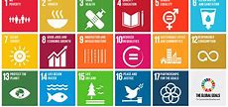
These Are The Global Goals For Sustainable Development:

Slide 3
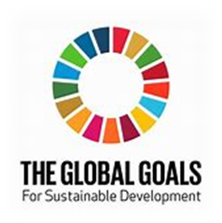
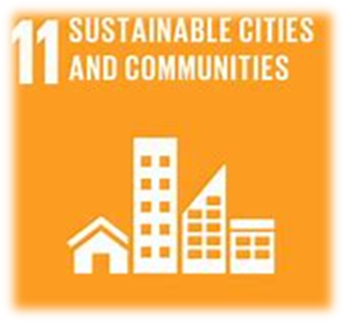
We Will Talk About
Sustainable Cities And Communities.
The Urban Cities In Our Country
Our Suggested Ideas To Help The Urban Cities Grow.

Slide 4
Hazem Magdy
Leader
Youssef Sherif
Co-Leader
Mohamed Ezz
Youssef Haitham
AbdAllah Reda
Youssef Mohamed
Mohamed AbdelFatah
AbdElrahman Mohamed
Mohamed Noureldin
Hussien Mahran
This Is Our Team:
The Group Members
Now Let’s Begin!

Slide 5
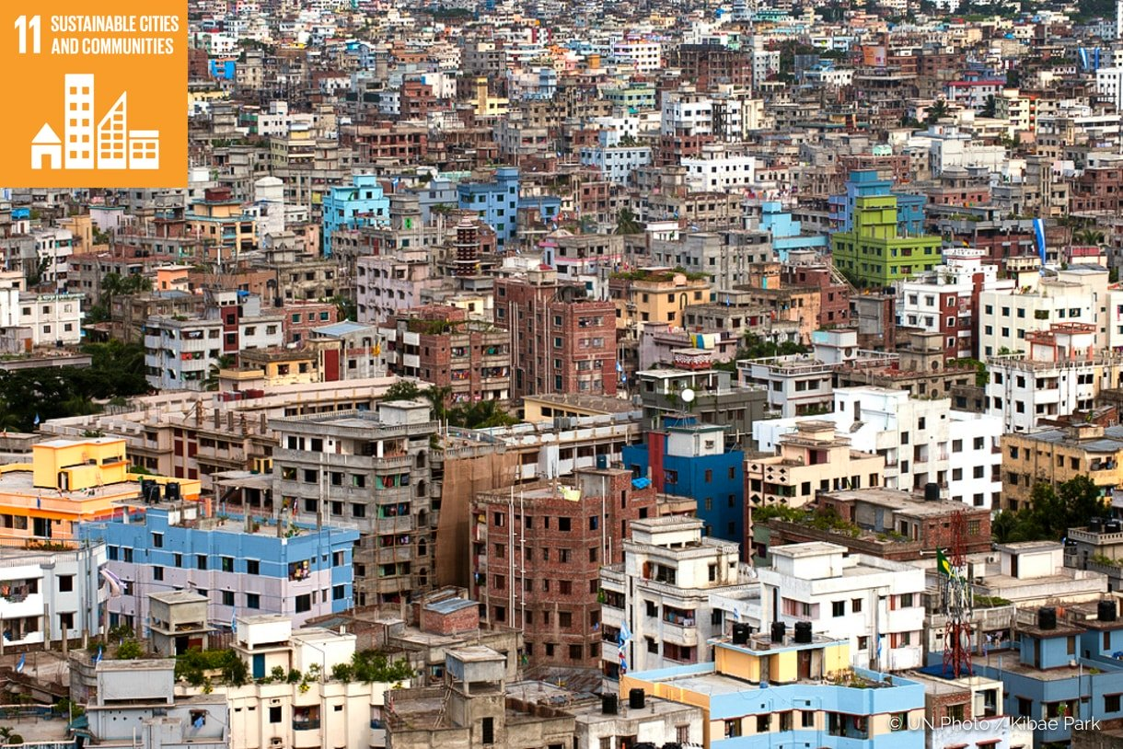
More than half of the world’s population now live in urban areas. By 2050, that figure will have risen to 6.5 billion people. Sustainable development cannot be achieved without significantly transforming the way we build and manage our urban spaces. The rapid growth of cities in the developing world, coupled with increasing rural to urban migration, has led to a boom in mega-cities. in 1990, there were ten mega-cities with 10 million inhabitants or more. In 2014, there are 28 mega-cities, home to a total 453 million people. A

Slide 6
Some Facts And Figures
By 2030, almost 60 per cent of the world’s population will live in urban areas.
95 per cent of urban expansion in the next decades will take place in developing world.
Half of humanity – 3.5 billion people – lives in cities today.
The world’s cities occupy just 3 per cent of the Earth’s land, but account for 60-80 per cent of energy consumption and 75 per cent of carbon emissions.
Rapid urbanization is exerting pressure on fresh water supplies, sewage, the living environment, and public health.
But the high density of cities can bring efficiency gains and technological innovation while reducing resource and energy consumption.

Slide 7
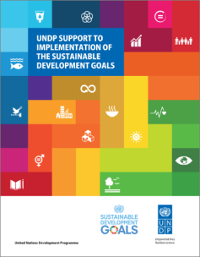
There is an imperative today to foster sustainable development. A vision for what this encapsulates is laid out in the new sustainable development agenda that aims to:
End Poverty
Promote prosperity.
People’s well-being while protecting the environment by 2030.
As the UN’s Development arm, UNDP has a key role to play in supporting countries to make this vision a reality:
Putting societies on a sustainable development pathway.
Managing risk.
Enhancing resilience and advancing prosperity.
Wellbeing.
UNDP has worked with the United Nations Development Group (UNDG) in developing a strategy for effective and coherent implementation support of the new sustainable development agenda under the acronym ‘MAPS’ (Mainstreaming, Acceleration, and Policy Support).

Slide 8
Now Lets See The Urban And Most Important Cities In Egypt!
New Administrative Capital
Dar Misr
The Golden Triangle

Slide 9
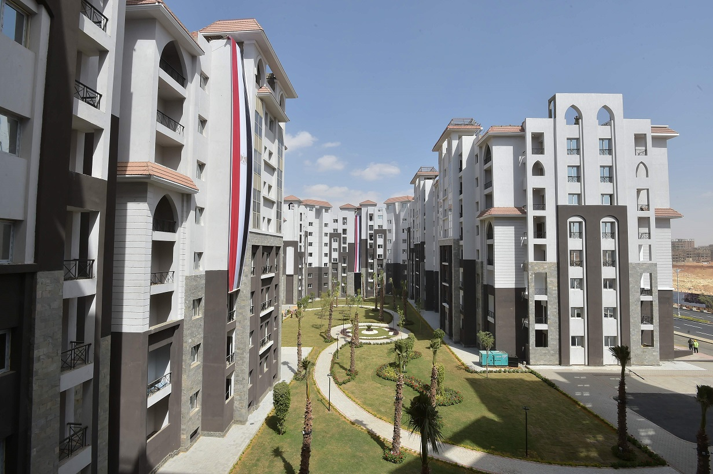
The New Administrative Capital
The mega-project, announced in March 2015, is part of the government’s plan to expand urban areas to deal with the country's rapid population growth rate and improve the nation's infrastructure.

Slide 10
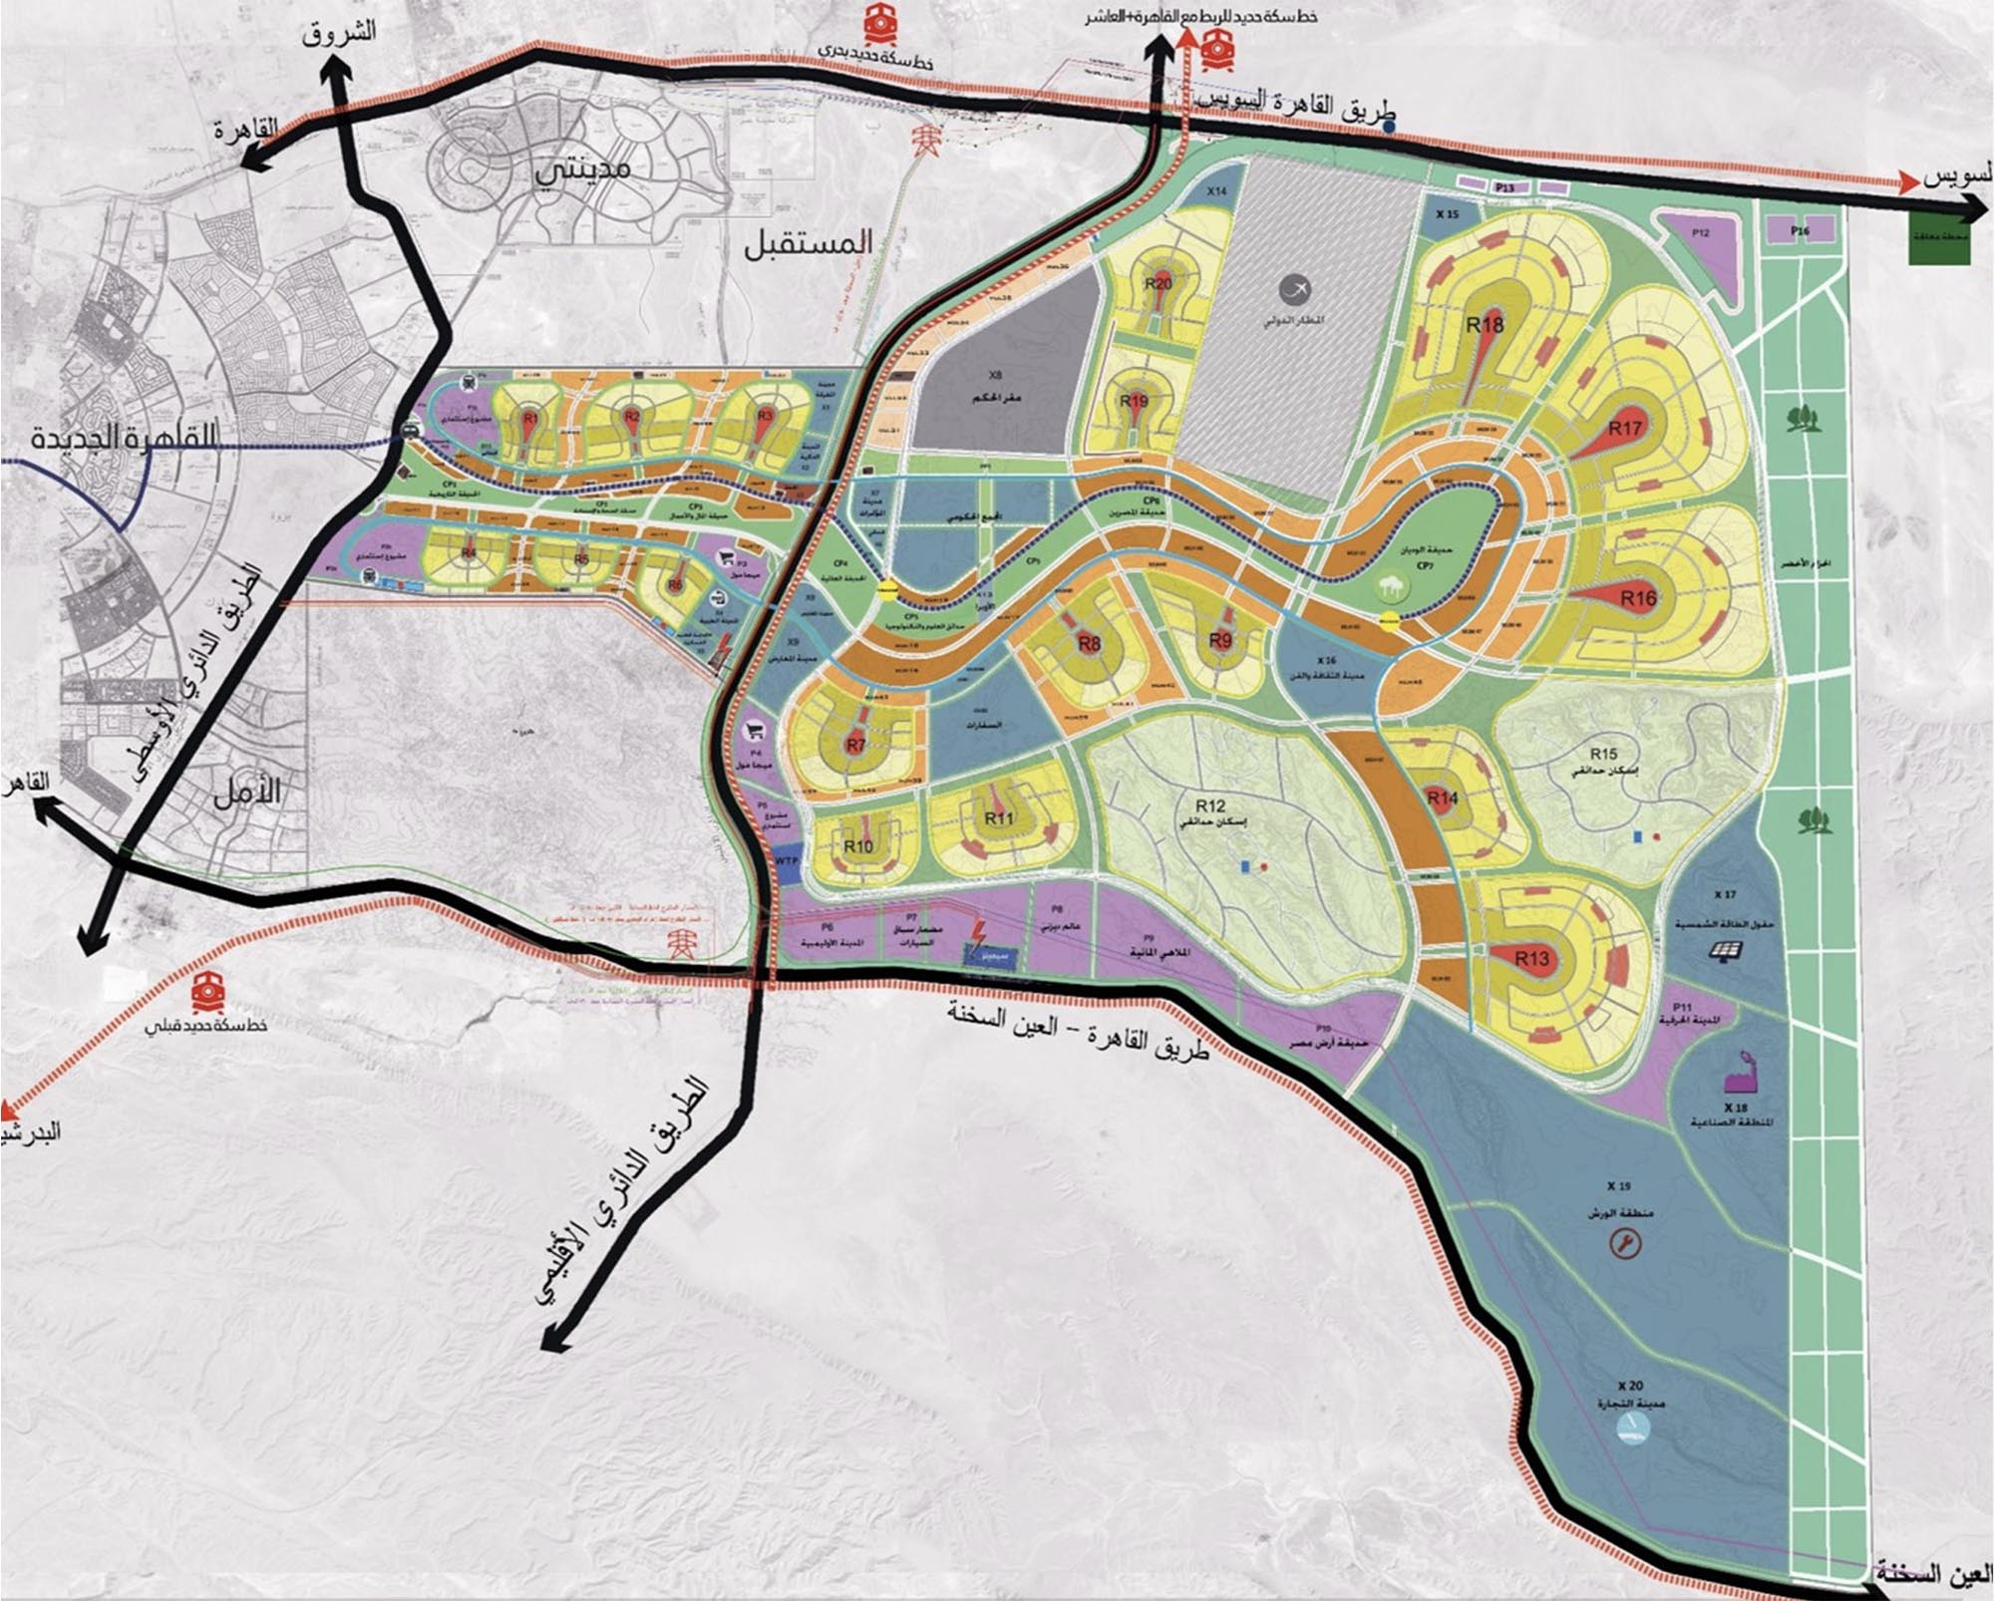
THE NEW CAPITAL
Located 40km to the east of Cairo, the new capital is intended to draw a population of 7 million people in its first phase.

Slide 11
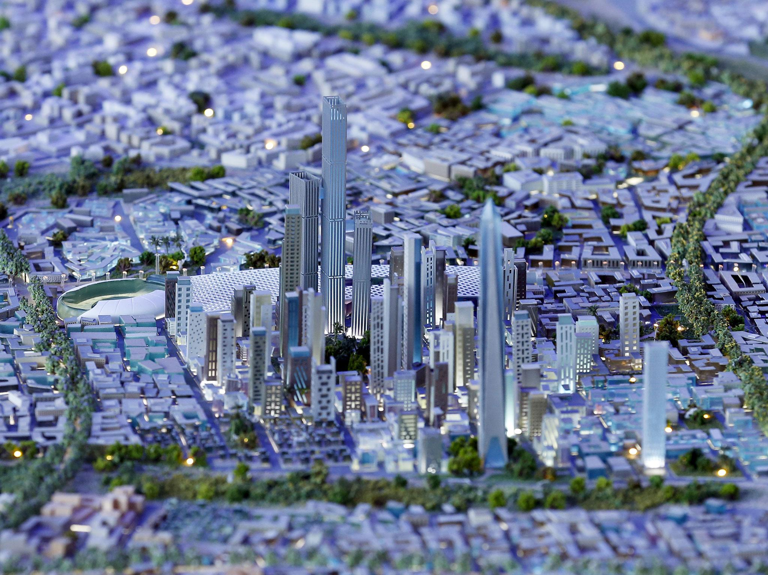
The city will also be a home to an international airport, public gardens and parks that total 35 square kilometer and a residential district offering a total of over 23,000 units.
There will be an office park of skyscrapers that will house a 345 meter-long high-rise, the tallest in Africa.

Slide 12
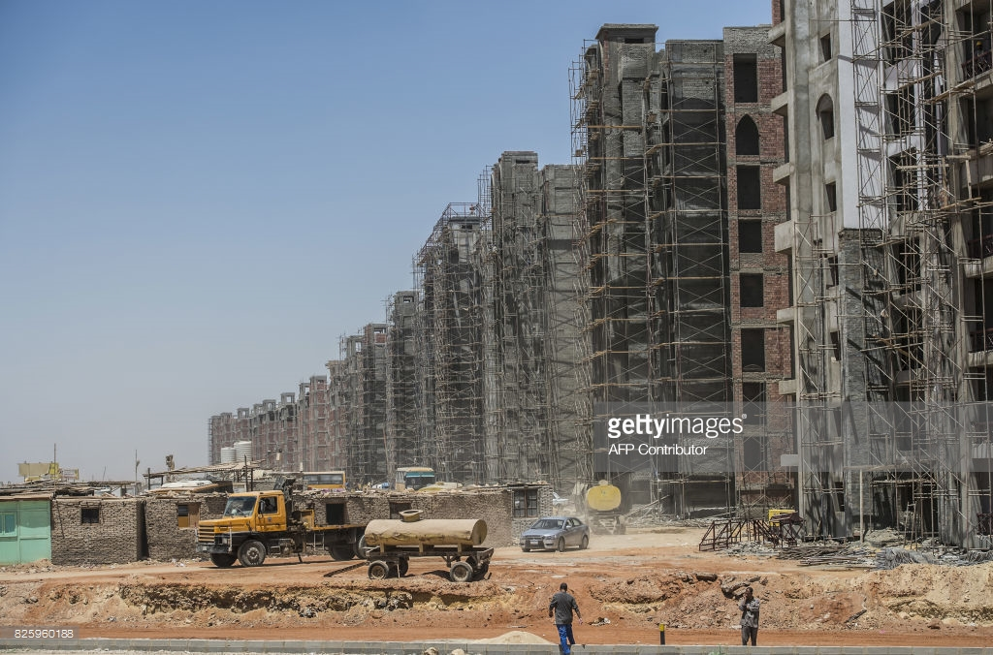
The new capital will offer homes for youth, low-income people as well as high-income brackets across 20 residential neighborhoods that will accommodate 6.5 million people, The government has started building 25,000 residential units so far.

Slide 13
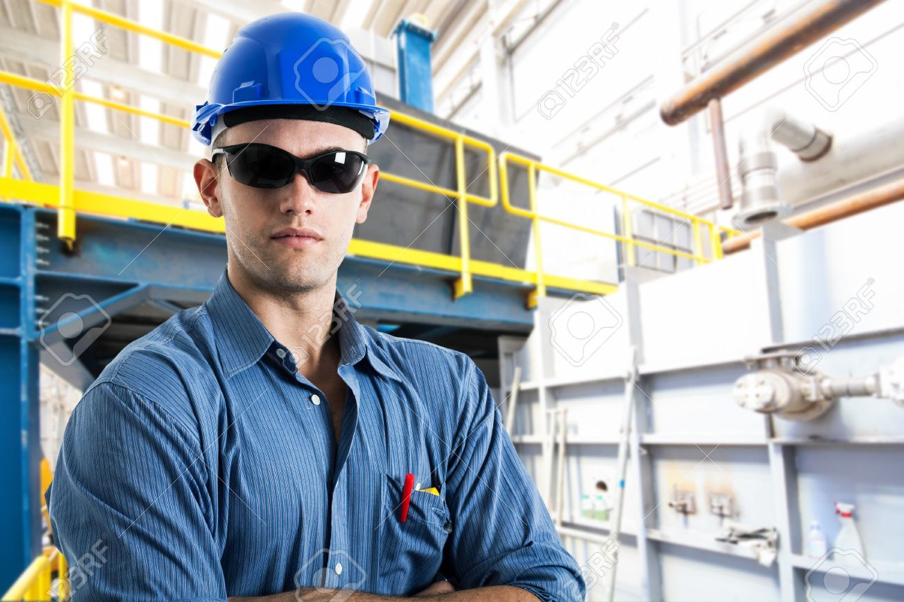
A main developer behind the project is the Armed Forces Engineering Authority and many of our national companies.
The ministries will start moving to the new city in 2018, with residents expecting to arrive at the same time.
The project is set to be completed in 2020.

Slide 14
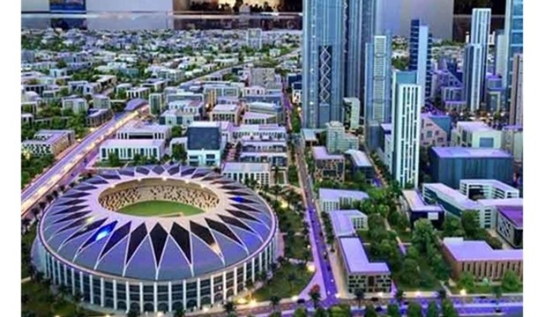
provide Various models of housing programs to meet the growing demand for urban urbanization on the one hand, and to reduce the negative effects of unplanned urban growth on the other and provide integrated services and quality of life for middle-level

Slide 15
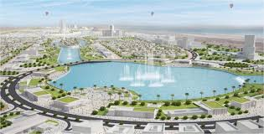
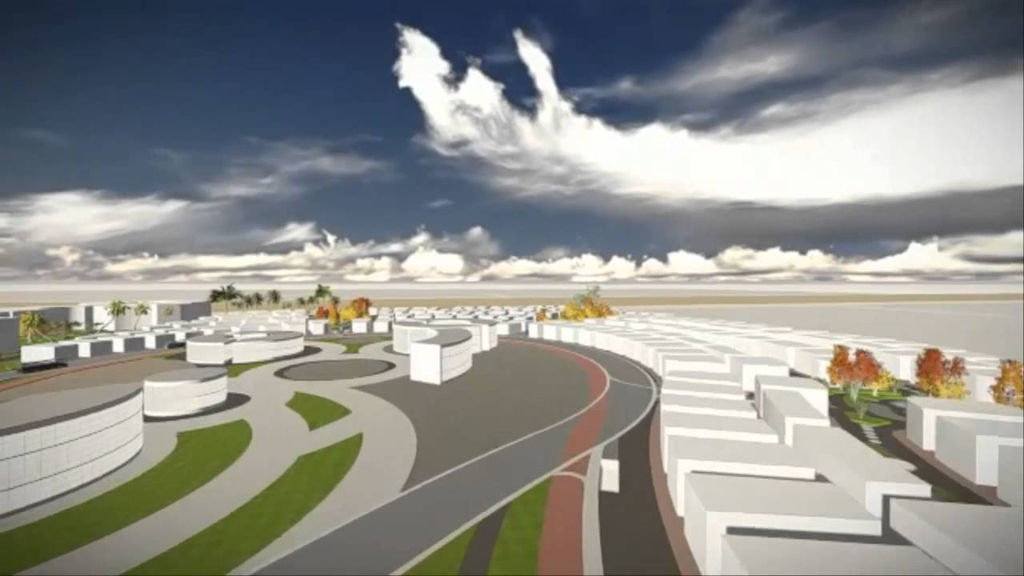
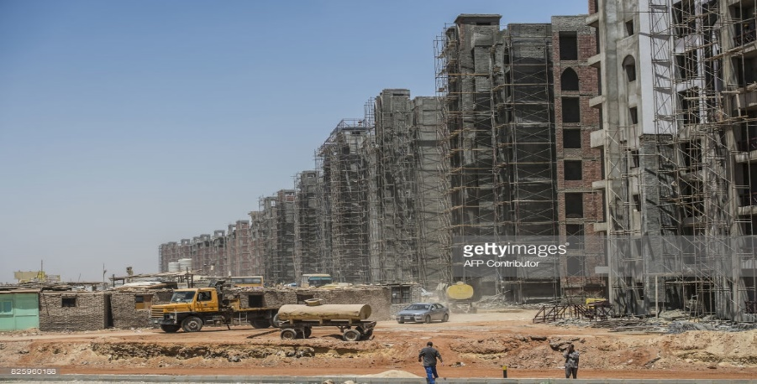
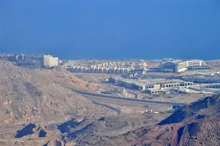
Implementation of a total of 31872 units in 8 cities: New Cairo-Sadat – 10th of Ramadan-Badr-Damietta New-Sunrise-6th of October-Transit

Slide 16
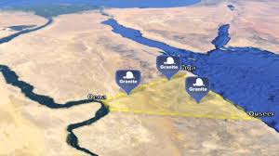
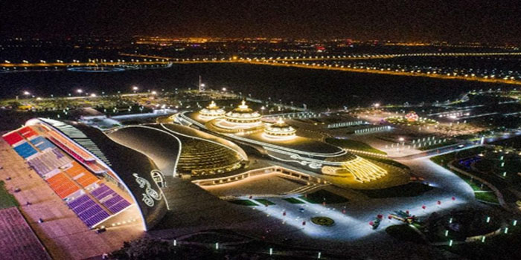
The Golden Triangle
The Golden Triangle Project is located in the enclave between Qena counties from the western side and the Red Sea from the eastern side, the city of Safaga north and the short south, where the total area of development is estimated at about 1.5 million acres.
Creation of a new economic zone in Egypt, through the creation of an integrated global center.
It serves Egypt, Africa and all parts of the world to achieve sustainable development in the region and drive development in its various cities.
It provides large investments and significant employment opportunities for the people in particular and the National people in general in all disciplines.

Slide 17
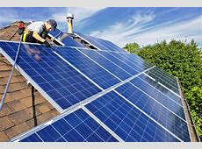
Our Suggestions For Development For The Sustainable Cities
Convert The Old Cities Into Sustainable Cities by:
Add More Green Fields To The Cities.
Use The Clean Energy For Generating Energy [Like Solar Energy]
Use Clean Filterlization For Automobile Exhaust.
The Expanding In The City’s Buildings.
Build More Sustainable Cities To:
Provide Funding .
Create Services For The Youth.

Slide 18
Special Thanks To
MRS/Soheir Zaki
And All The Group Members

Slide 19
THANK YOU
Victory College
Preparatory Department

