Slide 1
Gender equality
Empower women and make them equal to men.
Goal 5.8 : Enhance the use of enabling technology, in particular information and communications technology, to promote the empowerment of women
Notes:
2B, Disha Sheth, Arianna Bohara, Polina Letova

Slide 2
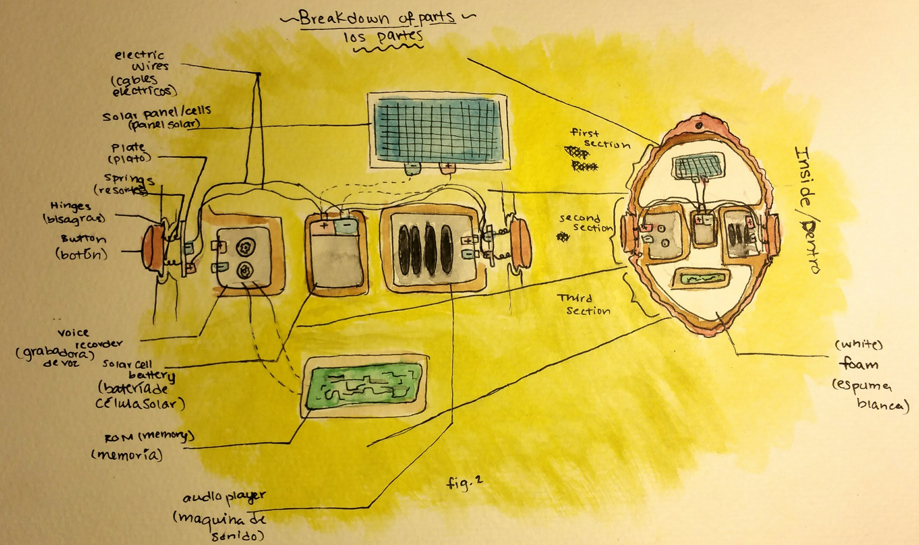
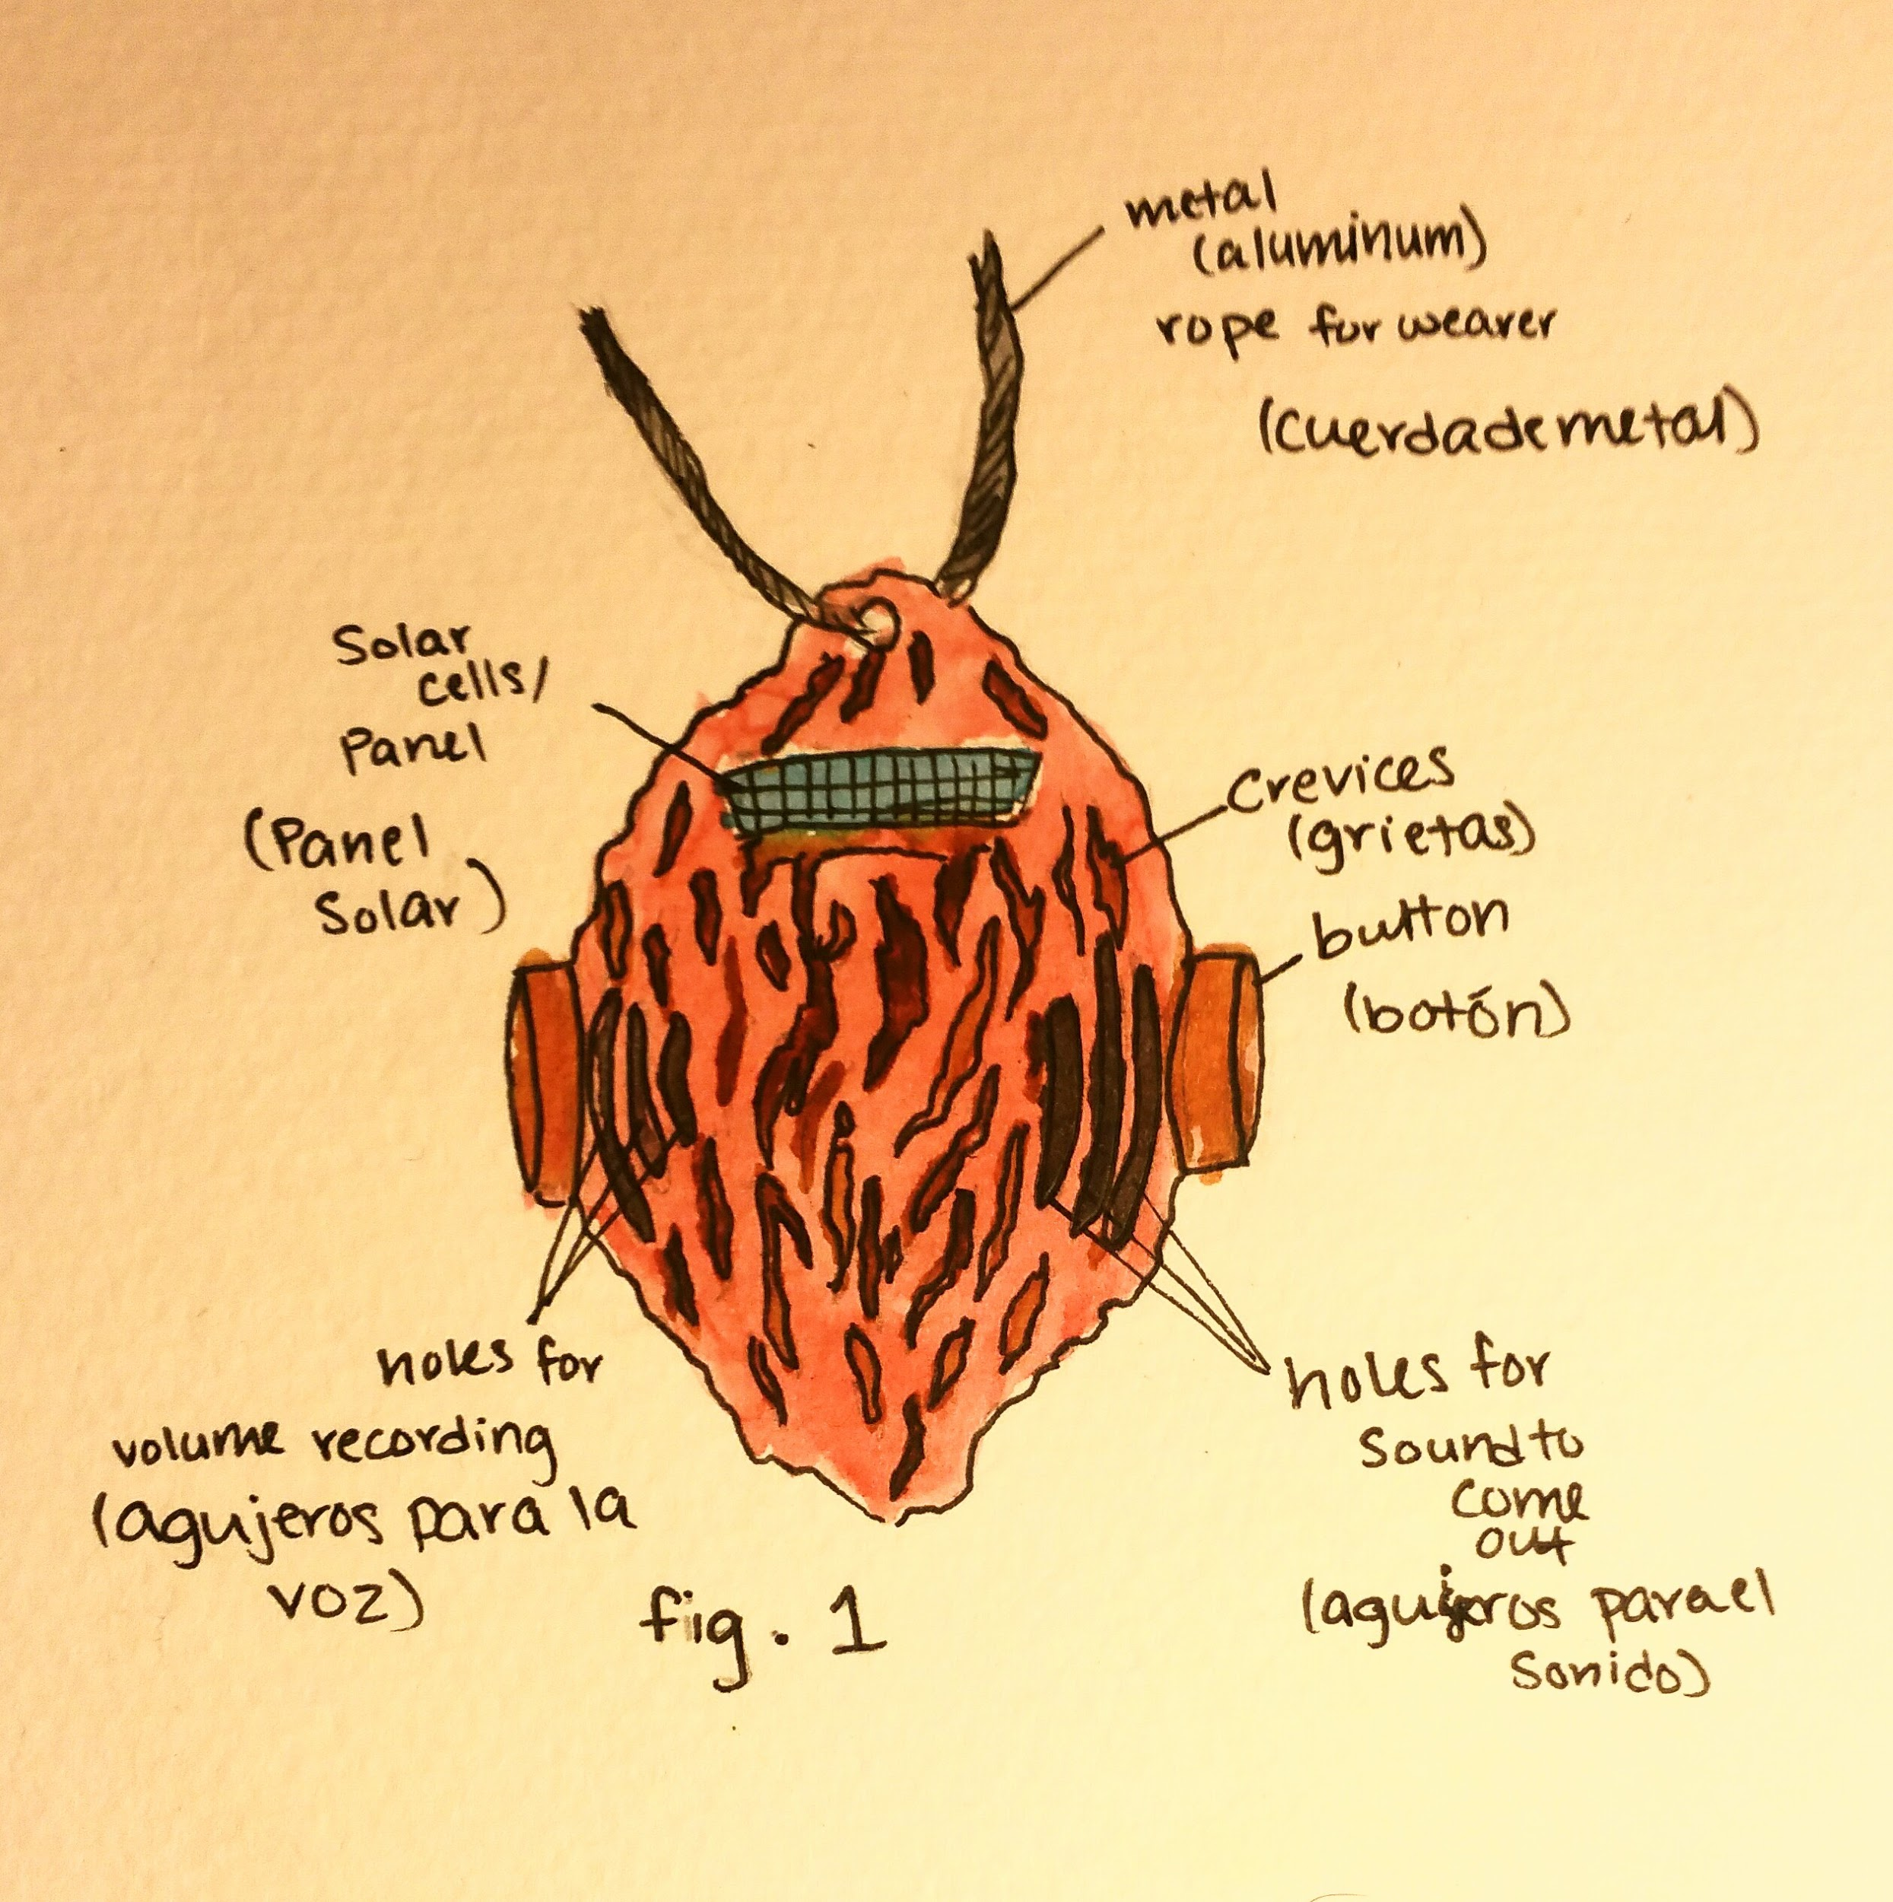
Preview of The Solution:
Safety Necklace

Slide 3
Essential Question
How can we convince governments to change their policies that limit female empowerment in society and schools (in the education system)?

Slide 4
The Challenge
Men continue a cycle of only men with power in government.
Parents want girls helping in the house and not learning in school.

Slide 5
How can women feel safe in their community?
What recyclable electronics can be used to help women?
How can the status of women be raised in government?
Where do women need the most help today?
What is keeping the status of women behind men?
What ideas can the nature not impacted by humans give us?
The Challenge-
Guiding Questions
The underdeveloped countries can not use too much help from developed countries and become a burden.
Women around the world need to know what rights they have and that their status is not below a man.
The amount of recycled material available may not be enough to keep everyone safe.
The Challenge-
Guiding Activities
“Female leadership is all about the economy”:
https://www.usnews.com/news/best-countries/articles/2016-11-07/under-female-leadership-it-is-all-about-the-economy
Rape has gone down:
https://www.motherjones.com/kevin-drum/2014/12/rape-way-down-over-past-two-decades-so-all-violent-crime/
The Challenge-
Guiding Resources

Slide 6
Partner School(s)
Steve Sostak- China

Slide 7
Reflection Gallery
All women should feel safe with a device that can alarm everyone around them and have evidence with the DNA or voice of a attacker. We need to keep the levels of rape down and the help women get from other people up with the innovation.

Slide 8
The Solution
We created a prototype necklace that uses an alarming system to sound out to everyone around the woman and record the attacker. If they try to take away the necklace and do not succeed, their DNA should get stuck on it. If we do this, the empowerment of women and their self esteem can go up.

Slide 9
The Solution/Implementation- Evidence Gallery
http://www.unwomen.org/en/what-we-do/ending-violence-against-women/prevention
https://newrepublic.com/article/119436/how-stop-domestic-violence-experts-offer-5-steps-policymakers
The two websites show how we can prevent abuse and statistics on how the rates of female abuse is down.

Slide 10
The Solution/Implementation- Evidence Gallery 2
With the necklace to control how much men will try to abuse women, female empowerment will go up. Additionally if little cracks in the prototype are built in, the DNA of the abuser can be caught in it and turned into the police. If the women become more comfortable with the police handling a case, the community will become even more connected as one.

Slide 11
The Solution/Implementation- Evidence Gallery 3
With the fear of men with the government and police involved with the negative impact they create in society, they learn to stop harassing others. If adult men can learn to stop abusing women, they will teach their kids not to hurt women and a cycle of no abuse will start, and one day we will not need technology to stop abuse because there will be none.

Slide 12
Reflection Gallery 2
When women have more respect from men in the community, they have a higher self esteem and potential for a bigger position in the government. With more time, the equality of women will be completely equal to men.

