Slide 1
The challenges that china IS facing in the next decade
AISG HS EAL BLOCK E

Slide 2
High school students were asked, "What are the challenges China will face in the next Decade?"
Climate change
Air pollution
Embracing other cultures
Censorship (social media, movies, television, newspapers)
Ability to qualify for college admission
What to do with plastic
Rebellion in response to censorship
Gender imbalance

Slide 3
After discussing, our class decided to focus on
AIR
POLLUTION

Slide 4
Overview of the main sources of air pollution
Transportation
Factories/Industry
Fossil fuels

Slide 5
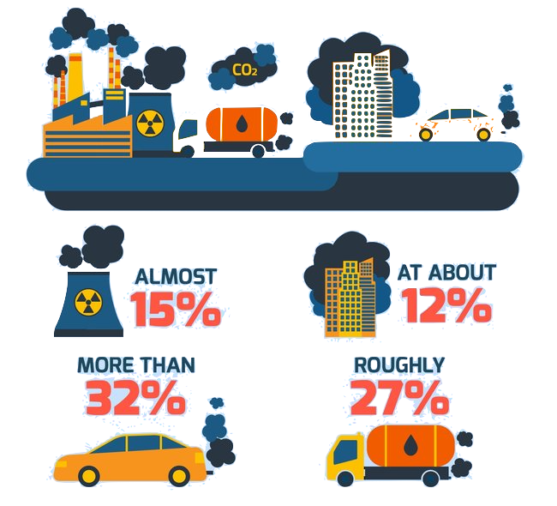
Transportation
Problem
Possible Solutions
In 2013, transportation contributed more than half of the carbon monoxide and nitrogen oxides, and almost a quarter of the hydrocarbons emitted into our air.
Li Keqiang suggested that China is rolling out the world's biggest investment in wind and solar power to reduce coal.
Be ecofriendly
Travel by bikes
Notes:
Katheen denise vicky

Slide 6
Industrial/Factory Pollution
Lack of effective policies and poor enforcement allows many companies to bypass the law
Inefficient waste disposal causes water pollution and soil pollution
Use of outdated technology to avoid high cost of new technology or equipment
Industries require lots of raw materials from nature to make products

Slide 7
Possible Solution for Industrial/Factory Pollution Problem
Some national and state or international policies can be used to control factories making air pollution. Many cities and countries that were once heavily polluted have substantially attained clean air mainly due to the institutionalization of anti-pollution laws for factories.

Slide 8
Burning Fossil Fuels
Fossil fuels are hydrocarbons, primarily coal, fuel oil or natural gas, formed from the remains of dead plants and animals.
China emits about 13% of the world's carbon by burning fossil fuels

Slide 9
Possible Solution for Burning Fossil Fuel
In order to solve the problem of burning fossil fuel, decrease the amount of carbon dioxide. As we solve, us humans have to work on two different problems.
First, it is the use of natural gases and LP gases which are the resources that have less rate of carbon dioxide compared to fossil fuels and coals.
Next, to have more process of respiration (which is the process to change carbon dioxide to oxygen), we will have to make less deforestation which increases the capacity of the holding carbon dioxide in the forests.

Slide 10
Now what?
According to Earth Eclipse "Solving the air pollution problem requires joint effort and takes different ways from one region to another. For example, it primarily requires behavior change and institutionalization of measures that can considerably reform the situation in the short-term and the long-term."

Slide 11
Works Cited
“5 Brilliant Solutions to Air Pollution.” Earth Eclipse, 23 Mar. 2016, www.eartheclipse.com/pollution/brilliant-solutions-to-air-pollution.html
"China's Strengthened Pollution Laws Yield Results." China Daily, 5 Sept. 2017, http://www.chinadaily.com.cn/china/2017-09/05/content_31602351.htm
"Climate Change in East Asia Caused by China's Air. "South China Morning Post, 8 Sept. 2016, http://www.scmp.com/news/china/policies-politics/article/2017595/climate-change-east-asia-caused-chinas-air-pollution
"Environmental Consequences of Rising Energy Use in China." 1 Dec. 2005,
https://www.brookings.edu/research/environmental-consequences-of-rising-energy-use-in-china/

