Slide 1
The ınnovatıon project week: 1
Ahmet Erdem Anatolian High School
Bursa, Turkey

Slide 2
Whıch ınnovatıons are making cities more sustainable ?
When we mention about making a city more sustainable, the first thing to think is make the energy we use reuseable. And nowadays, there are lots of innovations on it. Making people’s life easier would also make a big difference in prosperity of the city.
In this presentation, I’ll demonstrate some of the innovations making cities more sustainable and write about the innovations we need in where I live.

Slide 3
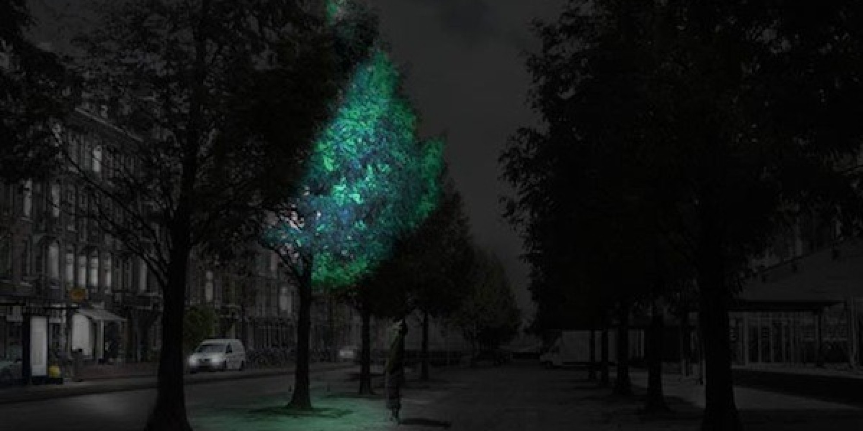
Glow in the dark trees
This biomimicry technology attempts to create a self sufficient and self sustaining source of street light in our urban environments which would reduce the need for the electricity powering artificial streetlights.
The idea behind glow in the dark trees is to harness the luminescent bacteria found in many marine species and apply it to urban flora. The technology is still in the development stages but would have tremendous sustainability benefits for our cities by increasing green space and decreasing the need for electricity.

Slide 4
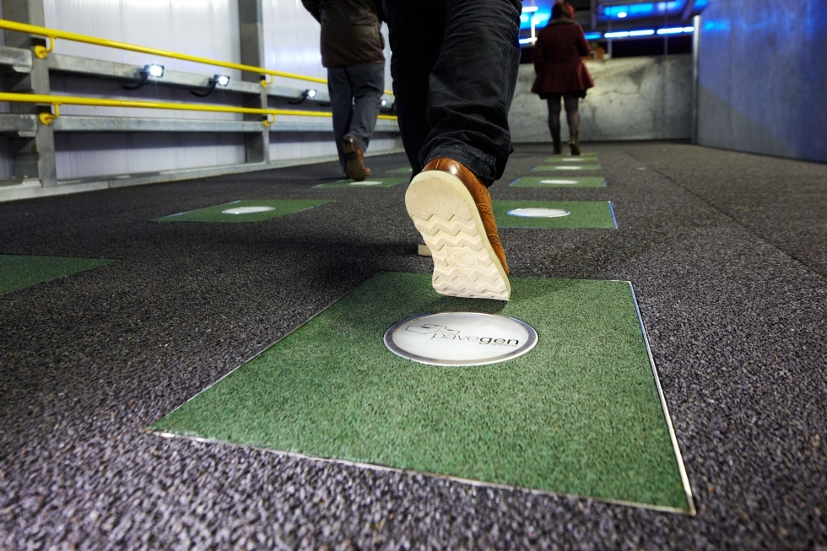
Foot TraffIc Electrıcıty
The mass of foot traffic in cities has the potential to be a valuable energy source. The idea behind foot traffic electricity is to install "springy" tiles that that are sensitive to movement and flex underfoot. These tiles harness the kinetic energy in foot traffic and use it to generate electricity. This innovative technology has found a way to use the renewable
energy of human movement and has been
Installed in London’s Heathrow airport
as well as other locations.

Slide 5
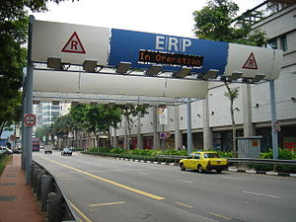
Electronic Road PrIcIng
The Electronic Road Pricing (ERP) system is an electronic toll collection scheme adopted in Singapore to manage traffic by way of road pricing, and as a usage-based taxation mechanism to complement the purchase-based Certificate of Entitlement system. The ERP was implemented by the Land Transport Authority in September 1998 to replace the Singapore Area Licensing Scheme after successfully stress-testing the system with vehicles running at high speed. Singapore was the first city in the world to implement an electronic road toll collection system for purposes of congestion pricing. The system uses open road tolling; vehicles do not stop or slow down to pay tolls.

Slide 6
Flowers that suck up smog
Engineers have developed a flower that could have the capability to suck up large amounts of smog. This new type of honeysuckle was created in Amsterdam with enhanced features so that it could absorb particle matter. The "Green Junkie" has more tiny hairs on it than the original honeysuckle, which allows it to pick air pollution out of the air. Tests have proved this flower successful, and now scientists are just trying to figure out what types of streets the flower would be used most effectively. Hopefully soon the Green Junkie can be used in many cities, not only Amsterdam.

Slide 7
In Bursa ?
The main issues of Bursa are traffic jam and polution (both air and ground). There are several ways to prevent these problems. Electronic Road Pricing is suitable for traffic jam and Green Junkie could be used in our city.

