Slide 1
The Innovation Project
Week 1

Slide 2
Content:
Introduction: Define Innovation
Body-the History of Drought in South Africa
Current Drought and How it’s Affecting South Africa
Examples of Innovative Projects in Southern Africa
Conclusion

Slide 3
INNOVATION:
a new method, idea, product, etc.
"technological innovations designed to save energy"

Slide 4
The History of Drought in South Africa
The economic problem – sometimes called the basic or central economic problem – asserts that an economy's finite resources are insufficient to satisfy all human wants and needs. It assumes that human wants are unlimited, but the means to satisfy human wants are limited.

Slide 5
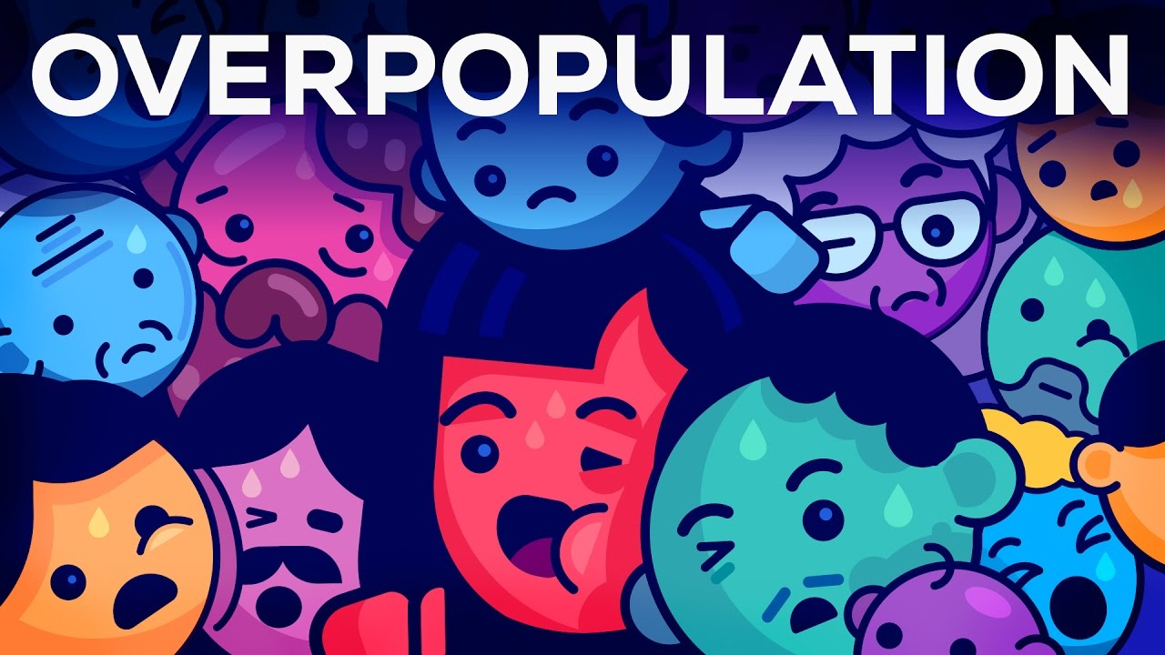

Slide 6
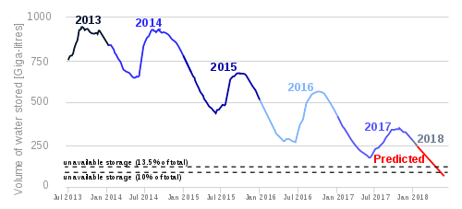
Median Water Storage/Volume of Dams

Slide 7
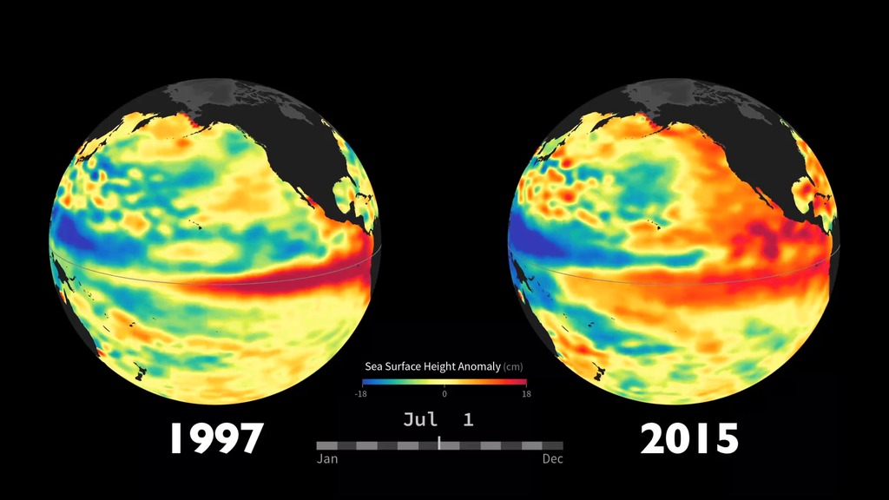
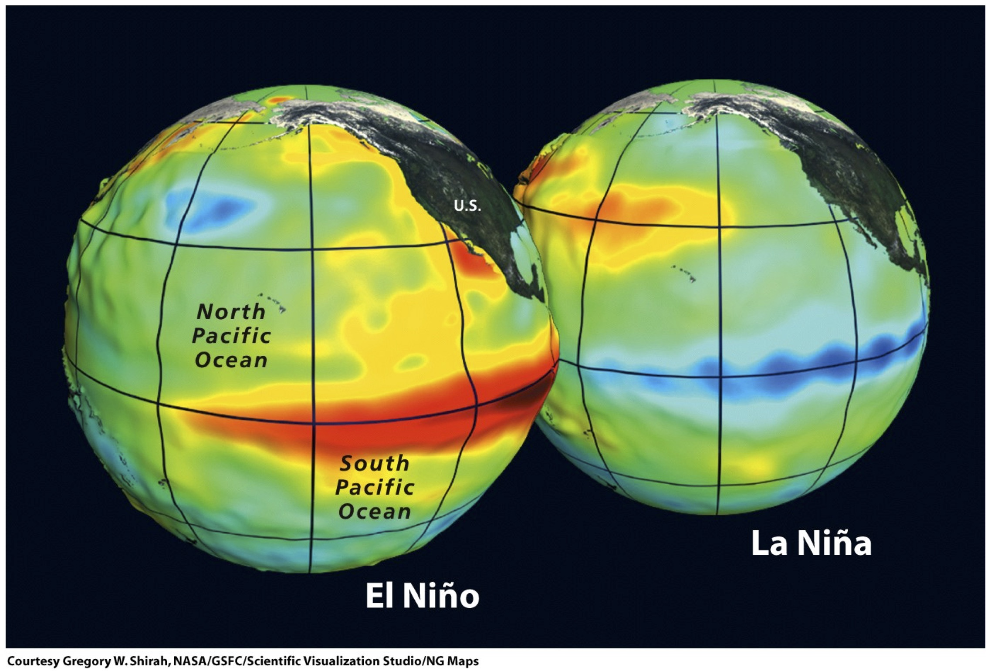
Effect of Climate Change on Drought (el Niño)

Slide 8
How Drought Affects Us Today

Slide 9
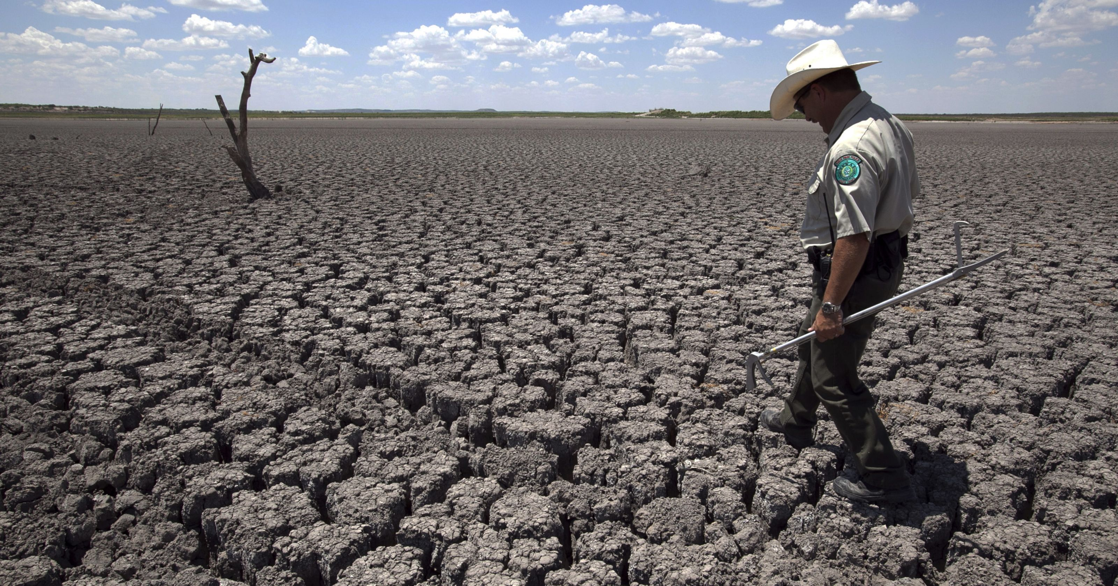

Slide 10
Examples of innovation in south Africa
Only through strife can a country truly be united.
Teamwork-
The combined actions of a group, especially when effective or efficient.

Slide 11
CONCLUSION

